Slide 1
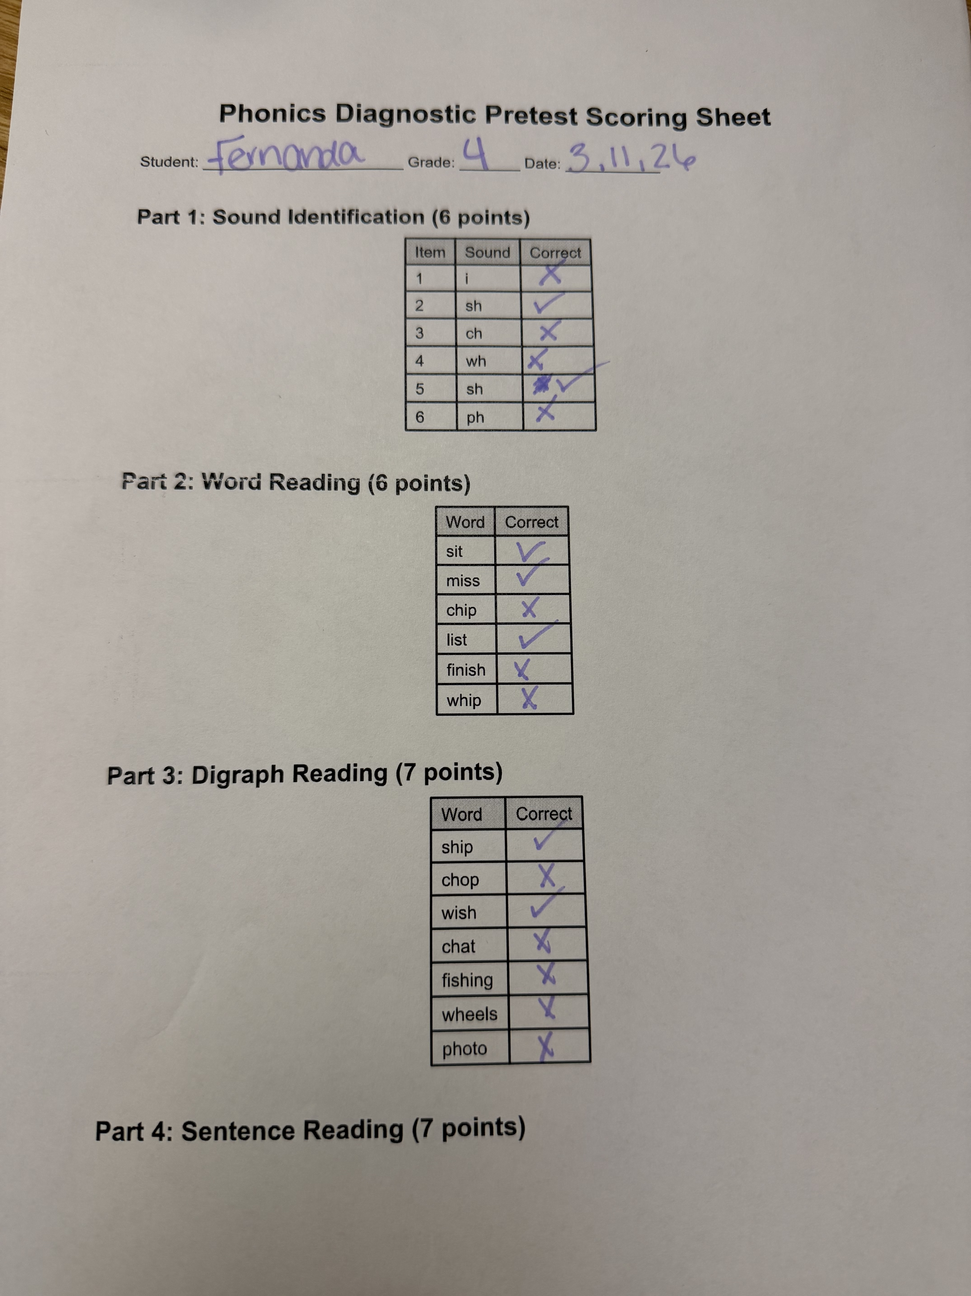
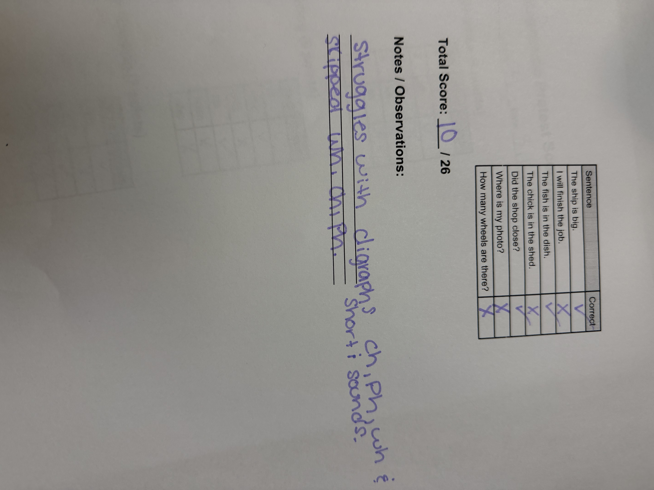
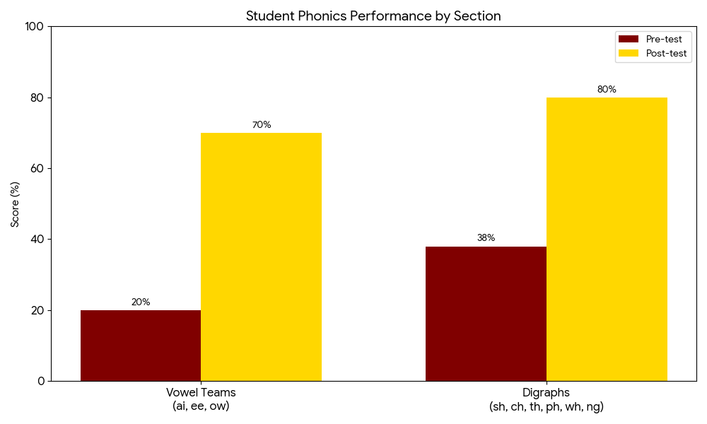
.
.
.
.
Targeted Phonics for 4th Grade ELL Success
Bailey Walters
Florida State University Panama City
College of Education
.
Phonics knowledge is essential for early reading development, helping students connect sounds to letters for decoding and spelling. It is especially important for English Language Learners (ELLs), who benefit from explicit instruction in English sound patterns. The purpose of this project is to evaluate how targeted phonics interventions improve reading outcomes for fourth grade ELL student using data driven instruction and progress monitoring. Targeted interventions address specific skill gaps, supporting decoding, pronunciation and overall reading success. This study takes place in a fourth- grade classroom of 21 students, including four ELLs and one student with a 504 plan, using differentiated instruction.nics knowledge is essential for early literacy, as it allows students to connect sounds to
Introduction
Pre Intervention
Post Intervention
To develop the intervention, initial data was first collected using the Core Phonics Survey to identify specific areas of need. The results showed significant gaps in vowel recognition and decoding skills, particularly with long and short vowels and multisyllabic words. Based on this data, vowel patterns and decoding were selected as the focus of instruction.
A phonics diagnostic pretest was then created to further assess the student’s ability to apply these skills in context. The pretest included sound identification, decoding of short vowel words, digraph reading, and sentence reading to measure accuracy and fluency . These components were chosen to align directly with the identified skill deficits and to provide a baseline for measuring growth.
The student demonstrated impressive growth, which significantly increase her phonics mastery on both targeted categories. In the Vowel Teams section (ai,ee,ow), she made a substantial leap from a 20% baseline to 70%, while her understanding of Digraphs (sh,ch,th,ph,wh,ng) jumped from 38% to a 80%. This progress shows she has transitioned from a foundational struggle to aa high level of proficiency.
.
Participant
The student is a fourth-grade female English Language Learner from Mexico whose native language is Spanish, selected due to gaps in foundational phonics skills impacting reading performance.
Initial data from the Core Phonics Survey showed strengths in letter recognition and blends/digraphs, but weaknesses in vowel skills, including long vowels (0/5), short vowels (3/5), and multisyllabic words (9/24). These results indicate a need for targeted instruction in vowel patterns and decoding.
Intervention
The intervention focused on explicit, systematic phonics instruction targeting vowel patterns identified as areas of need, including long vowel , vowel teams such as (ai,ee,oa), and vowel consonant-e patterns. Instruction was delivered in a one-on-one setting over a period of 10 weeks.
Each session began with a brief review of previously taught skills, including consonant digraphs (ch, sh, wh, ph, th, ck, ng) to support decoding accuracy. New vowel patterns were then introduced through direct instruction and teacher modeling. The student engaged in guided practice by reading word lists, identifying vowel teams and digraphs , and patterns.
The student then applied the taught skills in connected text using decodable passages aligned to the targeted instruction. Additional activities included circling the vowel team and digraphs in the word also, writing complete sentences using the vowel team or digraph. These activities helped strengthen both decoding and encoding.
Progress was monitored through informal assessments and observation, which allowed instruction to be adjusted based on the students needs.
Next Steps
The student’s significant growth demonstrates that targeted, explicit instruction has successfully moved her from a state of frustration to a functional instructional level. Moving forward, the most critical next steps involve solidifying look alike patterns through word sorts , introducing R-controlled vowels (ar,er,ir,or,ur) as her next step, and shifting to chunking multi-syllabic words. By doing this and repeated readings she will become more fluent over time.
.
Research Question
References
What is the effect of targeted phonics intervention in vowel patterns on decoding and reading performance for a fourth-grade English Language Learner?
August, D., & Shanahan, T. (2006). Developing literacy in second-language learners: Report of the National Literacy Panel on Language-Minority Children and Youth.
National Reading Panel. (2000). *Teaching children to read: An evidence-based assessment of the scientific research literature on reading its implications for reading instruction*. National Institute of Child Health and Human Development.

