Slide 1
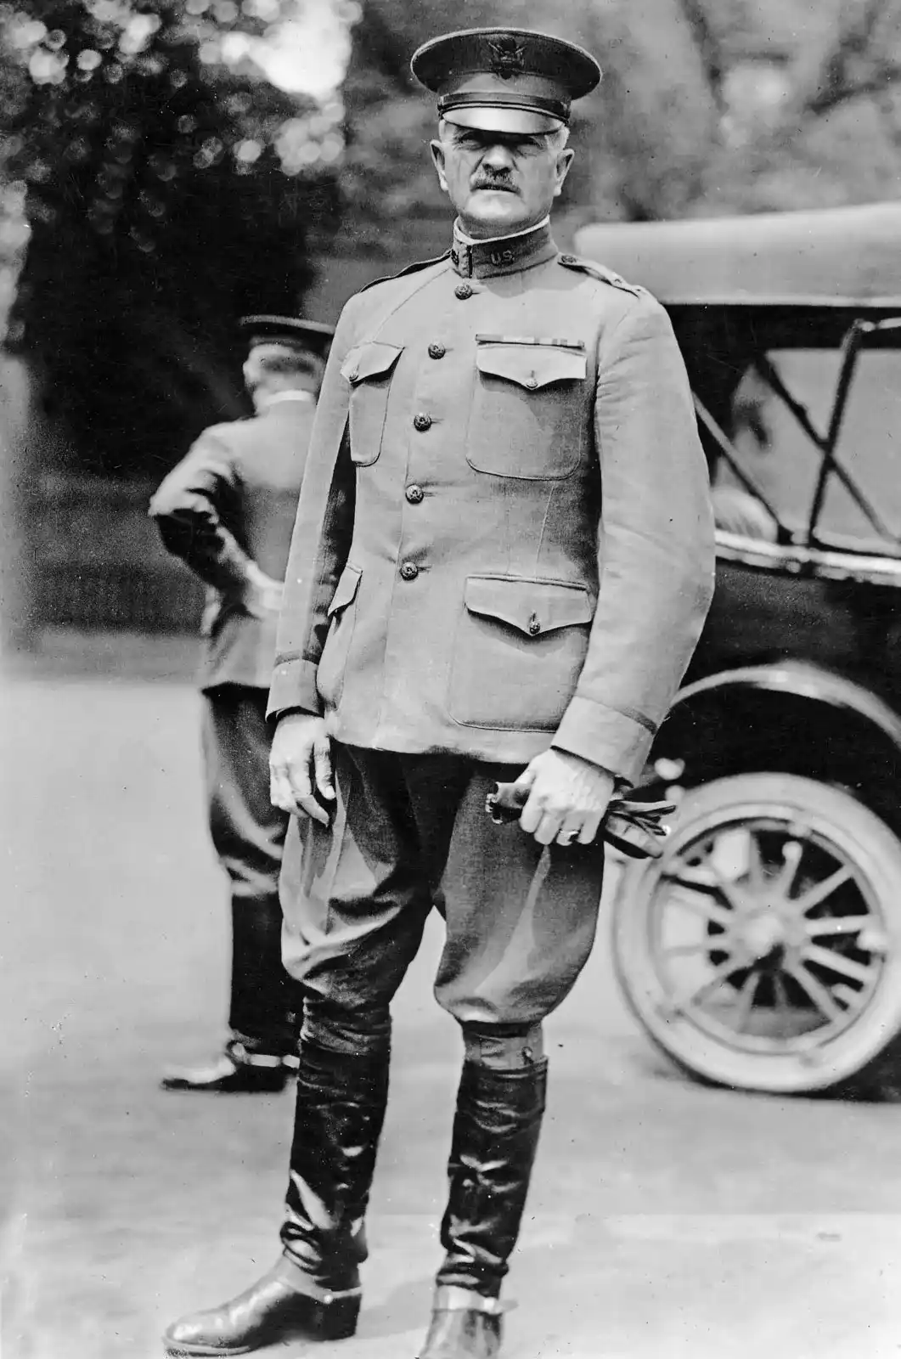
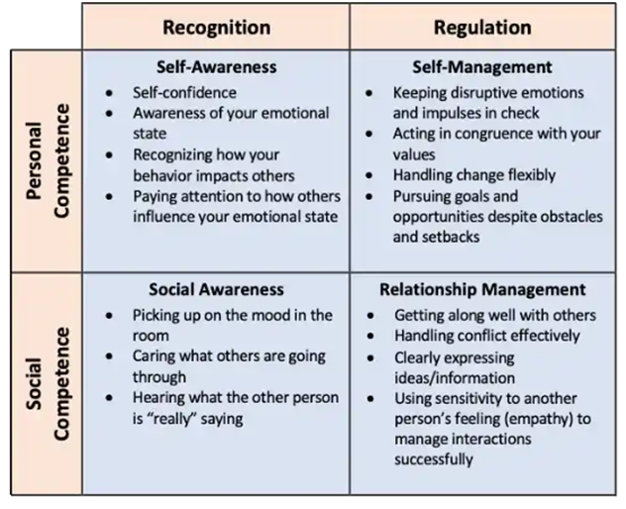
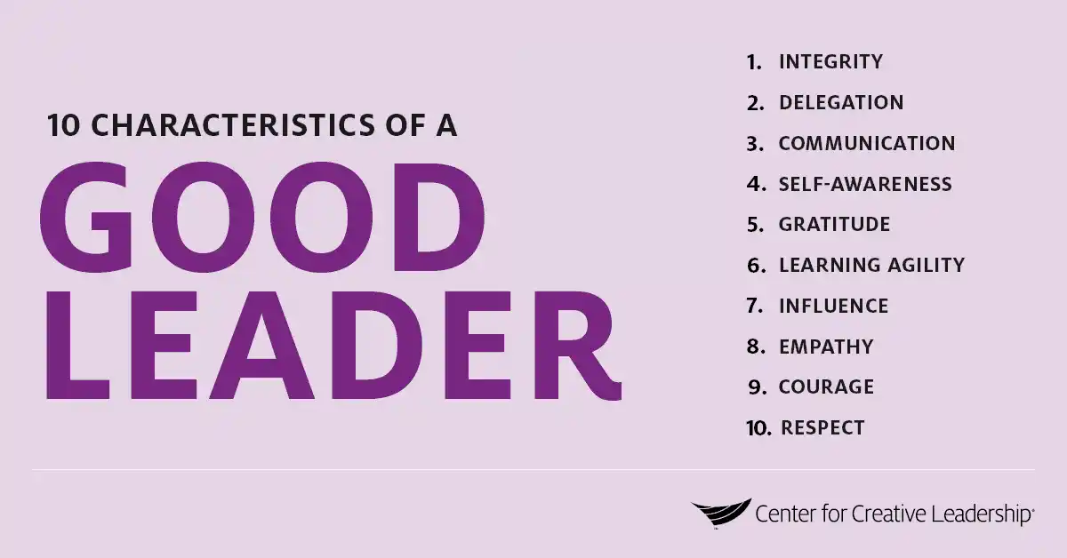
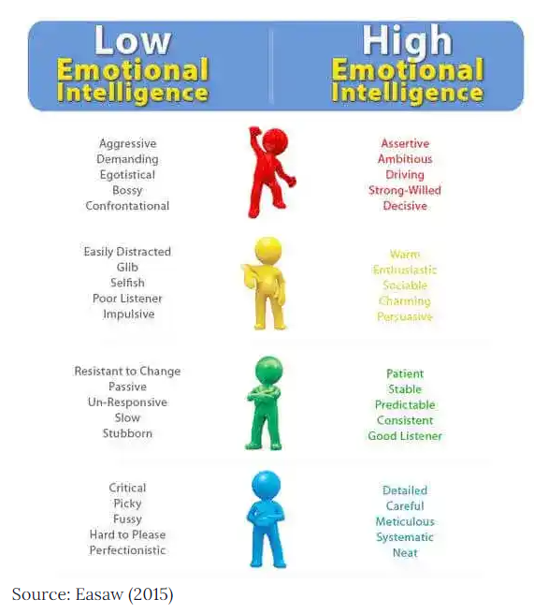

“Black Jack” – General of the Armies John J. Pershing
Kevin Wisniewski
Florida State University - Panama City
Leadership Traits & Behaviors
“Pershing's self-discipline, his sensitive humanity, honesty, his example of rising to every challenge, are hallmarks of a superb leader and are as inspiring in this time as in his own.”
(Vandiver, 1963)
“Without question, the honor which most deeply touches the General is the confidence and affection of the men he commands. This is more and deeper than mere popularity.”
“But the deep regard, the confidence and pride which the American forces universally manifest for their leader are based primarily, not upon their impulses or impressions, but upon their belief in the qualities he has quietly manifested, the record he has made, and the power of his own personality.”
(Tomlinson, Apr 7, 2010).
Emotional Intelligence
General Pershing was a prolific leader who was highly adaptable to any situation, and able to influence subordinates, superiors, and our Allies alike. Known as a strict disciplinarian, General Pershing tackled every assignment with enthusiasm, however he did not allow his position or notoriety to influence his decisions or compromise his integrity. It is said that the United States’ position as a world power was a direct result of General Pershing’s actions during World War I.
"Your country is proud of you, and I am more than proud to command such men as you. You have fought splendidly.“
“A direct report states that "faces are brighter, eyes have a new expression whenever, which is as often as the crush of his duties permits—he visits a hospital.“” (Tomlinson, Apr 7, 2010)
"General Pershing is one of the finest men I ever met. Everybody in the army admires him greatly," declares a prominent American officer, and another adds, "I have never met a nobler man in my life than General Pershing."”
(Tomlinson, Apr 7, 2010).
Despite criticism by some, over his strict discipline and demand for high standards, General Pershing embodied numerous leadership traits and behaviors that many of his subordinates emulated and instilled in the following generations of military officers. General Pershing transformed the Army into a modern force and most of World War II’s greatest Generals, such as Patton, Marshall, and MacArthur were all influenced by General John Pershing’s leadership and continued his legacy.
“Embodied in General Pershing's character were all those soldierly qualities that are essential to a great captain: brilliant leadership, steadfast courage, tireless energy, unswerving loyalty, and constant devotion to duty. He had a genius for organization, as everyone who served under him will bear witness. In World War I, he led the greatest army this country had, up to that time, been called upon to assemble.”
-- Harry Truman, July 15, 1948
As his career progressed, General Pershing developed a very high emotional intelligence. He was driven, detail oriented, kept meticulous notes and journals, organized, decisive, and highly self-aware. He knew that to defeat his enemies, he must understand them. Therefore, during the Moro uprising in the Philippines, Pershing learned the local language and studied the Koran. He was so well respected by the Moro chiefs that they honored him by making him a member of the tribe and a Datto (chief). Pershing knew the value of good morale among the troops and that genuine care and concern would do much to boost it. Whenever he could he visited wounded soldiers, sent personal notes for heroic efforts, and was known to listen to subordinates who had innovative ideas or just routine complaints.
“An intimate friend of his boyhood writes: "John was and still is intensely human and that is why we all love him. His old playmates and friends are proud of his success as a soldier, but they love him because of his high standard of principles and unswerving integrity.” (Tomlinson, Apr 7, 2010).
“America's prominent position in world affairs today is largely the result of Pershing's activities in Europe. If he had less firmly insisted on an independent American Army, and American soldiers were divided among English and French forces, the power of the American government at the peace conference would have been negligible and the American nation would not likely be the world power it is today.” (Patterson, 2023)
“I think he was a great man- great, if character, if devotion, if self-discipline and self-development are elements of greatness. Stonewall Jackson's personal motto was "You may be whatever you resolve to be," and it might have been Pershing's. He rose to every responsibility because he had the capacity to learn from experience and to practice what he learned. There seems no limit to his ability to grow- suffice it to say that he grew beyond the demands of colonialism to shape an army of democracy.” (Vandiver, 1963)
General Pershing was a prolific leader who was highly adaptable to any situation, and able to influence subordinates, superiors, and our Allies alike. He undoubtably achieved his potential, made significant impacts on the Army and United States foreign policy, which far outlived him, through new and innovative ways of thinking that were shaped and molded by his experiences throughout his storied career.
General Pershing served selflessly, with integrity, and constantly sought knowledge to grow and succeed. He studied people, kept meticulous journals and notes and was able to learn from his interactions and experiences to evolve his leadership style. He learned that the key to success was interdependence and relied heavily on his staff and commanders during World War I, to be triumphant.
Abstract
“The difference between an acceptable leader and an exceptional leader often lies with emotional intelligence. Emotionally intelligent leaders are self-aware, excellent communicators and can adapt their behaviour to suit a variety of situations.” (Thomas, Dec 1, 2022).
References
Ethical Climate
Daft, R. (2011). The Leadership Experience, Sixth Edition.
‘
(Daft, 2018). Courage comes in many forms - moral courage or the willingness to do the right thing and follow your own codes of ethics; the courage to take risks when necessary to accomplish the goal or to do the right thing; the courage to take responsibility or stand behind your decisions and actions; the courage to push beyond our comfort zone in order to learn new skills in order to achieve the mission; the courage to oppose unethical conduct which could compromise your integrity or the integrity of the organization; the courage to fight for your beliefs; and the courage to speak out when required.
Throughout his life, General Pershing demonstrated the various tenants of courage as stated above. During the Moro Uprising, General Pershing studied the Koran and learned local dialects to learn as much as he could about his enemy, displaying the courage to push beyond his comfort zone. During World War I as the commander of the AEF, General Pershing refused to relinquish United States units to Allied commanders, as he believed that Americans fighting as whole units would be more demoralizing to the Germans, thus displaying the courage to fight for his beliefs and his soldiers, to the chagrin of the Allied commanders.
(Daft, 2018). Ethical leaders are selfless, self-aware, and set an ethical tone. General Pershing set an ethical climate and his behaviors contributed to that climate. He possessed each of the traits listed below:
  • Concern for the greater good
  • Honesty
  • Committed
  • Responsibility
Courage
Leader Blind Spots
Travis, N. (2018). The Challenge Culture. PublicAffairs (Hachette Book Group).
Daft, R. L. (2018). The Leadership Experience. (7th ed.). Cengage Learning.
Henry, T. (2020). The Motivation Code. Pruvio Press.
Vandiver, F. (1963). John J. Pershing and the Anatomy of Leadership. USAFA Harmon Memorial Lecture #5. https://www.usafa.edu/app/uploads/Harmon05.pdf
Encyclopedia Britannica. (Jan 22, 2023). Pershing, John J. Retrieved from https://www.britannica.com/biography/John-J-Pershing#/media/1/452723/140248
Center for Creative Leadership. (Mar 4, 2023). The 10 Characteristics of a Good Leader. Retrieved from https://www.ccl.org/articles/leading-effectively-articles/characteristics-good-leader/
Riopel, L. (Mar 12, 2019). Emotional Intelligence Frameworks, Charts, Diagrams & Graphs. Positivepsychology.com. Retrieved from https://positivepsychology.com/emotional-intelligence-frameworks/
Tomlinson, E. (Apr 7, 2010). THE STORY OF GENERAL PERSHING. Gutenberg.org. https://www.gutenberg.org/files/31914/31914-h/31914-h.htm
The Editors of Encyclopedia Britannica. (Nov 23, 2022). John. J. Pershing. Britannica.com. https://www.britannica.com/biography/John-J-Pershing
The New York Times. (Jul 16, 1948). Leadership, Personal Courage, Devotion to Troops Won for Pershing Affection of Nation. NYTimes.com. https://archive.nytimes.com/www.nytimes.com/learning/general/onthisday/bday/0913.html
.
“Courage is the mental and moral strength to engage in, persevere through, and withstand danger, difficulty, or fear.” (Daft, 2018, p. 181).
‘
The nick-name “Black Jack”.
(Daft, 2018). The two most common leader blind spots are “being a jerk” and “being too nice”. A “jerk” bullies, belittles, is confrontational, and aggressively attempts to exert control over others.
As a cadet at West Point, Pershing was known for ruthlessly hazing underclassman. Later as a Tactical Officer assigned to the USMA, Captain Pershing earned his nickname “Black Jack”. Not necessarily because of a prior assignment with the 10th Cavalry, commanding an all-negro unit, but more for the harsh discipline and high standards he set for the Corps of Cadets. During World War I the nick-name became one of endearment by his soldiers.
• Respectfulness
• Encourages and develops others
• Service oriented
• Courage
Throughout his career General Pershing displayed the hallmarks of a truly ethical leader. From his time as a teacher prior to attending the United States Military Academy, through his cadet years, his time in the Philippines, as commander of the AEF, and later as Chief of Staff of the Army, Pershing selflessly served his country, motivated and encouraged his troops, and expected nothing less than he was willing to give from them. During World War I, General Pershing was given the almost inconceivable task of building a battle-ready army from scratch. He knew success depended on molding an inexperienced band of citizen soldiers into the finest fighting force the world had ever seen. To do so required strength of character and moral courage. He lived his life by the cadet motto of “Duty”, “Honor”, Country” and expected the soldiers in the AEF to model these behaviors to instill discipline, a sense of self worth in the individual, and to motivate each soldier to achieve their own success.

