Slide 1
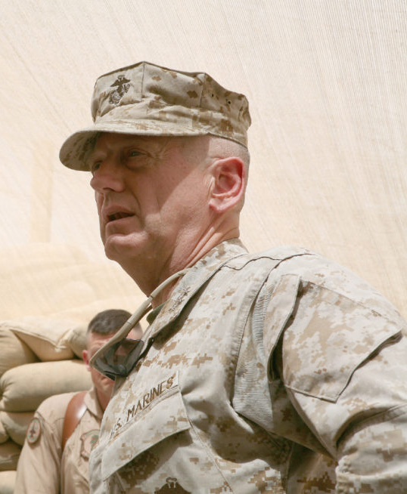
Gen. James “CHAOS” Mattis, USMC (Ret.)
Daniel Gage Vind Florida State University Panama City
Leadership
The most important six inches on the battlefield is between your ears. Engage your brain before your trigger finger.
Decision Making
General Mattis’ leadership style does not follow what may be considered the traditional ‘Command & Control’ approach utilized by numerous military leaders throughout history. During Capstone training at the Pentagon, the “greybeard generals” who had served in Vietnam reminded Mattis’ cadre of newly selected general officers that “once you made general, you never had a bad meal and you never again heard the truth.” This exemplifies one significant shortcoming with C2-style leadership; a breakdown in communication, whether an outright deprivation of information due to fear of reprisal or the application of a euphemistic lens to the circumstances, hinders a leader’s ability to make effective decisions. This led Mattis to adopt a methodology which relies upon a strong foundation of trust – ‘Command & Feedback’. A high degree of trust is integral to successfully employing a Command & Feedback leadership approach because it fosters a healthy culture of challenge, and in turn
- General Mattis
Anyone familiar with General Mattis will have heard him referred to by the moniker “Mad Dog.” This irreverent title was conferred to Mattis by a news organization as a result of his unapologetic warrior ethos, not by his troops following the second battle of Fallujah in the Iraq War as is commonly believed. In fact, those who fought alongside Mattis had another callsign for him – CHAOS. Colonel Has Another Outstanding Solution.
The “warrior monk” perception of General Mattis is well earned, having over 6,000 books under his belt. However, his extensive study of military history and its interrelated disciplines is not the root of his outstanding solutions. Nor can his success be attributed solely to improvements in modern data collection and intel gathering. Rather, it is a result of his purpose driven leadership. In the same way that Einstein posited “as our circle of knowledge expands, so too does the circumference of darkness surrounding it,” Mattis grew to accept that his perspective alone would invariably have blind spots. The best way to combat this would be to empower his fellow marines to respectfully challenge shortcomings.
One astonishing example of this in action took place during the preparations for combined US Army, Navy, Marine, and UK Army forces to push towards Baghdad in 2003. Mattis and his chief of staff were discussing the complexity of the operation, the number of disparate participants, the constraining terrain, and how they would be able to build an operational briefing that could be digested and executed by the combat leaders and their 60,000 troops. Without missing a beat, 25-year-old First Lieutenant Warren Cook interrupted then-Major General Mattis with a solution. Don’t build out a 2D map covered in arrows, build the mother of all sand tables outside of camp. And so, using paint and physical markers, the 1st Marine Division built an operational map larger than a football field in the desert. The combat leaders then physically walked through their movement plans and the order of battle relative to every other participant, both friend and enemy. “Young Warren Cook had come up with the most ingenious idea [Mattis] had heard in thirty years of war-gaming.”
honest feedback. As part of this leadership model, Mattis employs John Boyd’s OODA Loop – Observe, Orient, Decide, Act – which provides a structured approach to addressing abstract problems. For Mattis, the OODA Loop process is informed by his orders, the situation on the ground, and feedback from his personnel. Once he is ready to Act, Mattis’ intent is flowed down to the operational community. For Mattis’ subordinates, his intent is effectively filtered through the pertinent operational considerations – ROEs, logistics, psychological operations, etc. – during their OODA Loops. Following execution of the operation, feedback is then flowed back up to Mattis as a means of improving the next iteration.
L E A D E R S H I P
OODA Loop
C O M M A N D
Commander’s Intent
F E E D B A C K
Rules of Engagement
Logistics
Conclusion
Psy-Ops
General Mattis lead his marines with unwavering honesty & integrity, and he expected the same in return. The high-pressure decision making required of a commander must be informed not only by the data and intel available, but also the ingenuity of their subordinates. To foster a culture in which creative problem solving is a team activity requires trust, and building trust is the duty of a true leader.
OODA Loop
O P E R A T I O N S

