Slide 1
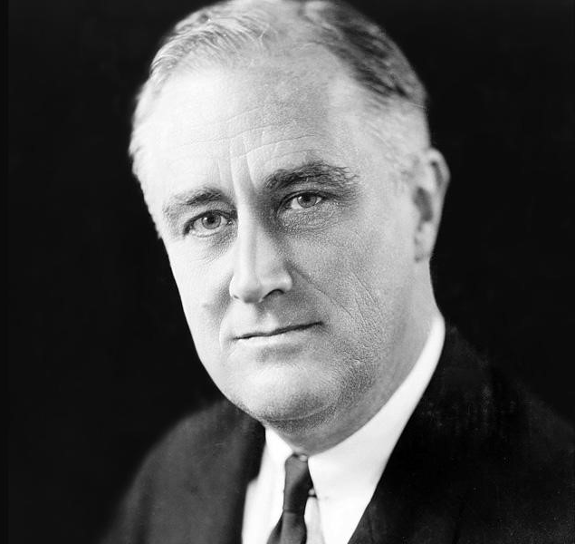
The Mastermind: Exploring FDR’s Leadership Legacy
Christopher A. Taylor
Florida State University Panama City
Abstract
The New Deal:
Established the Civilian Conservation Corps (CCC)
Established Social Security
Established the Public Works Administration (PWA)
Established the Fair Labor Standards Act
World War II:
United people for a common goal
Mobilized nation’s industry
Established the War Production Board
Bolstered ally relations
Strategic planning, including D-Day and the atomic bomb
Contributions
Franklin Delano Roosevelt, also known as FDR, was the 32nd president of the United States of America. He served as president from 1933 until his death in 1945. FDR was the first, and only, president to serve more than two terms. The election in 1936 resulted in FDR winning 60.8 percent of the popular vote and only two states not going his way. This victory is the largest in US election history. His reelection for a third consecutive term came at a time of world turmoil as World War II had begun. FDR went on to win his 4th presidential election in 1944 receiving 53.5 percent of the popular vote and 37 states. FDR’s leadership through the Great Depression and World War II kept the nation as stable as could be expected, allowed him to be continuously reelected, and cemented his position as one of the greatest leaders in history. This paper delves into the characteristics, traits, and other factors that led to FDR’s success as a leader.
References
Achives.gov. (2022, February 8). President Franklin Roosevelt's Annual message (Four freedoms) to Congress (1941). National Archives and Records Administration. Retrieved February 19, 2023, from https://www.archives.gov/milestone-documents/president-franklin-roosevelts-annual-message-to-congress#:~:text=His%20"four%20essential%20human%20freedoms,want%2C%20and%20freedom%20from%20fear.
Bass, B. M. (1990). Bass and Stogdill's Handbook of Leadership: Theory, research, and Managerial Applications. The Free Press.
Burns, J. M. (1978). Leadership. Harper and Row.
Daft, R. L. (2018). Leadership experience. Cengage learning.
Dallek, R. (1979). Franklin D. Roosevelt and the American foreign policy 1932 - 1945. Oxford Univ. Pr.
Goodwin, D. K. (1995). No ordinary time: Franklin and Eleanor Roosevelt: The Home Front in World War Ii. Simon & Schuster.
Henry, T., Penner, R., & Hall, T. W. (2020). The Motivation Code: Discover the Hidden Forces That Drive Your Best Work. Portfolio.
Leuchtenburg, W. E. (2015). The American president from Teddy Roosevelt to Bill Clinton. Oxford University Press
.
McCracken, S. (2008). Review: "FDR". Columbia Magazine. Retrieved January 22, 2023, from https://magazine.columbia.edu/article/review-fdr
McCullough, D. G. (1992). Truman / m. Simon & Schuster.
Renshaw, P. (2014). Franklin D. Roosevelt. Routledge.
Vision
“The Four Freedoms”
Empathy
The New Deal
Autocratic
4,300 Executive Orders
Democratic
“Fireside Chats”
Resilience
Polio
The Great Depression
WWII
“The only thing we have to fear, is fear itself”
FDR’s vision, Empathy, and Resilience allowed him to lead the nation through some of the worst times in history while dealing with several medical disorders including Polio and heart disease
FDR was able to combine Autocratic and Democratic leadership styles
FDR united the nation, developing unprecedented war efforts with the War Production Board as well as establishing the Fair Labor Standards Act
Traits and Behaviors
Conclusions

