Slide 1
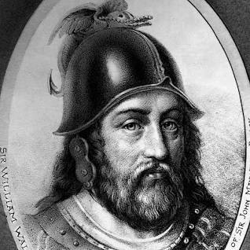
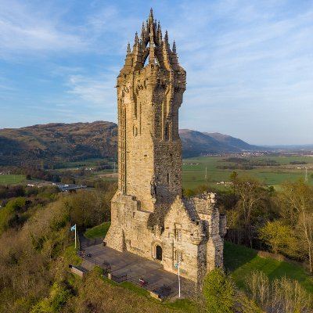
William Wallace: A Scottish Hero
John Sebelle
Florida State University Panama City
Abstract
“There's a difference between us. You think the people of this country exist to provide you with position. I think your position exists to provide those people with freedom. And I go to make sure that they have it.”
- Sir William Wallace
William Wallace’s Motivation Code
Sir William Wallace was a Scottish knight who is one of Scotland’s greatest national heroes. William Wallace was born in 1270 near Paisley, Renfrew, Scotland, and he died in 1305 in London, England (Wallace, W.). During his youth, he became known as an outlaw to the English after he allegedly killed some Englishmen who insulted him and questioned him over the poaching of some fish (UndiscoveredScotland). It was shortly after this that the legend of William Wallace, a Scottish hero and freedom fighter, came to fruition. Wallace led many raids and battles and his passion for freedom was fueled by vengeance after the English murdered his family and wife. After Wallace’s efforts in notable battles, Wallace returned his Army home to Scotland where he was knighted and proclaimed the guardian of the kingdom (Britannica). In 1305, Wallace was captured by the English in Scotland after one of Wallace’s friends betrayed him (UndiscoveredScotland). He went to trial in Westminster Hall, where he was sentenced to death and labeled a traitor to the king. After a brutal torture and murder, his head was sent on a spike on London Bridge and his limbs put on display in Newcastle, Berwick, Stirling, and Perth. Although Wallace never saw the day that the Scots gained their independence from the English, his leadership and efforts continued to rally the Scots. They eventually won their independence from England 23 years after Wallace’s death with the Treat of Edinburgh in 1328 (Wallace, W.). During Wallace’s life he portrayed many leadership qualities, and many of the lessons learned will be applied to the author’s personal career as a Systems Engineer.
The Visionary Family
Motivated to make an impact according to what is possible or ideal
Able to spot the potential
Future focused, sometimes at the expense of the present
The Achiever Family
Driven to persevere through challenges
Motivated to overcome obstacles and oppose an enemy
Engaged when making progress
The Team Player Family
Derives energy from working with others toward a goal
Wants to be a part of something bigger than themselves
The Learner Family
Driven to teach others what they’ve learned and share new skills
Able to bring new ideas and energy to projects
The Optimizer Family
Needs to lay firm foundations for future work
Wants systems and teams to be organized
Focused on getting it right from the beginning rather than fixing it later
Leadership Characteristics
Conclusion
Through William Wallace’s leadership and ability to enlist cooperation from his countrymen, Scotland eventually was able to win its freedom from England. To this day, Wallace’s mark on history is still well remembered. The William Wallace Monument in Stirling, Scotland stands tribute to his passion and leadership. Stirling’s famous landmark stands above the fields where William Wallace led his troops to victory at The Battle of Stirling Bridge and tells the story of the patriot and martyr who became Scotland’s National Hero.
Wallace, W. (2017, April 28). William Wallace. Biography. https://www.biography.com/military-figure/william-wallace
The Editors of Encyclopedia Britannica. (2018). Sir William Wallace | Biography & Facts. In Encyclopædia Britannica. https://www.britannica.com/biography/William-Wallace
William Wallace: Biography on Undiscovered Scotland. (n.d.). Www.undiscoveredscotland.co.uk. https://www.undiscoveredscotland.co.uk/usbiography/w/williamwallace.html
Daft, R.L. (2015). The Leadership Experience, 7th Edition. Stamford: Cengage Learning. ISBN 978-1337102278
Leadership Analysis of William Wallace: GradesFixer. Retrieved from https://gradesfixer.com/free-essay-examples/an-essay-on-leadership-analysis-on-william-wallace/
Revelations - Sir William Wallace - The Initial Journey. (n.d.). Retrieved from http://www.theinitialjourney.com/features/sir-william-wallace/
National Wallace Monument Feature Page on Undiscovered Scotland. (n.d.). Www.undiscoveredscotland.co.uk. https://www.undiscoveredscotland.co.uk/stirling/wallace/index.html
References
Passion
Humility
Intelligence, Cognitive Ability
Judgment, Decisiveness
Optimism
Dependability
Honesty and Integrity
Desire to Lead
Independence
Cooperativeness
Ability to Enlist Cooperation
Perseverance, Tenacity

