Slide 1
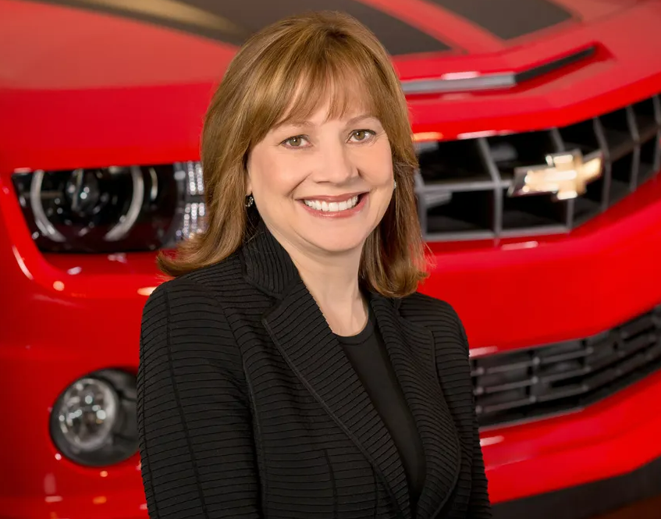
Lead Through Crisis – Mary Barra
Lon Schell
Florida State University Panama City
Mary Barra started her tenure at GM under fire. Navigating a very difficult situation with one of the largest and most costly recalls in company history. She was able to navigate this turbulent time with honest, open, truthful, and pointed response. Her leadership after that point was a pivot of General Motors from a traditional vehicle manufacture to a more agile software integrated company. Mrs. Barra has demonstrated outstanding leadership behaviors to continue to advance new technologies. These behaviors include integrity, “winning without integrity isn’t really winning”(Tamaguela, et. al., 2022) Barra also promotes a very open and honest dialogue that helps build relationship and promote a challenge culture within the company. One of her great leadership accomplishments was the re-organization of the company to eliminate silo and swim lane mentality. The culture she has built and lead at GM has driven great successes. This is captured in the overall business success GM has had with record earning. GM is a place that people now seek to be a part of. Her self-awareness, intelligence, and confidence is evident in how she carries herself and leads by example. The automotive space today is extremely challenging, with a shift away from traditional transportation and technology advancement. The company with dynamic leadership will be leading these advancements and Mrs. Barra has all the qualities of a great leader.
Abstract
Discussion
Mary Barra became the CEO of General Motors in January of 2014. She was the first woman CEO of any major automotive original equipment manufacturer (OEM). She was thrust into the spotlight early in her career managing crisis and was able to pivot the 110-year-old General Motors into a new era of innovation. The research into Mrs. Barra’s leadership as CEO will analyze her behaviors, traits, motivations, and compare them to known leadership theory. The outcome of the project is to better understand how one of the most power women in the world came to be and how her leadership style has elevated General Motors to a position of transforming mobility as we know it.
Key Achievements
First woman to lead one of the “Big Three” or any major automotive manufacturer
Crisis Manager of the year 2014
Fortune’s most powerful woman 2015
2nd most powerful woman Forbes 2018
Achieving GM as the world’s top business for gender equality, equity, and inclusion.
Creator of the General Motors Diversity, Equality, and Inclusion board
Time Magazine “agent of Change”
Make an Impact
Make it Work
Overcome
Leadership Motivations
Serve
Comprehend and Express
Conclusions
Democratic leadership with an embrace in challenge culture has made Mary Barra’s leadership successful.
The ethical climate, cultural environment, and inclusionary atmosphere she has created has furthered GM’s long-term goals.
Barra has a deep understanding of emotional intelligence and leads by thinking of people.
The velocity of change in the current automotive space will challenge her leadership in the coming years.
References
Leadership Behaviors
Daft, R. L. (2017). The Leadership Experience (7th ed.). Cengage Learning
Henry, T., Penner, R., Hall, T. W., & Miller, J. (2022). Motivation code. PRUVIO.
LaReau, J. L. (2023, January 26). GM CEO Mary Barra's rare, behind-the-scenes interview: Who she relies on in 'lonely job'. Yahoo! Retrieved January 31, 2023, from https://www.yahoo.com/now/gm-ceo-mary-barras-rare-033811463.html
Tamaguela, J., YouTube. (2022). Leadership Dialogues Speaker Series. YouTube. YouTube. Retrieved January 23, 2023, from https://www.youtube.com/watch?v=Zbe-jhyQviE.
.
Self Awareness
Confidence
Accountability
Intelligence
Honesty
Integrity
Dependability
Decisiveness
Loyalty

