Slide 1
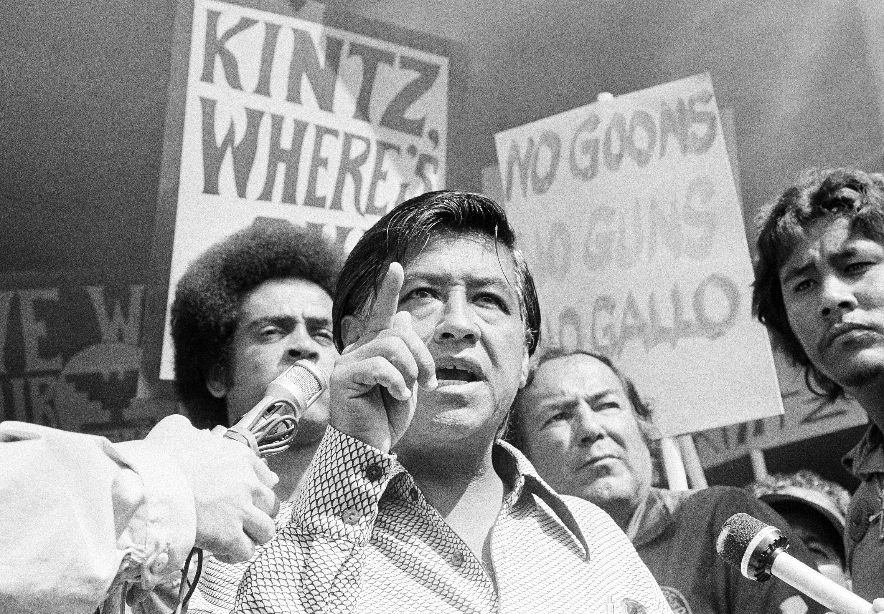
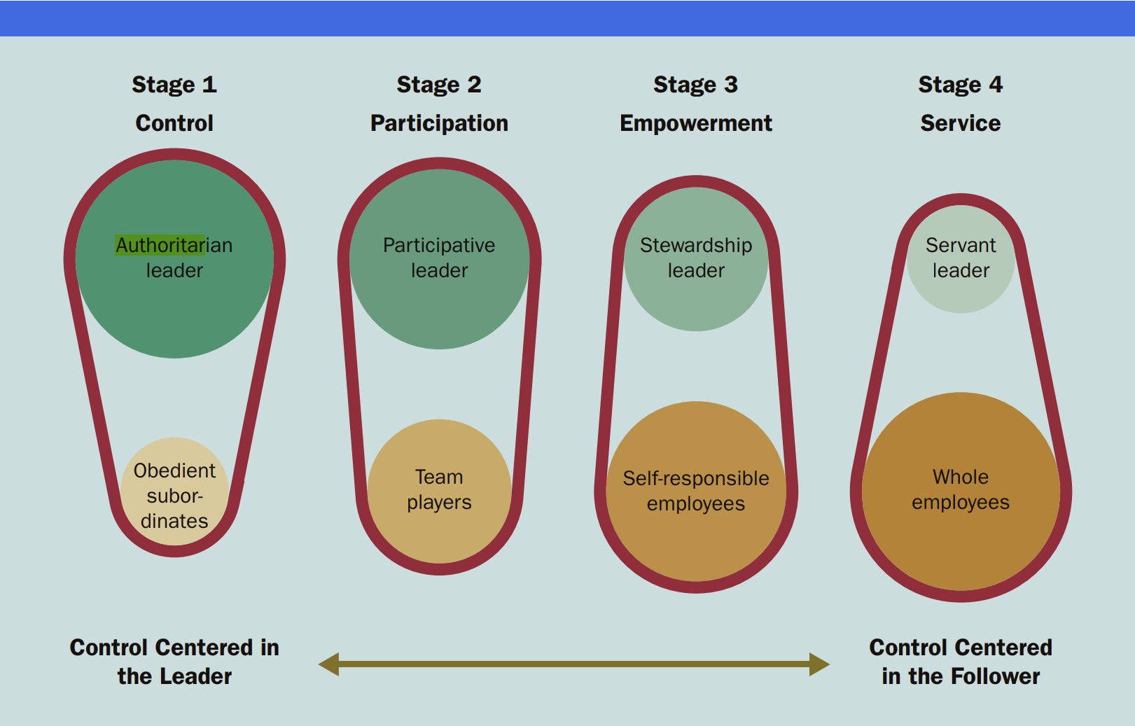
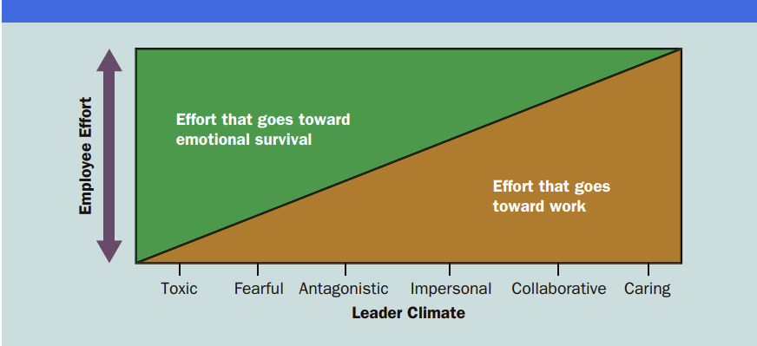
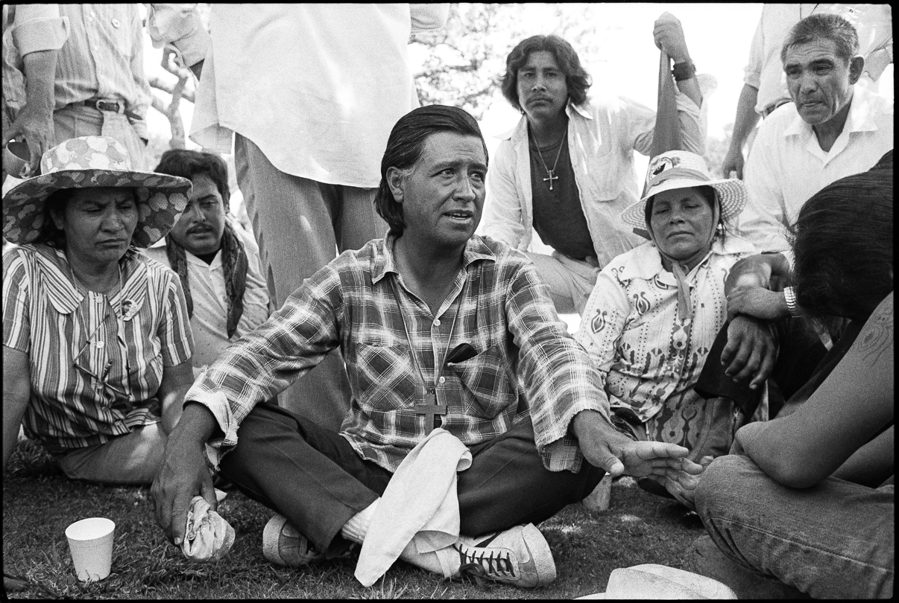
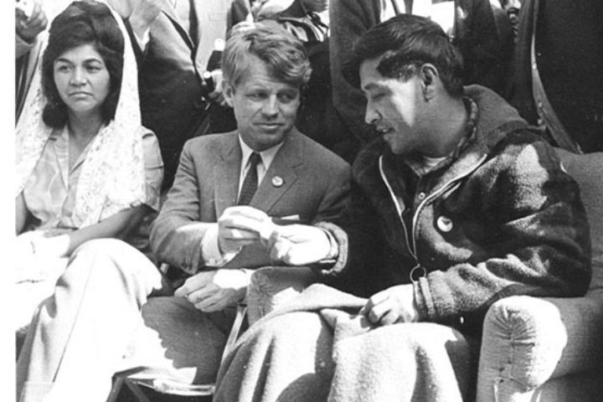
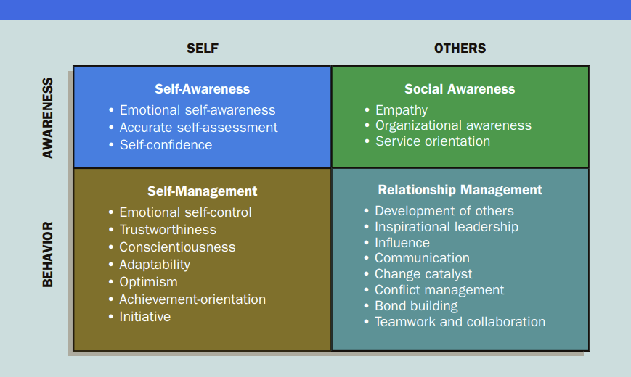
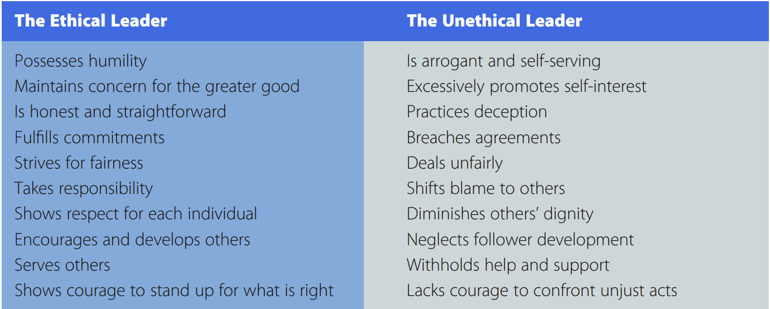
Leadership Analysis of Cesar Chavez
Bryant Rodriguez
FAMU-FSU College of Engineering
Abstract
Cesar Chavez made great strides in improving the quality of work and life for farmworkers and fought for a sympathetic and seemingly noble cause that focused on righting wrongs in the world.
Leadership style was more controversial; was said to employ manipulative tactics to undermine those who worked under him.
Extremely authoritarian; took inspiration from popular figures; purges
Rarely fired anybody; generated toxic environments for them
Great vision led to Chavez personality cult
Authoritarian leadership suited to task-oriented goals
Leadership
This research aims to analyze the leadership of labor leader and civil rights activist Cesar Chavez, most widely known for co-founding the United Farm Workers union and campaigning for improved conditions for farm workers in the United States. The research will scrutinize the key traits and behaviors Chavez exhibited that contributed to his success as a leader. By examining the tactics Chavez employed to successfully achieve his goals, which included mobilizing a large coalition of supporters to achieve lasting change, as well as how they parallel popular theories of leadership, the project will provide insights into the overall dynamics of effective leadership and its correlation with achieving social and political goals.
Community organizer and labor activist that founded United Farm Workers labor union in 1966
Organized Delano Grape Strike as well as multitudes of other strikes
Helped lobby for passage of California Agricultural Labor Relations Act of 1975
Characteristics
Overview
Devoted to non-violence
Charismatic
Ideologically servant-oriented
Interpersonal relationships
Moderate Emotional Intelligence
Autocratic
Set ethical climate
Conclusions
Chavez was a charismatic and sympathetic leader who rallied many to his cause
Chavez’s authoritarian and paranoid leadership ultimately pushed other leaders away
References
Daft, R. L. (2018). The Leadership Experience, 7th Ed. Boston: Cengage Learning Inc.
Levy, J. E. (1975). Cesar Chavez: Autobiography of La Causa. Norton.
Pawel, M. (2014). The Crusades of Cesar Chavez: A Biography. Bloomsbury Press. New York.
Cesar Chavez Foundation. (n.d.). [Cesar Chavez portrait]. Retrieved from https://chavezfoundation.org/about-cesar-chavez/
NPR. (2016). [Cesar Chavez protest image]. Retrieved from https://media.npr.org/assets/img/2016/08/02/cesar-chavez-protest-04_custom-5b5a5be5af5c33aee46bb62de8c9c313d43ed9c6-s800-c85.jpg
California Humanities. (n.d.). [Cesar Chavez with a group of farmworkers]. Retrieved from https://calhum.org/four-projects-highlight-cesar-chavez-and-todays-farmworker-struggles/

