Slide 1
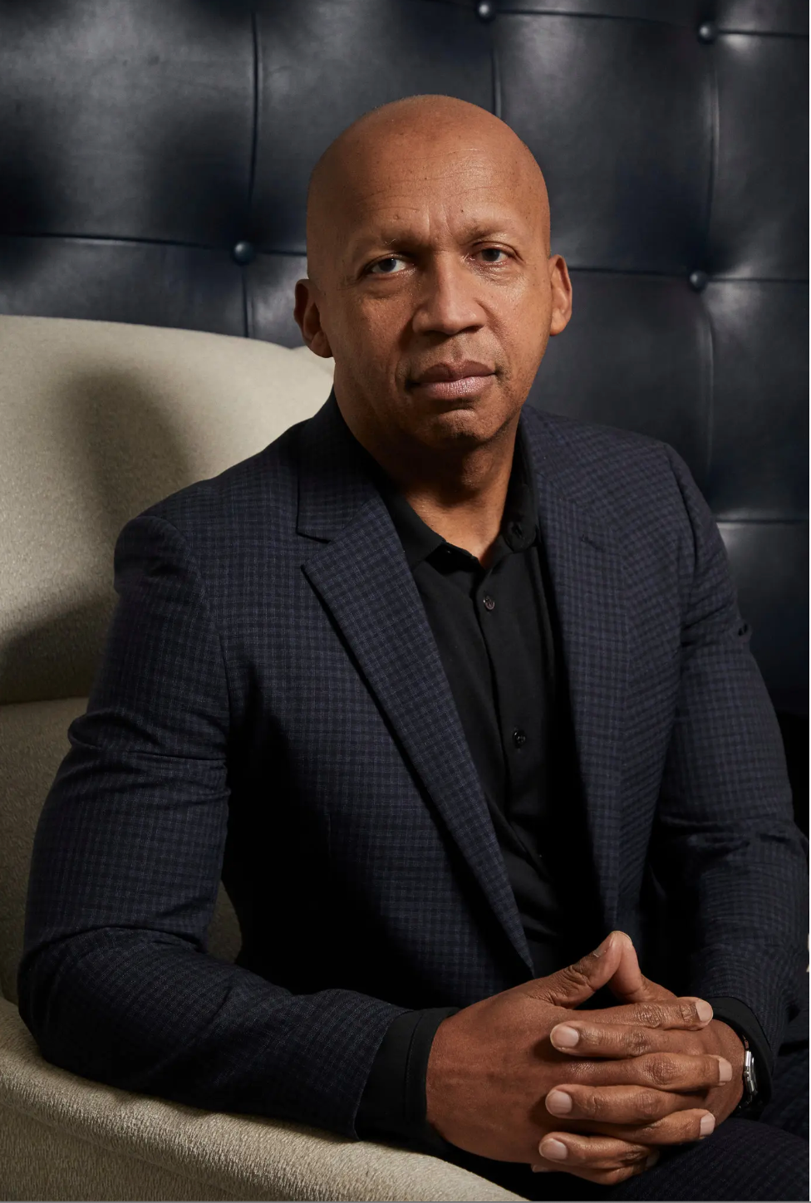

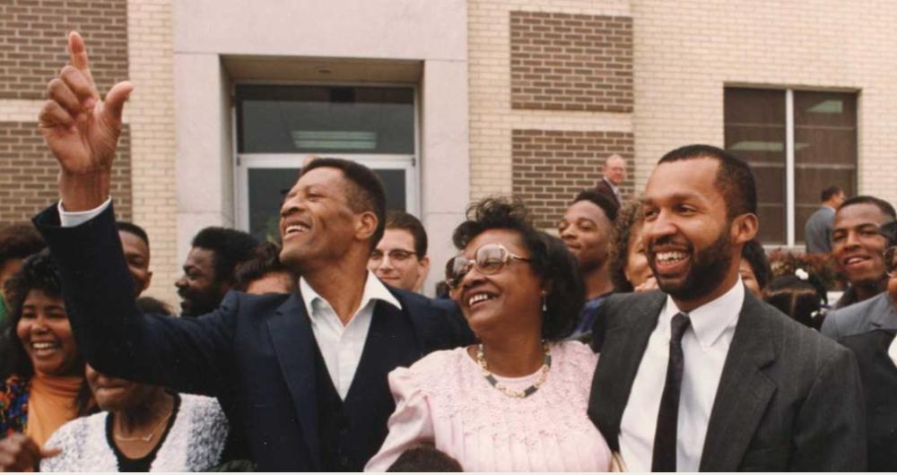

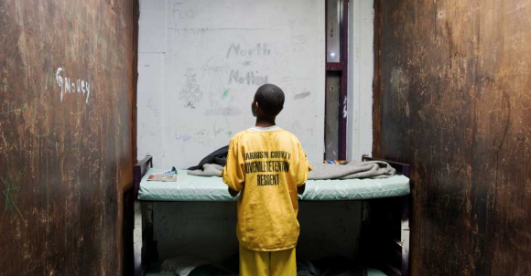
The Chief of Justice for Civil Rights
Anjelica Rivers
Florida State University Panama City
Abstract
“The true measure of our character is how we treat the poor, the disfavored, the accused, the incarcerated, and the condemned.” – Bryan Stevenson
Ethical Leadership
Leaders who inspire and empower have a greater ability to influence those around them and the world. Bryan Stevenson is the founder and Executive Director of the Equal Justice Initiative (EJI), a human rights organization in Montgomery, Alabama. Under his direction, EJI has won major legal challenges eliminating disproportionate and unfair sentencing, exonerating innocent death row prisoners, confronting abuse of the incarcerated and the mentally ill, and aiding prosecuted children as adults. Mr. Stevenson has argued and won multiple cases at the United States Supreme Court. The purpose of this research is to evaluate Mr. Stevenson's leadership qualities, personality attributes, and how he has led multiple initiatives to raise awareness about inequality.
The Secret Ingredient to Success
Stevenson worries about how quickly those in positions of authority judge those who are vulnerable. The lesson is that it takes compassion and hope to overcome ingrained prejudice and innate bias. He argues that in order to maintain our humanity, we must learn to accept challenges, difficulties, and suffering because our humanity depends on everyone's humanity. Mr. Stevenson suggests four ways to bring about change: getting proximate, changing the narrative, maintaining hope, and being willing to do things that are difficult and inconvenient. Hope is a component of change and is essential to the ability for transformation. Where there is continued hopelessness, injustice rules. “Hope is your superpower, says Mr. Stevenson, Don't let anybody or anything make you hopeless. Hope is the enemy of injustice."
Major Contributions
Emotional Intelligence
“Emotional intelligence refers to a person’s abilities to perceive, identify, understand, and successfully manage emotions in self and others” (Daft, 2017). Stevenson has had to deal with the stressors or pressures of arguing in front of the Supreme Court or those who hold opposing views to his. In a society that has condemned many of the clients he represents, he maintains a composed level-headed, even-tempered demeanor in order to make sound decisions on their behalf. He contends that increasing empathy among people on all sides is necessary for creating a society that is more just. Prejudice and injustice thrive when individuals can be labeled as "other" or "criminal," creating a divisiveness between "us" and "them." Stevenson asks readers to hear and comprehend the intimate stories of prisoners in order to narrow that gap.
Criminal Justice Reform
Ending mass incarceration, according to EJI, is the most pressing civil rights issue of our time. In a system defined by official indifference to innocence and error, thousands of people have been wrongfully convicted across the country. The rate of exonerations are becoming more frequently, revealing an unreliable criminal justice system. A lack of accountability for police and prosecutors, reliance on dubious evidence, misinformed eyewitnesses, and the indigent defense crisis are all major causes to wrongful convictions, which have harmed our system's credibility and ruined the lives of innocent people. EJI challenges wrongful convictions and exposes the wrongful imprisonment of innocent people, undermining the credibility of even the most serious cases.
Public Education
Stevenson's founding of the Equal Justice Initiative demonstrates his commitment to working as a team. His organization has received recognition for its work in the fields of human rights and peace. The Legacy Museum and the National Memorial for Peace and Justice were all developed by the organization with the goal of assisting visitors in meaningfully confronting America’s tumultuous racial history and fostering a more hopeful commitment to racial equality and the treatment of all people.
Walter Mcmillian (left) celebrate with family after Bryan Stevenson won his release from death row in 1993.
Children in Adult Prison
Unlike adults children have very limited experience managing their disabilities, anxieties, fear, and trauma. In order to fight the imposition of death-in-prison sentences on children, Stevenson and EJI started a litigation campaign in 2006. Three years later, they argued in front of the Supreme Court that it is against the Constitution to sentence children to die in prison. On May 17, 2010, the Court in Graham v. Florida banned life-without-parole sentences for youth convicted of non-homicide offenses. The Court acknowledged that punishment must take into account the ways in which children differ from adults. Stevenson and EJI have successfully advocated for children around the country since 2010 to receive new sentences.
Conclusion
Stevenson demonstrates compassion, tenacity, and oratorical skills in his role as the head of his organization and as a defense attorney for inmates. As the author of Just Mercy he uses specific stories of actual people who have to live with the consequences of a single bad decision for the rest of their lives. We are more than just a past act of poor judgement or mistake. In the act of hope we have the capacity to be forgiven and rehabilitated. The passion and purpose he has to speak on topics that are difficult and uncomfortable, while educating others is a strong trait to encourage and motivate the minds of all people.
Children housed in an adult jail or prison are up to 9 times more likely to commit suicide than those in juvenile facilities.
Every state in America has capacity to house juveniles separate from adults but many refuse to do so.
Some 4,500 children are housed in adult jails and prisons on any given day in America.
References
Daft, R. L. (2017). The Leadership Experience. Cengage Learning.
Equal Justice Initiative. (2023). Wrongful Convictions. https://eji.org/. https://eji.org/issues/wrongful-convictions/
Lahey, J. (2016, January 8). The Steep Costs of Keeping Juveniles in Adult Prisons. https://www.theatlantic.com/.https://www.theatlantic.com/education/archive/2016/01/the-cost-of-keeping-juveniles-in-adult-prisons/423201/

