Slide 1
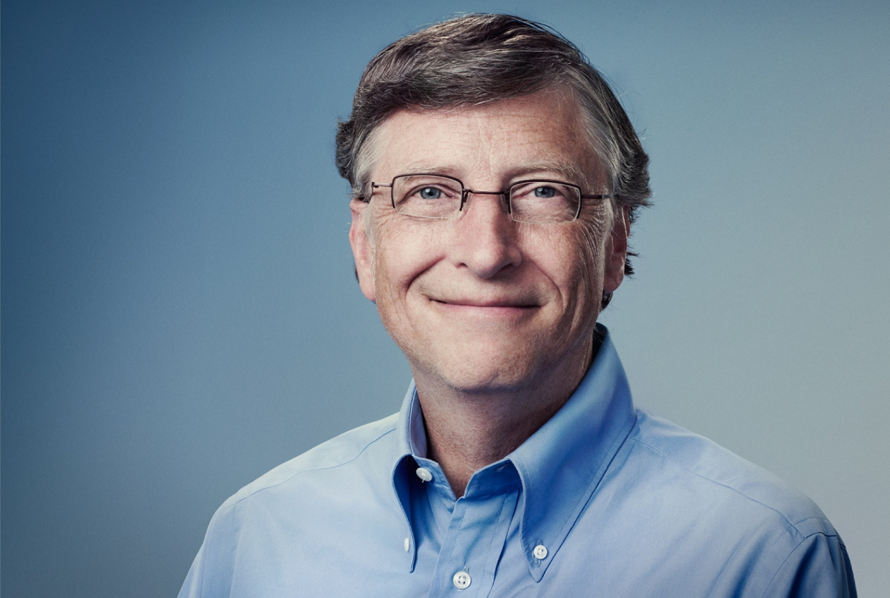
Bill Gates: Leadership and Change
Liam McConnell
Florida State University
Abstract
Discussion
This research poster is for the 2023 FSU Panama City Student Research Symposium centers around the leadership abilities, strategies, and history of Bill Gates, the co-founder of Microsoft and the Bill and Melinda Gates Foundation. I will be presenting information based off literature and other primary sources in a poster format to inform on the achievements of Bill Gates and how specific leadership qualities and structures helped him to achieve success. The research is currently ongoing through the coursework of Systems Engineering Leadership with Dr. Georgiadis.
Bill Gates is an effective leader through a variety of traits and methods. Looking towards The Motivation Code by Todd Henry, Gates is part of many families of motivation. First, he is a member of the visionary family through his drive to make an impact through technology and philanthropy. Next, Gates is part of the achiever family through his persistence and bringing projects to completion. Lastly, Bill Gates is a member of the optimizer family due to his organization, improvement mindset, and want to develop new technologies.
Bill Gates has established himself as a leader through his social awareness as well, mainly through his philanthropy projects in the Bill and Melinda Gates foundation and his product developments that seek to improve the lives of those who use them.
"As we look ahead into the next century, leaders will be those who empower others."
Results
High moral intelligence - Moral Tenets
Team leadership
Philanthropic efforts
High emotional Intelligence
High empathy
Self-awareness
Self-management
Relationship management
Growth in relationship management over time
Courageous
Participate in transformation
Wide-spread influence
Products and philanthropy
References
Conclusion
Through his motivational tendencies, work ethic, and strong moral character, Bill Gates is an effective leader and has shown so throughout his career. Co-founding Microsoft and the Bill and Melinda Gates Foundation and running them effectively are testaments to his leadership abilities. This poster investigates some of Gates’ leadership strengths and abilities, but it is not a fully comprehensive list.
Bill and Melinda Gates Foundation. (n.d.). Discover what our foundation does with its influence. Retrieved from Bill and Melinda Gates Foundation: https://www.gatesfoundation.org/
Daft, R. L. (2017). The Leadership Experience.
Henry, T. (2020). The Motivation Code. Pruvio.

