Slide 1
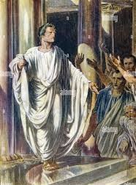
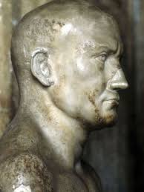
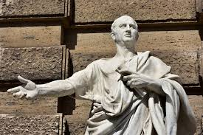
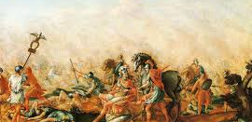
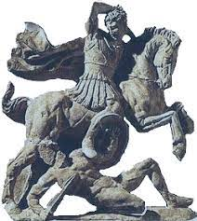
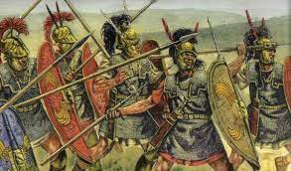
Quintus Fabius Maximus Verrucosus: Cuncator!
Peter W. Liedman, Jr
Florida State University Panama City
Technical Contributions
"If you would have peace, prepare for war.“
Quintus Fabius; Roman Consul.
Social Dynamics
Political Strategy
Fabius was an advocate of the Roman Republic and believed in the importance of maintaining the Republic's traditional values and institutions. He also believed in the need for strong leadership and was a proponent of the idea that the Senate should be the ultimate authority in Rome. Fabius also believed in the importance of maintaining a strong military and was a proponent of the idea that Rome should maintain a large standing army. He also advocated for the use of diplomacy and alliances with other states, in order to ensure Rome's security.
Emotional Intelligence
from his actions and strategies. He was known for his ability to remain calm and collected in the face of adversity, and for his ability to think strategically and make decisions based on the situation at hand. He was also known for his ability to read people and situations, and to understand the motivations of his enemies. He was able to use this knowledge to his advantage, and to devise strategies that would outmaneuver and outwit his opponents. In addition, Quintus Fabius Maximus Verrucosus was known for his ability to inspire loyalty and respect from his troops. He was able to motivate them to fight for him and to trust his decisions. He was also able to maintain a sense of unity and camaraderie among his troops, which allowed them to work together effectively.
Use of Power
Fabius was a strong advocate of the Senate's authority and was known for his ability to persuade the Senate to take action. He also used his influence to ensure that the Senate would take a more active role in the war effort. Additionally, his ability to use his power to reward those who supported him and punish those who opposed him. Known for his ability to use his power to manipulate the Senate and the Roman people to his advantage. His ability to use his power to build alliances and secure support from other states. He was able to use his influence to gain the support of the Etruscans and the Greeks, which helped Rome to gain a foothold in the Mediterranean. He was also known for his ability to use his power to negotiate favorable terms with other states, which helped Rome to gain a strategic advantage in the war.
Quintus Fabius (ca. 278 BC - 203 BC) was a Roman statesman and military leader who was considered one of the greatest generals in Roman history. He is best known for his successful strategy of delaying and outmaneuvering Hannibal during the Second Punic War. Fabius was also noted for his political and diplomatic skills, and for his ability to work with and influence the Roman Senate. He served as consul five times and held the office of dictator twice. His leadership during the Second Punic War earned him the title of Cunctator, or "the Delayer".
Conclusion

