Slide 1
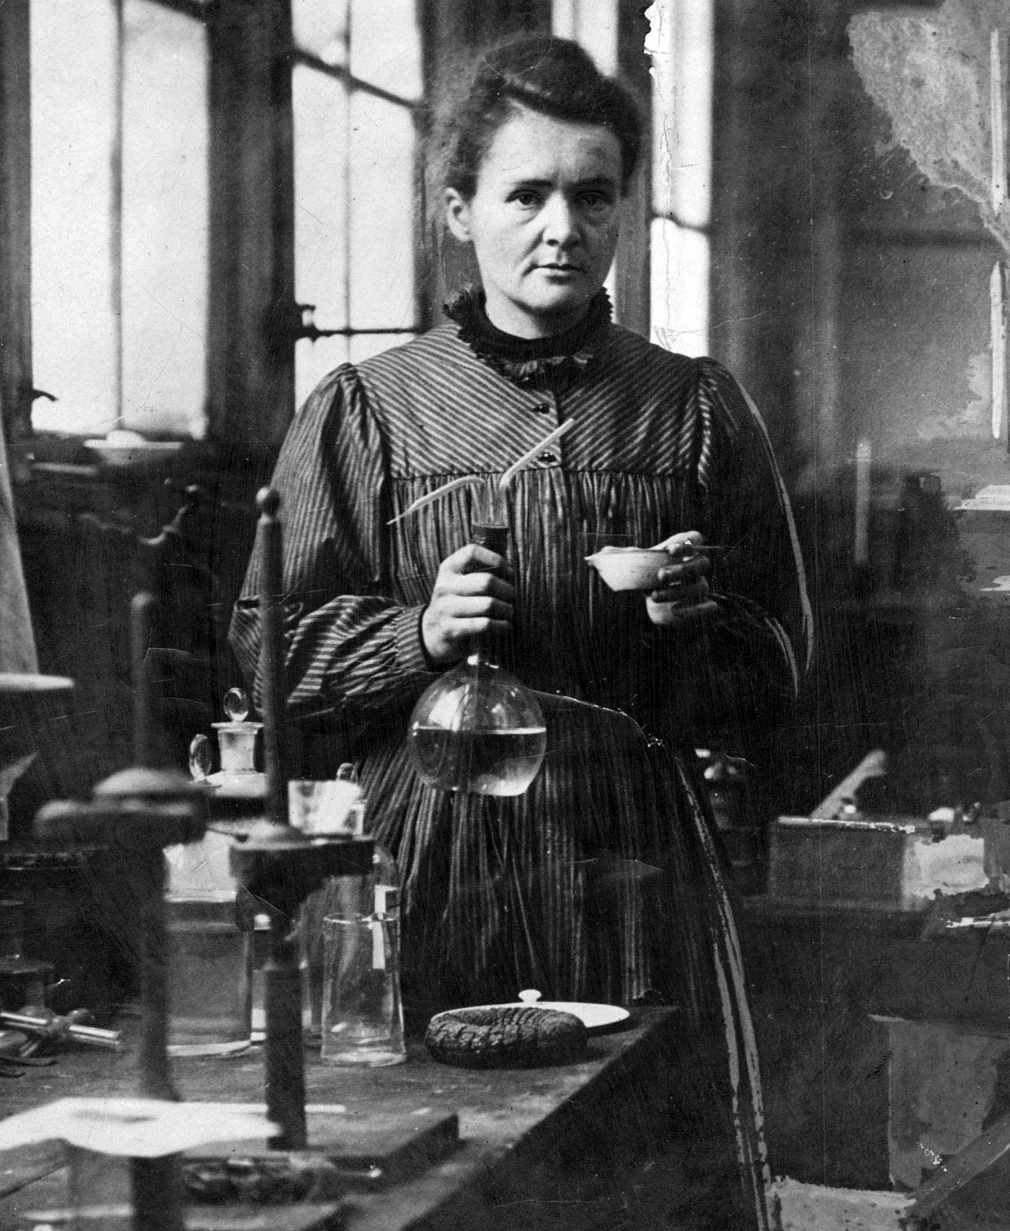
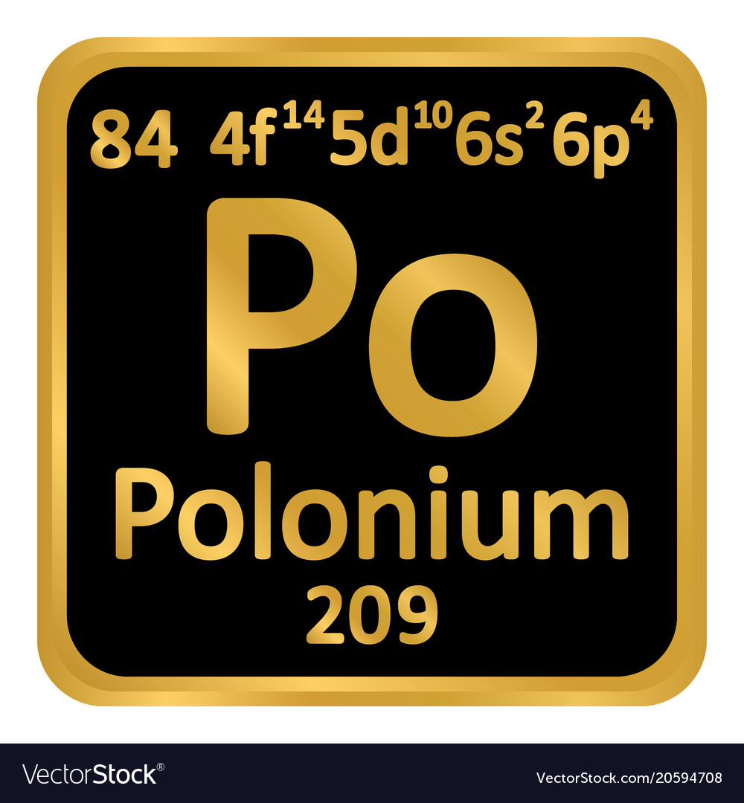
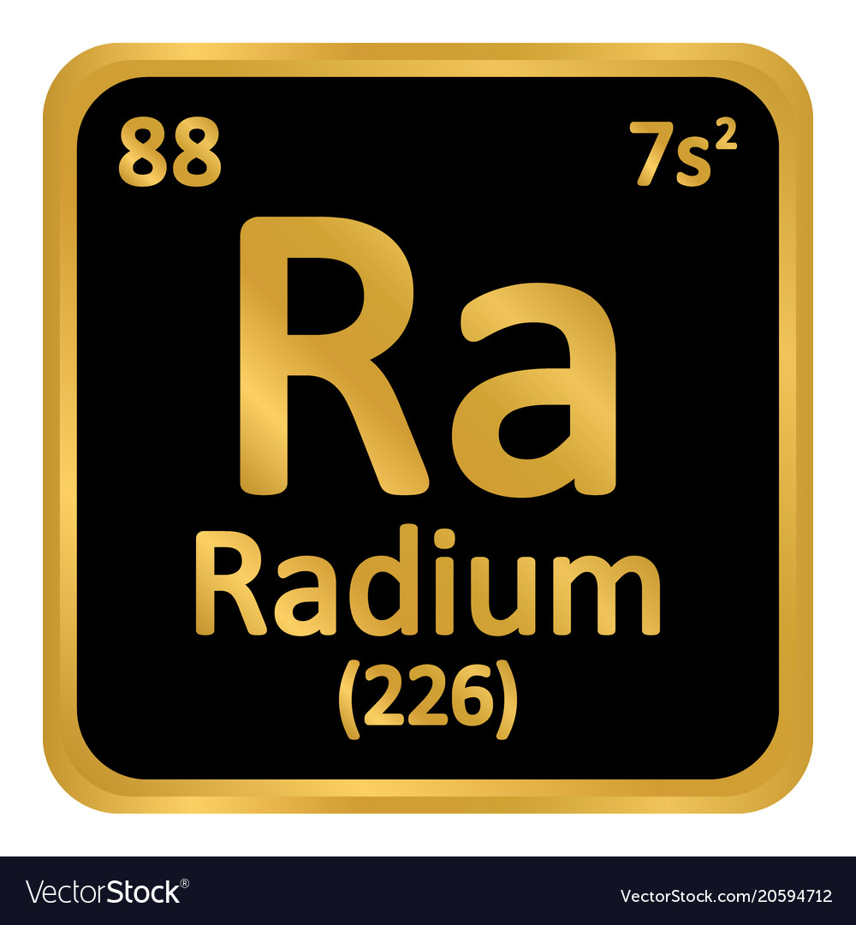
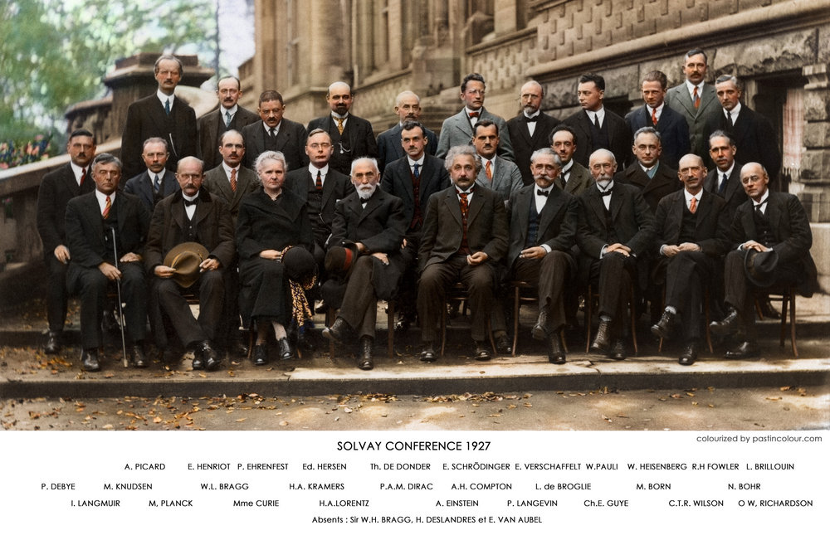
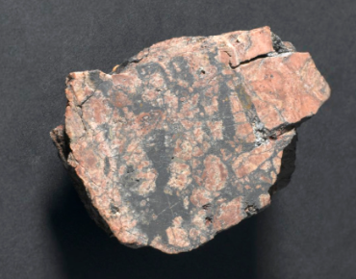
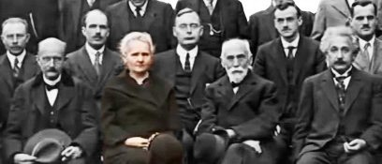
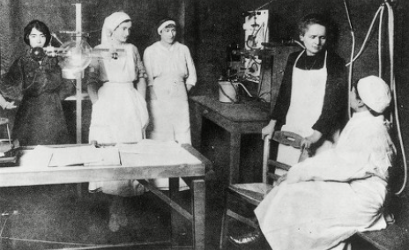
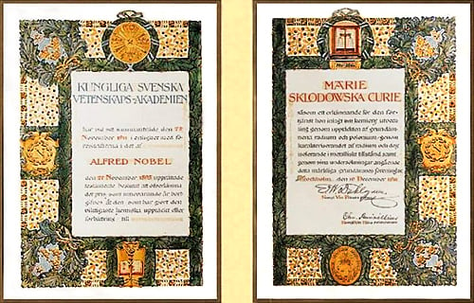
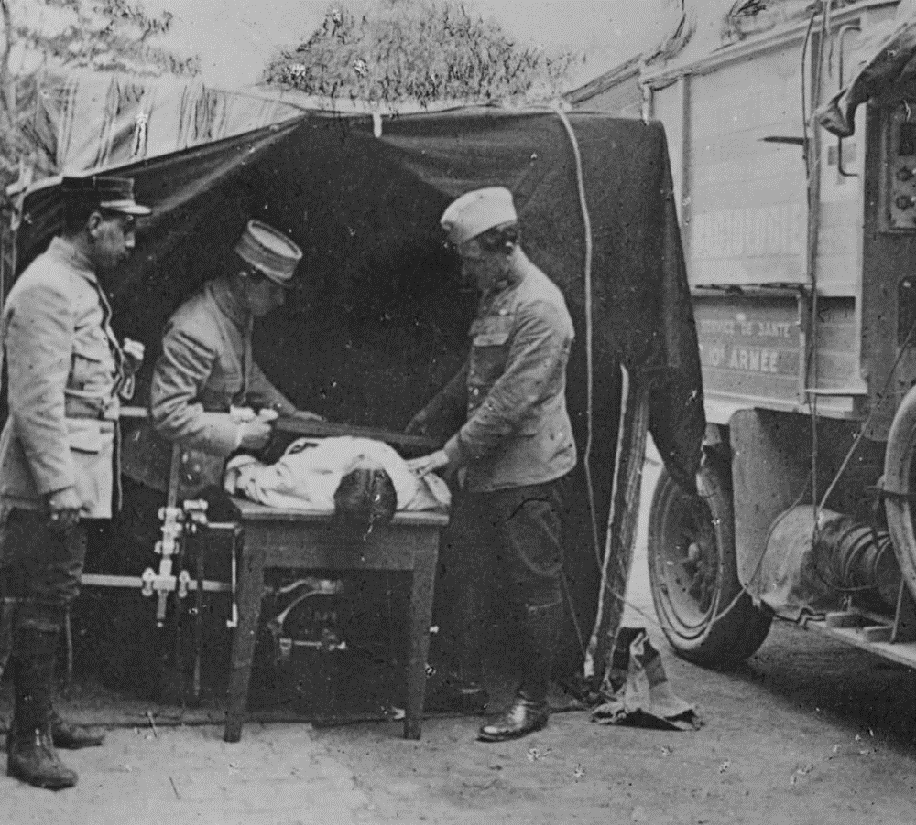


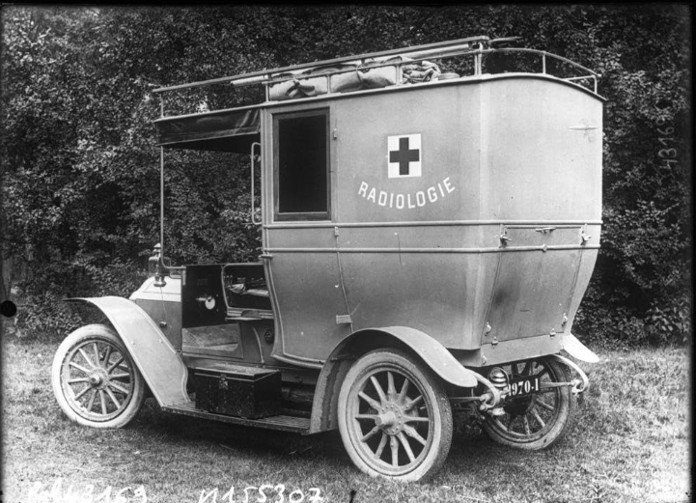
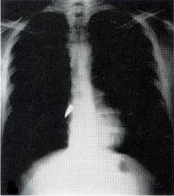
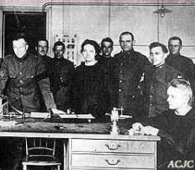
Be Curious - Marie Curie
Gabriela L. Le
Florida State University Panama City
Contributions
Leadership
Polonium and Radium
In the Spring of 1894, Marie received a research grant to study the magnetic properties and chemical composition of steel, where she worked on radioactivity. She continued her dedication and love as a researcher and in the Summer of 1898, she discovered a new substance, which was called Polonium in honor of Marie’s native land, Poland and a few months later the discovery of radium which was named after “radius,” the Latin term for “rays”. In 1903 Marie, her husband Pierre Curie, and Henri Becquerel, a French physicist, were awarded the Nobel Prize in Physics for their contributions to dissecting “radiation phenomena.” She was the first woman to be awarded a Nobel Prize.
Leaders Set the Ethical Tone
Marie Curie portrayed many traits and behaviors that reflected her leadership abilities. Not only did she prove to everyone that women could successfully work side by side with men, but she also demonstrated her ability to never stop trying and showed great perseverance. Her love for research has provided the determination and dedication needed to overcome physical and personal hardships, which is what has made her into such a great leader.
Mission to Save Lives
As an ethical leader, Marie has showed various qualities and behaviors during World War I when she decided to redirect her scientific skills and apply her expertise toward the war effort; not to make weapons, but to help save the lives of the wounded soldiers. She trained and led others to use the X-ray equipment in the battle front, where army surgeons could use x-rays to guide their surgeries. As well as oversaw the construction of 200 radiological rooms at several fixed field hospitals behind the battle lines. Through her efforts, she was able to use her skills to help injured soldiers and demonstrated her humility, showing her concern for the greater good as well as serving others.
Nobel Prize in Physics and Chemistry
Marie’s work ethic and choices were underpinned by her confidence in her own abilities. She was always motivated to learn as she was constantly trying to master and demonstrate new knowledge. Her constant desire to explore new realms has fed to her curiosity of learning about polonium and the isolation of radium, which provided science with a method for isolating and purifying radioactive isotopes. This has led to her receiving two Nobel Prize, one in Physics in 1903 and the other in Chemistry in 1911. Marie quotes “First principle: never to let oneself be beaten down by persons or by events” and “Nothing in this world is to be feared… only understood. Now is the time to understand more, so that we may fear less”. This attitude is a wonderful clear expression of the importance of being open to learning.
“Life is not easy for any of us. But what of that? We must have perseverance and above all confidence in ourselves. We must believe that we are gifted for something, and that this thing must be attained.”
-Marie Curie
Little Curies
When World War I broke out in 1914, Marie produced portable X-ray equipment that was used in the field nicknamed “Little Curies”. In her hopes to save lives, Curie came to a solution and created the first “radiological car”, a vehicle containing an X-ray machine and photographic darkroom equipment that allowed the equipment to be portable and driven up to the battlefield. Establishing more than 200 mobile X-rays allowed her to give an exceeding amount of one million X-ray exams to wounded soldiers during the war.
Major Outcomes
Through her hard work and passion, she was the first woman to win a Nobel Prize twice in two different categories for Chemistry and Physics. It was through Marie’s efforts that led to the discovery of polonium and the discovery of the element radium. She was a pioneer in the field of radiation research, and it was through Curie’s research that medical use of X-rays became a possibility. Even with the many difficulties she faced, she was able to overcome them and motivate others to achieve and dream. These qualities of a great leader that Marie possess has led and inspired the scientific and medical community to continue to encourage innovation for years to come.
The Secret Ingredient of Leadership Success
The most important capability that a leader can develop is self-awareness. Being self-aware involves being conscious of the internal aspects of one’s nature, such as personality traits, emotions, values, attitudes, and perceptions, and appreciating how your patterns affect other people. Marie Curie’s ability to be able to focus on something positive when she was in a negative situation provided her the ability to push through in her most difficult times.
Notes:
https://www.nobelprize.org/womenwhochangedscience/stories/marie-curie#:~:text=During%20World%20War%20I%2C%20Curie,soldiers%20and%20operate%20more%20accurately.

