Slide 1
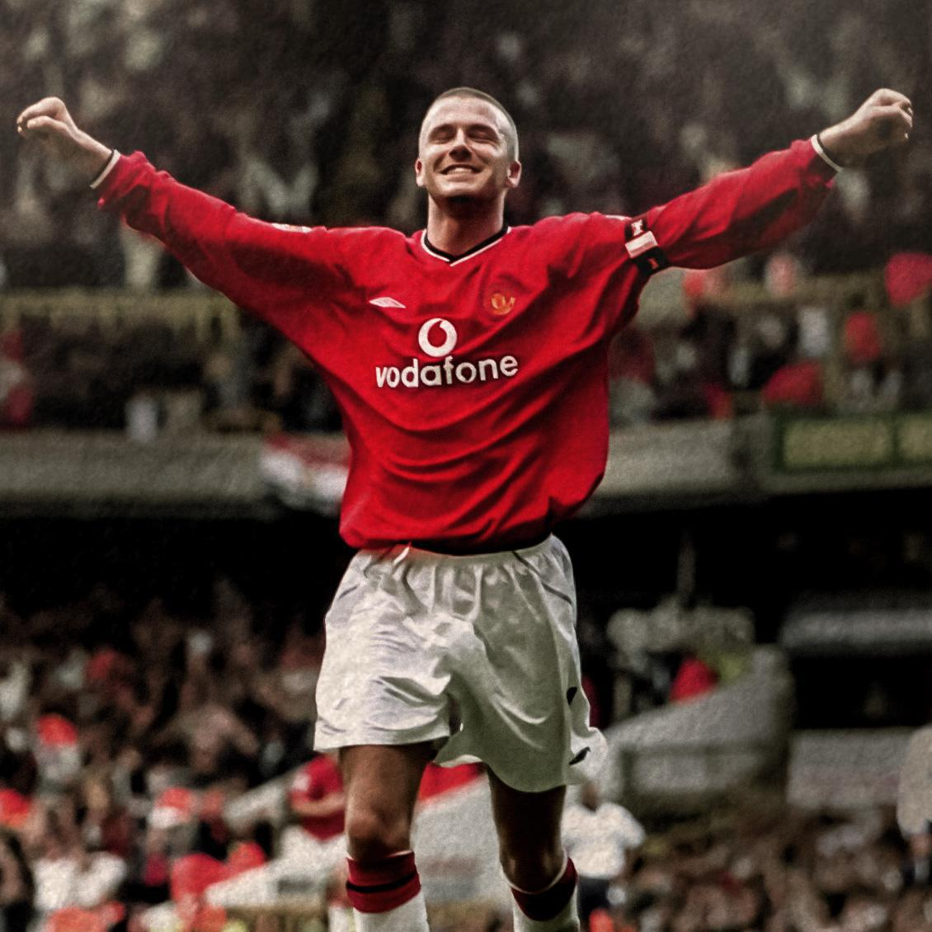
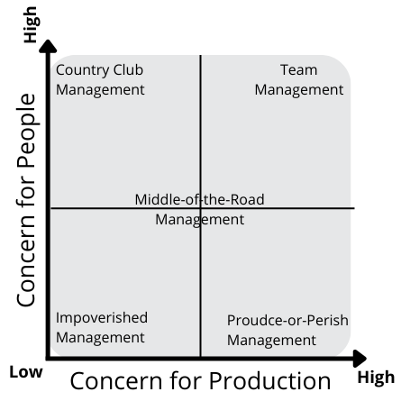
Lead it like Beckham: Analysis of David Beckham’s Leadership
Joshua Leary
Florida State University Panama City
Abstract
Leadership Qualities
David Beckham was undeniably one of the most prominent and influential footballers in the 1990’s and 2000’s that has extended past his football career. He achieved levels of the sport that very few can reach. Had successful stints at many football clubs, captain of England’s national team, currently holds 5 records for English footballers, inducted into two different Hall of Fames, and first English footballer to win a major title in four different international leagues that comprised his 19 professional football titles/trophies. The influence on football, especially in England, also led him to receive Officer of the Order of the British Empire by Queen Elizabeth II. David Beckham has also had a major impact off the pitch as he has spent many years using his influence to spread awareness and gather aid for various philanthropy initiatives. He has met with world leaders, volunteered his time and money, and set up his own charities to help those initiatives, such as support for protecting children that are malnourished and victims of violence. This research delves into the effectiveness of David Beckham’s leadership style and examines his traits, behaviors, and personality that ultimately led to his success despite some troubling moments in his career and personal life. Theories of leadership and motivation will be applied to his life to determine the type of leader and person David Beckham is and how it has led him to be so successful and an icon for many people.
Traits:
Energy/excitement
Self-confidence
Drive/persistence
Dependability
Behaviors and Leadership Style:
Democrat Leader (valued each member and saw the whole team as a collective group to achieve their goal)
Team Management Style
Success and Blind Spots:
Self-Awareness
Stubborn
Criticized and “comes out fighting”
Motivation:
Visionary
Achieve Potential
Make an Impact
Experience the Ideal
Emotional Intelligence:
D.B showed high level of self-awareness when it came to his emotions. He recognized the impact that his private life and the emotions associated with that have on his work. D.B has high level of social awareness and had a service orientation that is recognizing and serving the needs of others.
Conclusion
David Beckham is an effective leader. He is motivated by his vision to achieve, and his traits have allowed him to be a very successful footballer and leader. The Beckham effect is incredibly powerful and all his traits, leadership style, emotional intelligence, ethical climate, and courage have made him an impactful leader on and off the pitch. While he has his short comings, he has achieved true greatness and will go down in history as one of the most influential footballers and leaders in this sport.
Methodology
Ethical Climate:
Qualities: humility, fairness, honesty, encouraging, respectful, and taking responsibility
D.B showed respect on and off the pitch. “It’s so important to have manners and treat people from all walks of life the way they should be treated.” He showed concern for the greater good of all those in his life and did everything he could to help others through his efforts, serving, and encouragements.
Leadership Traits
Behavior & Leadership Style (Democratic/Autocratic)
Motivation
Visionary Family
Achievement Family
Team Player Family
Learner Family
Leadership Success and Blind Sports
Emotional Intelligence
Ethical Climate
Courage
Courage:
Assume Responsibility – Stints as captain of the different football clubs and took responsibility for team’s actions and did everything he could to achieve and be the one they relied on.
Serving – knew where his skills were needed in the team and pushed himself to serve the team because he knew that is what was necessary for the team to prosper
Leaving – courageous step to be the first European footballer to make their way across the ocean and play for a team in Major League Soccer
References
Bass, B. M., & Stogdill, R. M. (1990). Bass & Stogdill's handbook of leadership: Theory, research, and managerial applications. Simon and Schuster.
Blake, R. R.& McCanse, A. A. (1991). Leadership Dilemma - Grid Solutions. Gulf Publishing Company
Daft, R. L., & Lane, P. G. (2018). The Leadership Experience. Cengage Learning.
Henry, T., Penner, R., Hall, T. W., & Miller, J. (2020). The Motivation Code. PRUVIO PRESS.

