Slide 1
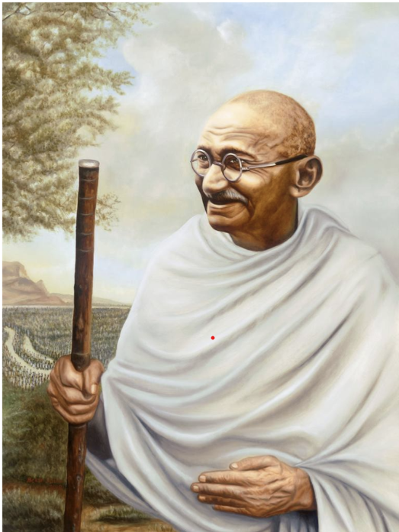


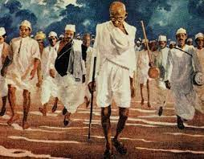

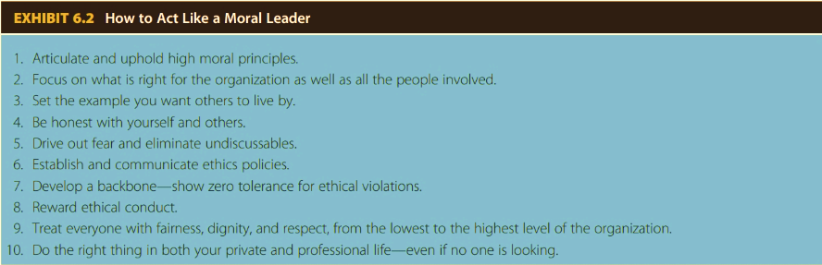

Mohandas Gandhi – “Leader of Leaders”
Yanique S. Lawrence
Florida State University – Main Campus
Abstract
Effective Leadership Traits & Behaviors
Major Contributions
Abstract
According to Daft (2015, p. 36), the earliest leadership studies proposed that certain people had natural traits and abilities of power & influence that enabled them to influence others in a way that other people could not. Other studies found that equally important is the recognition that effective leadership is reflected in behavior, not simply by what personality traits a leader possessed (Daft, 2015, p. 46). Although Gandhi led a simple life, was not the best orator nor was he classically good-looking, he continues to be looked upon today as one of the best leader to have lived. This is partly owing to some of the characteristics he possessed as a leader. As a leader he was:
Fought against racial discrimination in South Africa
His campaign of non-violent resistance led to the 1914 Indian Relief Act
Led his first non-violent civil disobedience movement in India that resulted in the passing of the Champaran Agrarian Act
Successfully led a non-violent tax revolt in Kheda
He led the famous Salt March to Dandi that later influence several activists including Martin Luther King, Jr.
Leading figure responsible for India achieving independence
Fought against social evils in society like untouchability
Played an instrumental role in the upliftment of women across the country
Gandhi was an Indian lawyer who led India to independence from British rule and has inspired movements of civil rights and freedom in several other countries across the world. As the revered father of the nation for the world’s largest democracy, he is recognized as one of the greatest leaders of all time. He has inspired many other leaders after him to persevere for the improvement of humankind and there are several lessons that leaders of today and those who aspire to be leaders can learn from him. The life & leadership of are explored in relation to several academic topics covered in the Systems Engineering Leadership course, with the goal of identifying areas within the author’s own leadership where relevant lessons learned can be applied in improving the leadership effectiveness of the author.
Men often become what they believe themselves to be. If I believe I cannot do something, it makes me incapable of doing it. But when I believe I can, then I acquire the ability to do it even if I didn’t have it in the beginning”.
    Mahatma Gandhi
Honesty & Integrity
He spent his life encouraging others to live honest and non-violent lives.
His use of empathy was a major proponent for the admiration he gained from the people of India. People followed him because he was fighting their fight, he was one of them, and he lived in such a manner that reflected their lives and struggles.
Optimistic & Self-confident
Considerate, Charismatic, Humble
Gandhi, like many leaders, had blind spots. Many in South Africa believe he was complicit in anti-black racism & members from the Hindu nationalist associations in India have been calling him a betrayer, accusing him of establishing a Brahmin rule in independent India.
Leadership Blind Spots
Fearless, Persistent, Courageous
He was willing to suffer death rather than to deny his social, religious and political beliefs.
Conclusion
The main takeaway from this research on the life & leadership of Mohandas Gandhi is that:
Optimism, self-confidence, honesty & integrity are traits typically considered highly important for leadership.
Ethical leaders have the fortitude to do the things that are right and stick to their core values despite outside pressures.
A lack of courage allows greed & self-interest to overcome concern for the common good.
Even the best leaders can have blind spots.
“Ethics is the process of questioning, discovering and defending our values, principles and purpose” (“What is Ethics”, 2020). It’s about finding out who we are and staying true to that in the face of temptations, challenges and uncertainty. It’s not always fun and it’s hardly ever easy, but if we commit to it, we set ourselves up to make decisions we can stand by, building a life that’s truly our own and a future we want to be a part of.
Leading with Courage – Gandhian Ethics
Gandhi’s ethical teachings were centered on:
Non-violence
Truthfulness
Non-stealing
Progress for all
Chastity
character
According to Gandhi, the seven deadly sins are:
References
Wealth w/out work
Pleasure w/out conscience
Science w/out humanity
Knowledge w/out character
Politics w/out principle
Commerce w/out morality
Worship w/out sacrifice
Daft, R. L. (2015). The leadership experience. Cengage Learning.
What is ethics? (2020, April 27). THE ETHICS CENTRE. https://ethics.org.au/about/what-is-ethics//

