Slide 1
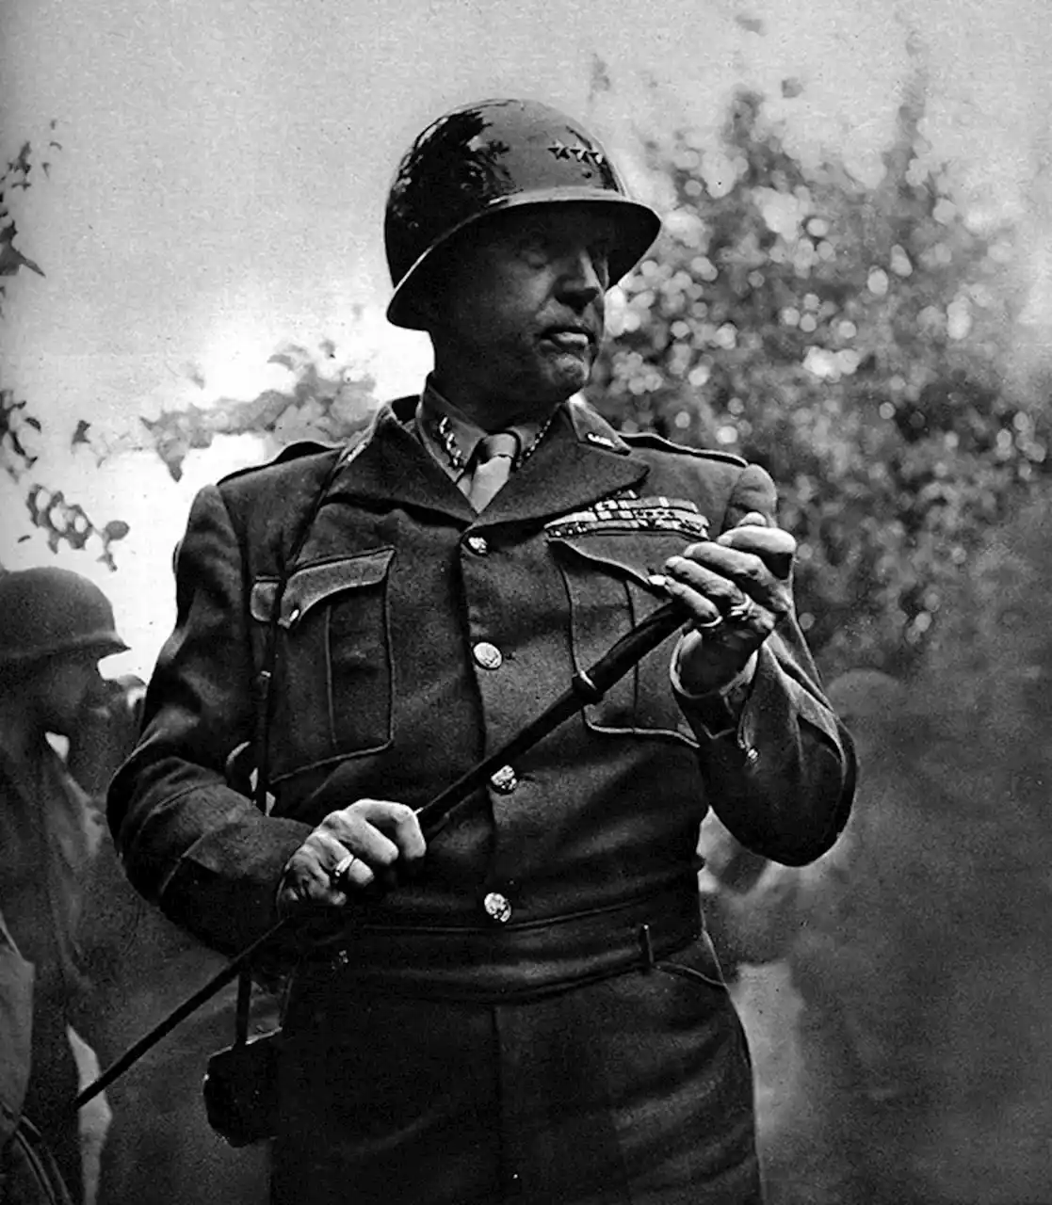
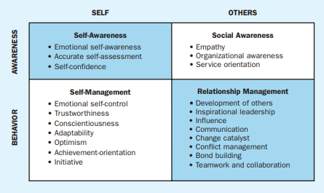
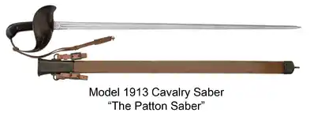
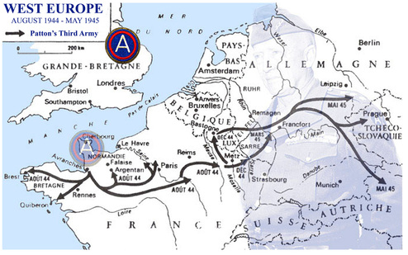
General George S. Patton Jr: Revolutionary or Unethical Leader?
Dustin A. Landers
Florida State University Panama City
Abstract
“We herd sheep, we drive cattle, we lead people. Lead me, follow me, or get out of my way.”
Gen. George S. Patton
Social Dynamics
Ethical Climate
Was Patton an ethical or unethical leader? While Patton exhibited more ethical traits and behaviors than not, he at times acted unethically. He always maintained concern for the greater good, and was honest with the men under his command, never mincing words about the horrors of war. Patton also understood the importance of moral courage, once saying “Moral courage is the most valuable and usually the most absent characteristic in men. (We are the Mighty, 2018)” Patton exhibited unethical behaviors as well, particularly dealing unfairly and dimensioning the dignity of soldiers in his command. He tended to let his emotions get the better of him and act poorly in tense situations. While Patton at least had enough empathy to realize after the fact that he acted wrongly and apologize, his formidable temper caused him to act unethically at times.
Perhaps the most prolific tank commander in U.S. history, General George S. Patton was not only one of greatest military leaders ever produced by the United States but also one of the most complex and controversial. Patton believed it was essential for a general to stand out and lead from the front, as he thought that no one would follow a leader that didn’t know what the work was like firsthand; or as Patton stated: “No good decision was ever made in a swivel chair.” While his leadership style was seen as unprofessional by some officers at the time, he commanded unfaltering discipline and trust from the men under his command, which allowed him to produce more results, in less time, with fewer casualties that any other general in the army during World War II. This research will attempt to breakdown his leadership style to see the factors that made him an incredible leader, while also looking at traits that may have led him to make controversial decisions.
Emotional Intelligence
Overall, judging Patton’s level of emotional intelligence is a difficult endeavor, particularly if you subject him to the emotional standards that we expect from leadership in modern times. While his temper and his inability to understand some of the emotional responses of his troops hinders his ability to be called very emotionally intelligent, he does share many of the traits that one would consider when thinking of emotional intelligence.
Significant Contributions
Pre-World War II
  Represented the U.S. at the Stockholm Olympics, competing in the modern pentathlon. Finished fifth overall in the event.
  Designed the Model 1913 Calvary Sword (Patton Saber)
  Established the first U.S. Army Tank School in Bourg, France in 1917 (Bergeron, 2007)
Slapping Incidents
Patton was sharply criticized for a pair of incidents in August 1943, when he physically struck hospitalized soldiers who exhibited no outward signs of injury. Not understanding the concept of being shelled shocked, he accused the soldiers of cowardice and ordered them back to the front line. Many in the U.S. Congress and the press called for Patton to be sacked, and the Senate delayed Patton’s promotion to permanent major general. Although Patton kept his job, those incidents likely cost him a command role of ground forces in the Normandy Invasion in June 1944 (Lovelace, 2023).
Daft, 2015
Conclusion
World War II
  Led 1st and 2nd Armored Divisions during the invasion of North Africa in late 1942.
  Led U.S. troops to their first victory of WWII at the Battle of El Guettar in March 1943.
  Led U.S. Seventh Army during the successful invasion of Sicily.
  Led the U.S. Third Army in its famous march across France and played a key part in ending the Germen Ardennes Counteroffensive (History.com Editors, 2020)
Judging Patton’s leadership style is a difficult endeavor, particularly if you hold him accountable for standards we expect from modern leaders. Possibly the only thing that could outweigh his accomplishments as a military leader is the controversies that accompanied him, particularly later in his career. While some of his actions were unacceptable, such as the slapping incidents, he was overall a very effective leader that played an instrumental part in the Allied Victory during WWII. He was an incredible motivator of his troops and produced results when needed. While he may not have been perfect, he was exactly what the Army needed at the time and served his role well.
References
Bergeron, A.W. (2017). The Birth of Armored Forces. U.S. Army.
Daft, R.L. (2015). The Leadership Experience, 7th Edition. Stamford: Cengage Learning.
History.com Editors. (2020). George S. Patton. https://www.history.com/topics/world-war-ii/george-smith-patton
Lovelace, A. (2017). George Patton. Britannica.
We Are the Mighty. (2015). 11 Quotes That Show the Great Leadership of General George Patton. https://www.businessinsider.com/11-quotes-that-show-the-great-leadership-of-general-george-patton-2015-11

