Slide 1
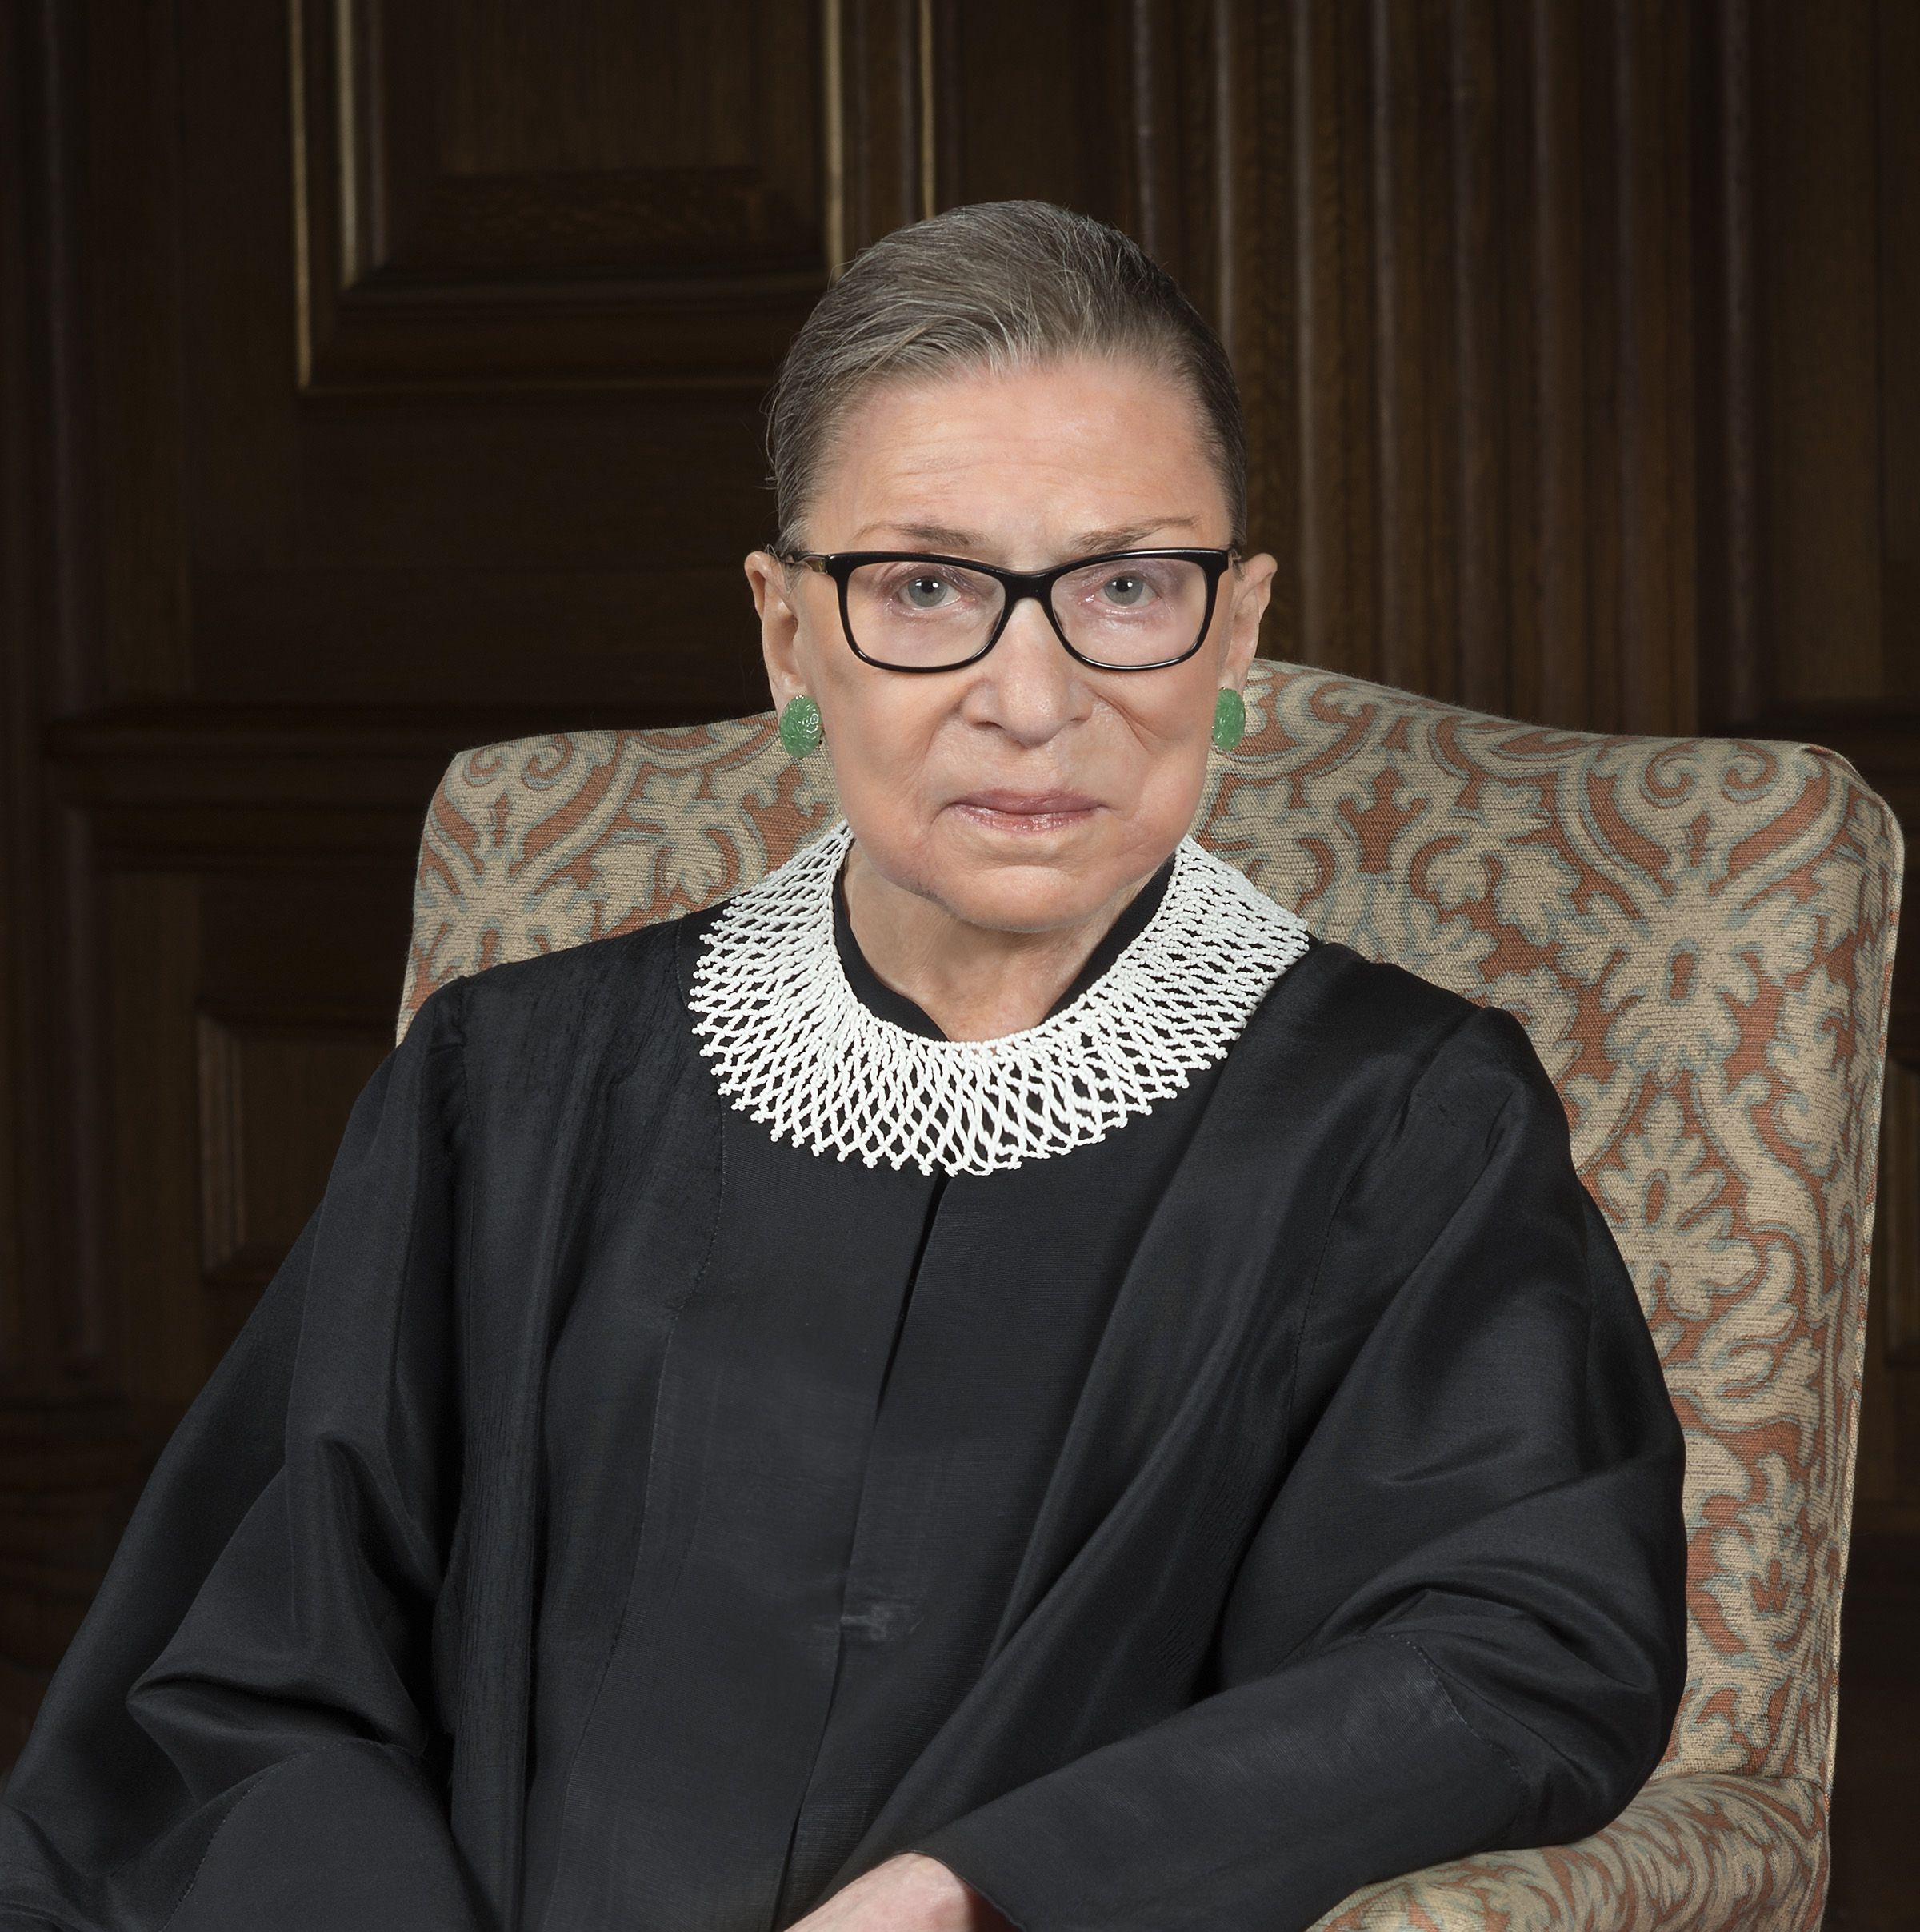
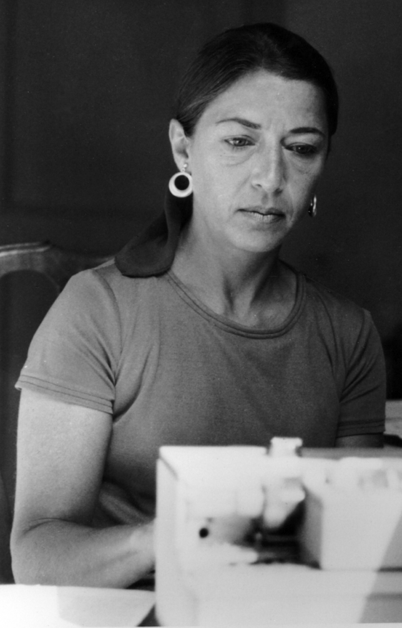
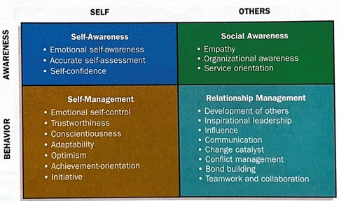
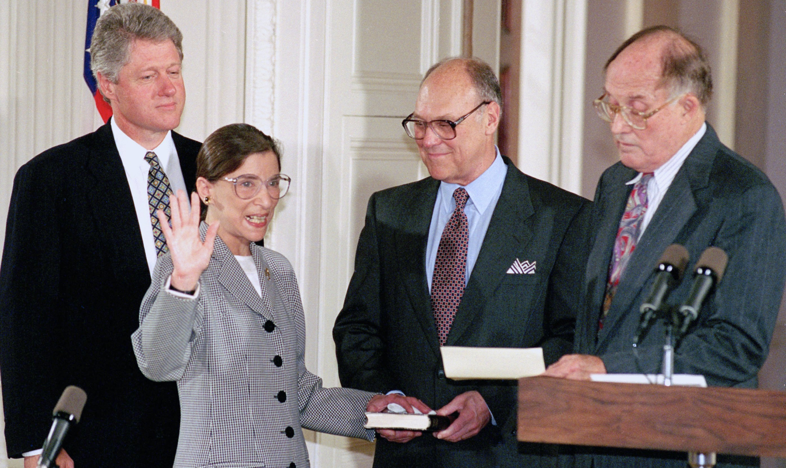
Ruth Ginsburg: Leading Through Trailblazing
Saralyn Jenkins
Florida State University Panama City
Abstract
”Fight for the things that you care about, but do it in a way that will lead others to join you.” - Ruth Bader Ginsburg
Five laws that Ginsburg helped pass in the U.S. to achieve gender equality (Rodriguez, 2020):
Employers cannot discriminate against employees because of gender or reproductive choices
State-funded schools must admit women
Women have the right to equal benefits and financial independence
Men are entitled to the same caregiving and Social Security benefits as women
Juries must include women
Major Contributions
A trailblazer, leader, mother, and a pioneer for women, that was Ruth Bader Ginsburg. Ginsburg is most known for her position on the Supreme Court from 1993-2020, gaining more recognition during these years up until her death in 2020. While she made history by being not only the second woman ever appointed to the Supreme Court, but the first Jewish woman. While in her time working with the legal system she rocked the boat, challenging court cases and speaking out on topics that male colleagues neglected to address. Because of her persistence and leadership, she helped pass multiple laws in an effort for gender equality. The purpose of this research is to showcase Justice Ginsburg’s leadership traits, characteristics, and motivation that allowed her to make the impact that she did in the legal system and to people across the nation.
Achiever: one who is motivated to persevere through challenges, overcoming obstacles to reach a goal (Henry, Penner, Hall, & Miller, 2020)
  Ginsburg persevered through the discrimination she faced as a Jewish mother, being 1 of 9 women in a class of 500 at Harvard Law
  When her husband got cancer during her first year of law school, she helped him finish his own law studies while keeping her top rank in her own class
  Skilled at realizing obstacles in her path to success, she would frame the male in a case as the plaintiff in order to fight for equality among men and women
  Duren v. Missouri
  Billy Duren was being convicted of murder when he
  faced an all-male jury, chosen from a panel of 53
  where only 5 of which were women. Ginsburg
  stated during the trial that her “argument addresses the
  citizen’s duty tied to a defendant’s fair cross section right
  and the complete absence of justification for exempting
  any woman” (Dreeben, 2022). At the end of the case,
  the Supreme Court announced a plan to analyze fair cross
  section claims at a later date, which would eventually
  result in the placement of women on the jury today.
Optimizer: they “want systems and information to be organized, focused on getting it right from the beginning rather than fixing it later” (Henry, Penner, Hall, & Miller, 2020)
  Ginsburg was extremely organized in the way that she presented cases, not only knowing the ins and outs of the case but the facts behind it
  She meticulously looked over her drafts, believing that every word had meaning, and conciseness was important
  Optimizers often feel the “need to lay firm foundations for future work,” which Ginsburg did through dissenting against Supreme Court majority rulings that she did not agree with for her points to be considered in the future (Henry, Penner, Hall, & Miller, 2020)
  “So that’s the dissenter’s hope. That they are writing not for today, but for tomorrow.” – Ruth Ginsburg
Her Motivation
Ginsburg had many key leadership characteristics, using them to push forward in strides for equality across the United States. Despite the discrimination that she encountered throughout her life, she continued to push forward, not letting it affect her negatively. “That’s an example of how something that may seem dreadful, very bad luck, turns out to be the most fortunate thing that ever happened to you,” Ginsburg stated in an interview (5 inspiring quotes from Justice Ruth Bader Ginsburg’s lecture in Little Rock, Arkansas, 2019). Had she not had the experiences that she did, she likely wouldn’t have become a Justice and the U.S. would look vastly different for women.
Key Takeaways
“In a study of leaders, two-thirds of the difference between average and top-performing leaders was found to be due to emotional competence, with only one-third due to technical skills” (Gallupe et al, 1994). Emotional intelligence is a large part of effective leaders. Ginsburg possessed traits of emotional intelligence as defined below from Exhibit 5.7 out of The Leadership Experience textbook (Daft, 2016):
She was self-aware, knowing that because of her gender she would be faced with challenges and put in difficult situations specific to females
Self-management allowed her to navigate these challenges while remaining calm and civilized, never letting her emotions take over
She was socially aware of the things going on around her, empathetic towards everyone, not only women
  While recognizing the constitution for what it was, she believed that it was written for the people of that time and not for the current society
  “People who were left out at the beginning – slaves, women, men without property, native Americans – were not part of ‘We the people.’ Now all the once left out people are part of our political constituency” – Ruth Ginsburg
She managed relationships effectively, embracing those who thought differently than her. She was aware of how her behaviors and words would influence those around her. “Instead of having to make others wrong, she strived to find common ground and worked forward from there to create ground-breaking legal and social outcomes” (Dr. Warren, 2020)
Her Leadership Traits
References
5 inspiring quotes from Justice Ruth Bader Ginsburg’s lecture in Little Rock, Arkansas. (2019, September 9). Retrieved from Clinton Foundation: https://stories.clintonfoundation.org/five-inspiring-quotes-from-justice-ruth-bader-ginsburgs-lecture-in-little-rock-arkansas-5b034176e485
Biography of Associate Justice Ruth Bader Ginsburg. (n.d.). Supreme Court of the United States. Washington, DC, United States of America.
Daft, R. L. (2016). The Leadership Experience. Cengage Learning.
Dr. Warren, C. (2020, September 28). Ruth Bader Ginsburg: The Heart of Justice. Retrieved from Institute for Health and Human Potential: https://www.ihhp.com/blog/2020/09/28/ruth-bader-ginsburg-the-heart-of-justice/
Dreeben, M. R. (2022, January 14). Defending Duren: Ruth Bader Ginsburg as Criminal Defense Attorney. Retrieved from American Bar Association: https://www.americanbar.org/groups/criminal_justice/publications/criminal-justice-magazine/2022/winter/defending-duren-ruth-bader-ginsburg-criminal-defense-attorney/
Gallupe, R. B., Cooper, W. H., Grisé, M.-L., & Bastianutti, L. M. (1994). Blocking electronic brainstorms. Journal of Applied Psychology, 79(1), 77–86. https://doi.org/10.1037/0021-9010.79.1.77
Henry, T., Penner, R., Hall, T., & Miller, J. (2020). The Motivation Code: Discover the Hidden Forces That Drive Your Best Work. Portfolio.
The Legacy of Justice Ruth Bader Ginsburg. (n.d.). Retrieved from Connecticut State Department of Children and Families: https://portal.ct.gov/DCF/SPOTLIGHT/2020/Sept-2020/Ruth-Bader-Ginsberg
Rodriguez, L. (2020, September 21). 5 Laws Ruth Bader Ginsburg Championed to Support Gender Equality. Global Citizen. United States of America.
Tribute: The Legacy of Ruth Bader Ginsburg. (n.d.). American Civil Liberties Union.
Vagianos, A. (2015, June 2). Ruth Bader Ginsburg Tells Young Women: 'Fight For The Things You Care About'. Retrieved from Harvard Radcliffe Institute: https://www.radcliffe.harvard.edu/news-and-ideas/ruth-bader-ginsburg-tells-young-women-fight-for-the-things-you-care-about

