Slide 1
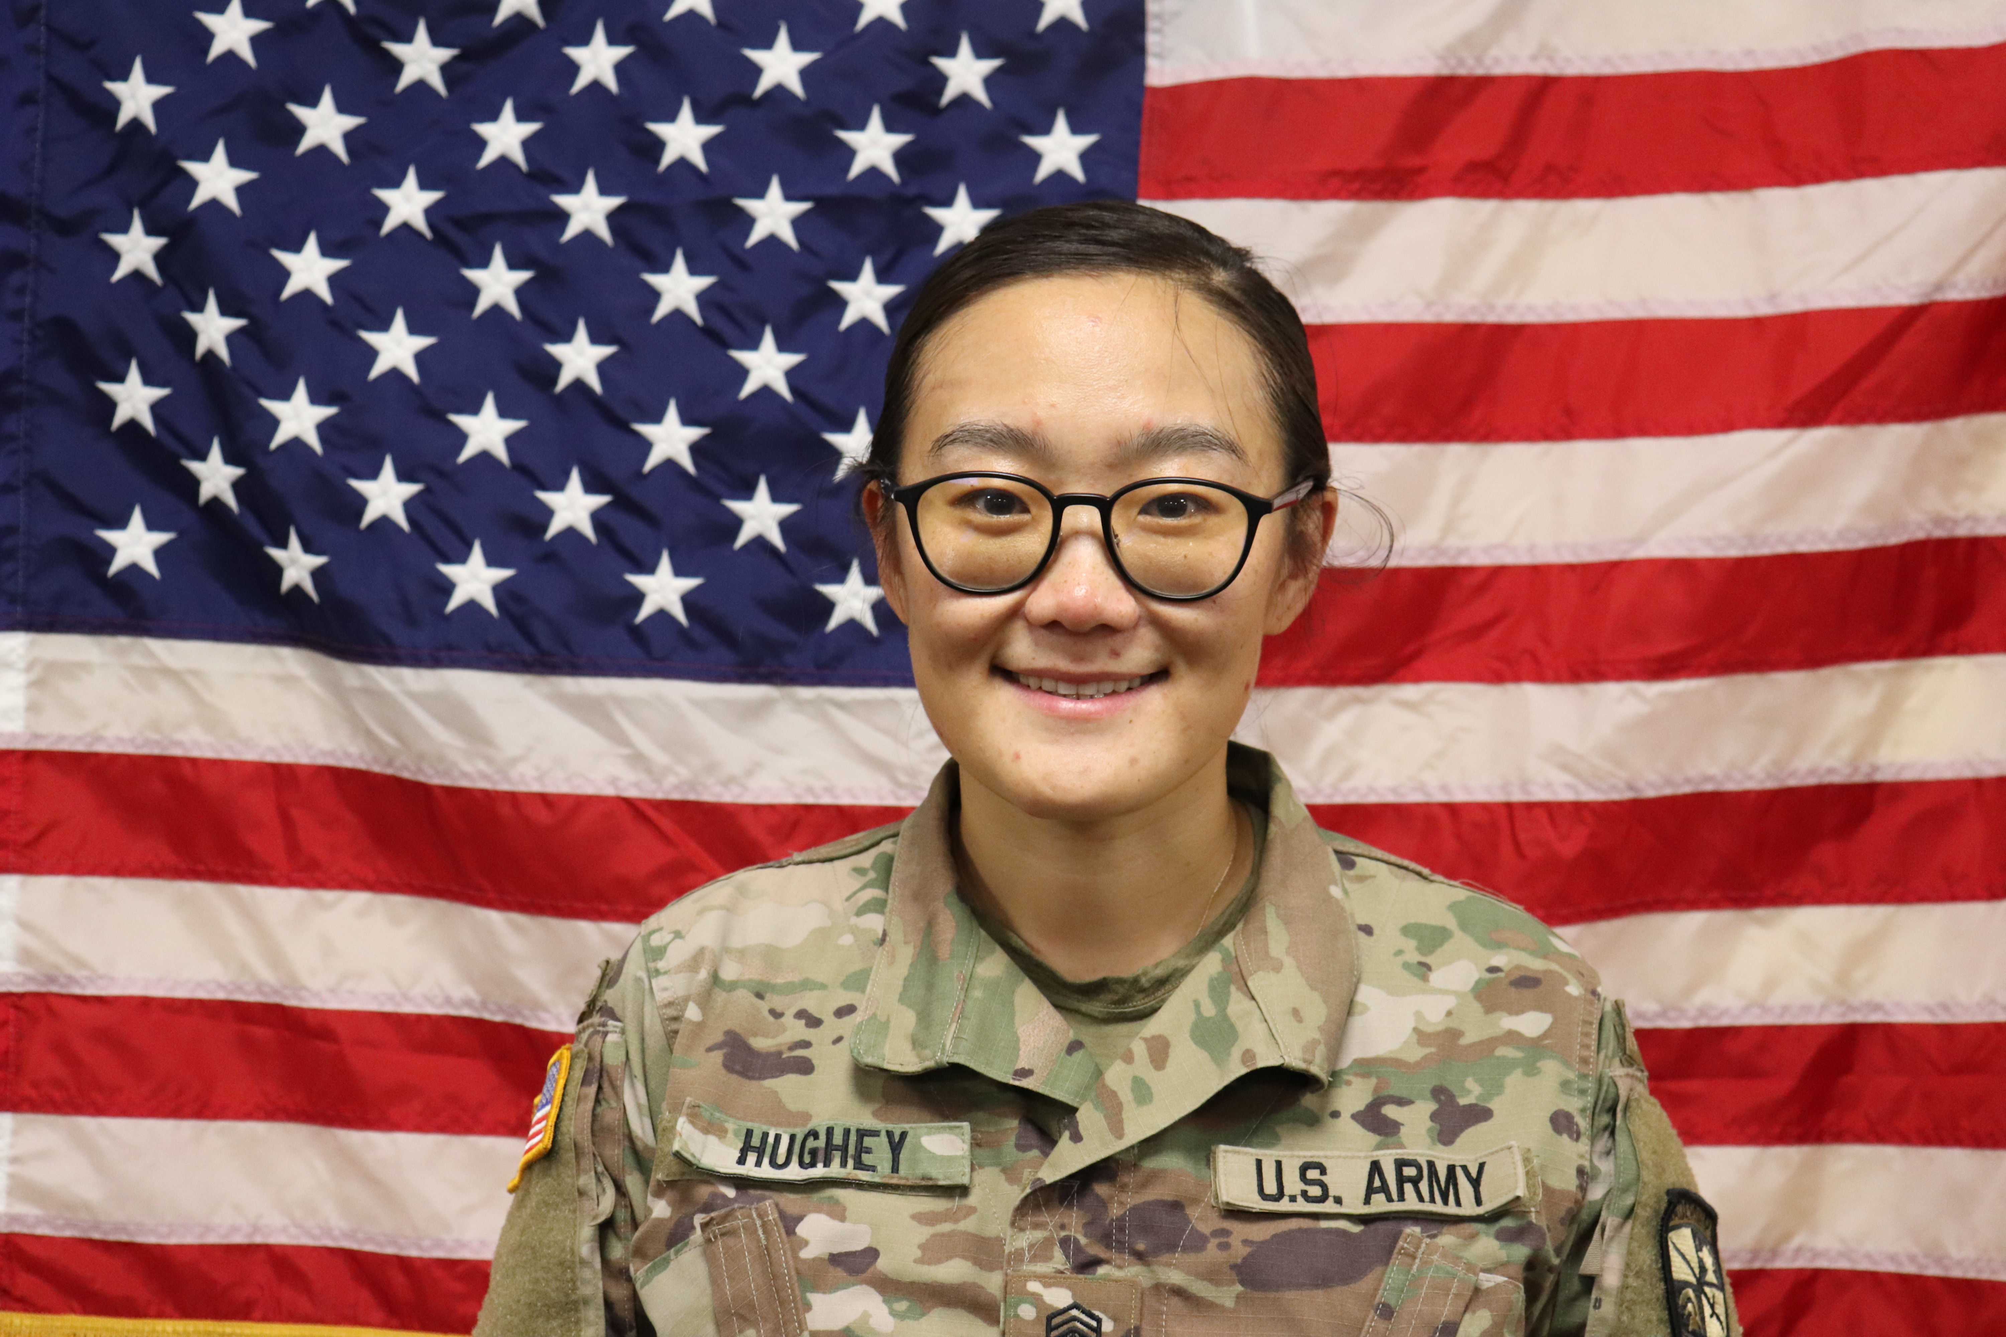

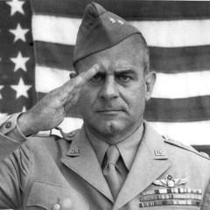
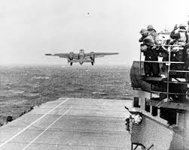
Lead from the Front – Lt. Col. Doolittle
Cecelia Hughey
Florida State University – Tallahassee Campus
Abstract
All the men know it’s a highly secret, dangerous, critical, and impossible mission, but when Doolittle expressed the significant impact of WWII, he did not lose a man. Most of the raiders are inexperienced and recently graduated from training. However, when they heard James Doolittle lead the operation, nobody feared for their lives, even though everyone knew the mission was probably a one-way ticket. “Most of the guys and I volunteered because Jimmy Doolittle asked us to. (Doolittle) had a reputation as a legendary flier, and when I heard he was leading the effort, I wanted to go,” said retired Lt. Col. Robert Hite after a ceremony to commemorate the 65th anniversary of the Doolittle Tokyo Raid. A military historian described Doolittle as having “integrity, morality, understanding, accepting responsibility for your actions and providing encouragement and praise when necessary”. Lt. Col. Jimmy Doolittle presented a great character of “working with a make an impact person” during the Doolittle Raid mission, which had a significant impact during WWII. Before the mission, all the 80 raiders did not know anything about the mission. They only knew the mission was extremely dangerous, was not until they board the USS Hornet, Doolittle told the raiders about the mission. Before the took off, due to the early takeoff and hours ahead of their schedule, nobody felt scared rather all focused on the objectives and the job they had to do.
Discussion
We all heard about famous World War II generals such as Dwight D. Eisenhower, Omar Bradley, and more. However, not many people heard the name James H. Doolittle and the Doolittle Raid. After December 7, 1941, Japan attacked Pearl Harbor, Doolittle was appointed to lead the planning of the first aerial raid on the Japanese mainland. Doolittle led 80 Soldiers and 16 modified B-25s to attack the Japanese homeland. Although the damage was mild, the operation boosted aligns morals and led to a significant turning point in the war. Doolittle’s leadership style put people at ease, invited questions and patiently treated people with respect, and set an example, which leadership characteristics led to the tremendous success of the mission. After Doolittle led the Great Raids on WWII, he received the Medal of Honor from President Franklin D. Roosevelt at the White House and advanced two ranks to Brigadier General. He also received two Distinguished Service Medals, the Silver Star, Three Distinguished Flying Crosses, Bronze Star, four Air Medals, and decorations from Great Britain, France, Belgium, Poland, China, and Ecuador. The raid is known as the “Doolittle Raid,” and his subordinates are the “Doolittle Raiders”
Put egos and fear aside
Boldness and risk-taking are critical to achieving greatness
Role model to the teams
Rely on the skills of their team members
Respond favorably to unwelcome changes
Do not micromanage
Characteristic
References
Air & Space Forces Magazine. (2021, February 20). Heroes and Leaders: Jimmy Doolittle | Air & Space Forces Magazine. https://www.airandspaceforces.com/article/heroes-and-leaders-jimmy-doolittle/
Air Force. (n.d.). GENERAL JAMES HAROLD DOOLITTLE. https://www.af.mil/About-Us/Biographies/Display/Article/107225/general-james-harold-doolittle/
Air Education and Training Command. (2007, April 20). Raiders point to leadership’s key role in Doolittle Tokyo Raid. https://www.aetc.af.mil/News/Article-Display/Article/263303/raiders-point-to-leaderships-key-role-in-doolittle-tokyo-raid/
Henman, L. (2019, May 2). We Need More Heroes: 6 Lessons in Leadership from War Hero James Doolittle. Corporate Compliance Insights. https://www.corporatecomplianceinsights.com/we-need-more-heroes-6-lessons-in-leadership-from-war-hero-james-doolittle/
History.com Editors. (2020, July 1). James H. Doolittle. HISTORY. https://www.history.com/topics/world-war-ii/james-h-doolittle
James Harold Doolittle. (n.d.). Congressional Medal of Honor Society. https://www.cmohs.org/recipients/james-h-doolittle
Lead from the front
Intellect, courage, and personality
Master of the calculated risk
Very persuasive
Out-of-the-box thinking
Leadership

