Slide 1
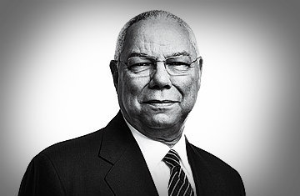
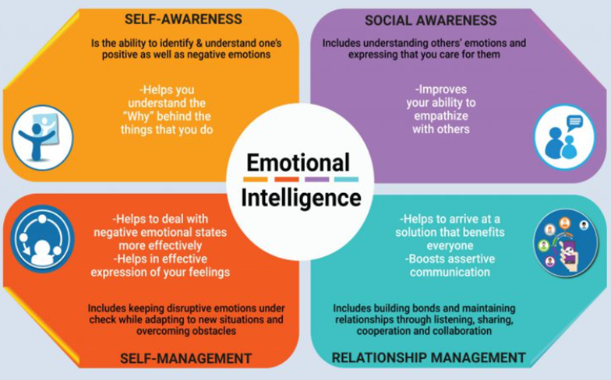
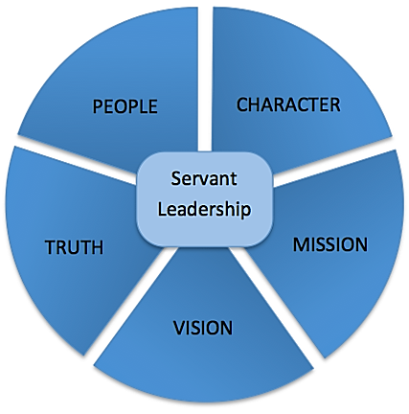
Colin Powell: A Servant for Diversity, Freedom, and Democracy
Mark Holden
EIN-5184 Florida State University Panama City
Abstract
Contributions
Colin Powell was one of modern America's most decorated and respected Generals, Statesmen, and Leaders. General Powell's s story is replete with practical and hard-earned examples of leadership successes and failures, promotions for diversity, and a life of serving others. His career, books, and speeches afford us lessons such as the Powell Character, the Powell Principles, and the Thirteen Rules of Leadership.“ [2]
Powell’s beginnings were humble but his accomplishments were extraordinary, and these themes resonate with and inspire achievers and leaders worldwide. The System Engineering Leadership research project surveys his catalyzing life moments, his published works, and his professional achievements, to pinpoint the attitudes, values, and motivations that qualify him as one of America’s exceptional leaders.
Powell Doctrine: prioritizing diplomacy, gaining public support, and making sure that there are ground forces and overwhelming strike capabilities before taking military action [3]
Powell Character: Courageous, kind, trusting, and serving…” as citizens of this great country, have an obligation to not only raise our own children in this manner so that they can be a great new generation; we have an obligation to do this for all of our children, especially those children who don’t have this family structure, or whose family structure needs some help. [4]
Thirteen Rules of Leadership: invaluable Insights attained in over fifty years of servitude to the people of the United States, reflecting a high degree of Self-Awareness
It Worked For Me In Life and Leadership Powell, C., Koltz, K. (2012). Ballantine.
My American Journey, Powell, C. L., & Persico, J. E. (2003) Ballantine.
Leadership traits
[1]
Servant Leader
Thirteen Rules of Leadership
1. It will look better in the morning: Maintaining Confidence and Optimism
2. Get Mad, then Get over it: Have self-respect and courage to not let your emotions misguide you.
3. Let go of your ego: Perfection is impossible. Recognize defeat and maintain self-confidence by keeping your ego in check.
4. It can be done: pursue your vision with optimism, passion, and flexibility.
5. Be careful what you choose: Accept your choices and learn from them, and from those it affects.
6. Make good decisions: trust in yourself, and others but be decisive.
7. Don't let someone else make your decisions: take full responsibility for failure and yield total credit for successes.
8. Check the small things: maintain perspective by seeing for yourself.
9. Share the credit: Provide your people the sense of credit and recognition they need.
10. Remain Calm and Kind: Be calm, caring, interested, and consistent to inspire others, build respect, and trust.
11. Have a vision: Embed your sense of purpose into the hearts of every follower and they will achieve your vision.
12. Don't listen to your fears or naysayers: Don't show fear, be courageous against your fears. Courage leads to progress.
13. Perpetual optimism is a force multiplier: Believe in yourself, in others. If you believe, they will believe.
Powell was a leader with an exceptional degree of emotional intelligence:
As a servant-leader, he built a coalition of trust, encouraged diversity, and put all others first
Service Before Self-Interest
Listen first to affirm others
Inspire trust by being trustworthy
Nourish others & help them become whole [6]
[8]
Self-Awareness: demonstrated through the reflection of his life in biographies, and echoed throughout his Thirteen Powell Principles.
Self-Management: Two principles “Perpetual optimism is a force multiplier” and Remain Calm & Be Kind explain the power of discipline and a positive attitude, which is contagious and seeds innovation.
Social Awareness: “a leader builds trust with a clear mission and selfless service. Good leaders are trusted by followers…leaders must take organizations past a level that management and science says is impossible. [2]
Relationship management: “The day soldiers stop bringing you their problems is the day you have stopped leading them. They have either lost confidence that you can help them or concluded that you do not care. Either case is a failure of leadership." [5]
[7]
References
[1] Photograph of Colin Powell (n.d.) https://64.media.tumblr.com/3e43d3362e96788ae4a039fdb53c812e/tumblr_inline_onw6orGZzS1sacoli_400.jpg
[2] Powell, C., Koltz, K. (2012). It Worked For Me. In Life and Leadership. 3-9, 18-19, 22-23, 201-204, 211. Harper-Collins. https://archive.org/details/itworkedformeinl0000powe
[3] Monten, J. Bennett, A. (2010). Models of Crisis Decision Making and the 1990–91 Gulf War. Security Studies. 19 (3): 486–520. doi:10.1080/09636412.2010.505129
[4] Powell, C. (2015). Video Interview. Who Mentored You? https://www.hsph.harvard.edu/wmy/celebrities/colin-powell/
[5] Harari. (2002). The Leadership Secrets Of Colin Powell (1st Ed.).129, 136, 138-139. McGraw-Hill.
[6] Daft,R. (2018) The Leadership Experience. 178-179. Cengage Learning.
[7] Hong, T. (2015)n Why Servant Leadership is Important. https://nuruinternational.org/blog/leadership/why-is-servant-leadership-important-to-nuru/
[8] Emotional Intelligence. (2023). Retrieved February 19, 2023, from https://3cubeservices.com/emotional-intelligence/

