Slide 1
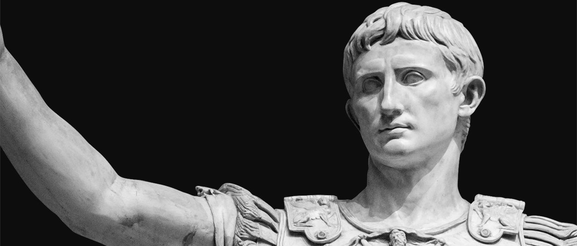
Augustus Caesar - The Greatest Emperor of Rome
David Harris
Florida State University - Panama City
Abstract
Perhaps the most important indication that Augustus Caesar was a great leader is the reverberation of his actions through time. His depth of leadership was the standard of which all Roman emperors were measured. Furthermore, leaders from all walks of the world have tried to emulate his results. Some, with great success.
Even today, there are many military and organizational leaders who look to his motto, "Festina Lente" or "Make haste, slowly," for guidance (Mukunda, n.d.).
Some other examples of his impact was his implementation of the following:
Expansion of the Roman roads network
Roman postal service
Regular Police and Fire service
System of taxation and Census (National Geographic Society, 2022)
Augustus Caesar, the first emperor of ancient Rome, is one of the greatest leaders of antiquity due to his exceptional leadership qualities. In many ways, Augustus’ influence has rippled through time and set a course to the modern world. From his early life to his rise to power to his ultimate ascension to deification, this project will describe multiple examples of how Augustus utilized his leadership traits for the betterment of Rome, the Senate, and the Roman citizens.
Impact on Modern Leadership
Courage is the ability to maintain mental and moral strength through doubt, confusion, and most importantly, fear (Daft, 2018).
Augustus displayed courage throughout his life as he was known for his strong moral values and his commitment to upholding the traditions of Rome. He implemented policies that focused on social stability and moral renewal, such as his efforts to promote marriage and family values (National Geographic Society, 2022). This stance presented him with difficulty as he exiled his daughter and eventually his granddaughter for acting against these values (Grant, 2023). He also took steps to ensure that corruption was minimized in his administration by punishing those who engaged in dishonest behavior (Six Aspects of Leadership Learned From Caesar Augustus, n.d.).
Courage
Leadership Traits and Styles
Leadership Traits of Augustus Caesar
Strategic thinker: A master of diplomacy and an opportunist, he was able to turn the Roman Republic into an empire through a series of political and military maneuverings that were carefully planned and executed.
Visionary: He was able to see the potential for the Roman Empire to become a great power. He had a clear vision for the future and worked tirelessly to achieve his goals. He was responsible for many significant changes, including the expansion of Rome's borders, the introduction of a new political and economic system, and the establishment of a strong and centralized government.
Leadership Style of Augustus Caesar
Authoritarian: He was not afraid to use his power to maintain order and to stamp out any opposition. He was known for his strict and often brutal punishments for those who defied his rule.
Charismatic: Despite his authoritarian style, Augustus was a charismatic leader who was widely admired by the people. He was known for his charm and his ability to win people over with his words and actions (Whitney, 2007).
Daft, R. L. (2018). The Leadership Experience. Cengage Learning.
Grant, M. (2023, February 4). Augustus - Personality and achievement | Britannica. Encyclopedia Britannica. Retrieved February 25, 2023, from https://www.britannica.com/biography/Augustus-Roman-emperor/Personality-and-achievement
Mukunda, G. (n.d.). Why The First Roman Emperor’s Motto Matters: Move Slowly To Move Quickly. Retrieved February 25, 2023, from https://www.forbes.com/sites/gautammukunda/2020/05/18/why-the-first-roman-emperors-motto-matters-move-slowly-to-move-quickly/?sh=7796f8e94ef7
National Geographic Society. (2022, October 12). Caesar Augustus. Resource Library. Retrieved January 21, 2023, from https://education.nationalgeographic.org/resource/caesar-augustus
Six Aspects of Leadership Learned From Caesar Augustus. (n.d.). Xenia Area Chamber of Commerce. Retrieved March 5, 2023, from https://www.xacc.com/news-releases/general-news/2634-six-aspects-of-leadership-learned-from-caesar-augustus.html
Whitney, G. (2007, March 2). Gleaves on the Leadership of Augustus. ScholarWorks@GVSU. Retrieved February 25, 2023, from https://scholarworks.gvsu.edu/cgi/viewcontent.cgi?article=1017&context=ask_gleaves
References
Communication
Augustus was a great orator as he was highly educated (Whitney, 2007). This meant that he could effectively communicate with his advisors, adversaries, and general public.
He utilized propaganda heavily by generating coinage with depictions of himself with mottos and phrases.
By implementing a postal service, he was able to communicate faster and more fluidly with the entire empire (National Geographic Society, 2022)

