Slide 1
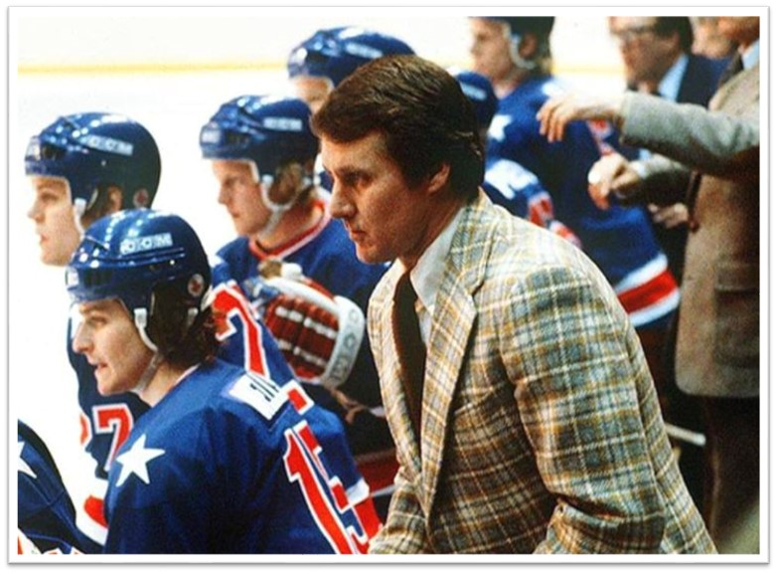

Great Opportunity – The Leadership of Herb Brooks
J. Everett Hansen
Florida State University Panama City
Unifying
“Let me start by issuing you a challenge: be better than you are.
-Herb Brooks
Visionary
The ability to manufacture confrontation is an atypical approach to unification; its effectiveness in the hands of Brooks’ is a testament to his brilliance. As recalled by John Gilbert, longtime writer for the Minneapolis Tribune, “...Herbie tended to look for windmills he could out-tilt. His search for adversaries were often attempts to develop ‘us against them’ scenarios to get his players’ adrenaline pumping” (2010). Brooks knew that a common enemy amongst his players had the power to supersede old rivalries and would unite them in their pursuit. Oftentimes Herb made this enemy himself, noting, “The guys from the East and West hate each other, and the only way to keep them from hating each other is to make them all hate me” (Gilbert, 2010).
Herb was, if anything, a visionary leader. There was no member of the U.S. team who had a better understanding of both the challenges associated with and possibility of winning the gold medal at Lake Placid. Brooks motivated and led by convincing others to share in his vision of success. According to center Mark Johnson, “That’s why he was so successful. He had vision, he was the ultimate salesman, he sold us on what he was teaching, and we believed it” (Gilbert, 2010).
Self-Aware
Brooks’ self awareness, the “secret ingredient for leadership success,” was perhaps his greatest asset in enabling his ability to lead through vision (Daft, 2018). Herb, like many other successful leaders, had the perfect balance of thinking, feeling, and doing. Herb’s awareness of other’s strengths and weaknesses was just as strong as his own, which enabled him to build the seemingly perfectly well-rounded team that won gold in Lake Placid. Self-awareness also allowed Herb to exercise some of his most aggressive motivational tactics, accepting the role of foe vice friend in order to push his players to their limits in the name of growth. “When leaders deeply understand themselves, they remain grounded and constant, so that people know what to expect from them” (Daft, 2018, p. 100).
Emotionally Intelligent
Though rough around the edges, Herb Brooks quietly demonstrated an incredible amount of emotional understanding. He knew exactly when he could push his players harder and further for the sake of their own growth. At the same time, he possessed a keen knowledge of when personal stressors were too great, and any additional burden brought on by his coaching risked breaking an individual player rather than building them up. Brooks’ emotional intelligence fostered connection with his players at levels which transcended the ice ensured they were free of as much personal burden as possible in order to be fully-focused on winning hockey games. This “generosity of spirit” as termed by goalie Jim Craig is a hallmark of Brooks’ leadership (Craig, 2021).
Abstract
The history of sport is no stranger to inspiring victories or remarkable accomplishments, but the story of the 1980 United States Olympic Hockey Team and their coach, Herb Brooks, continues to inspire more than 40 years later. The leadership of Herb Brooks, his “...directing, driving, cajoling, teaching, digging, nurturing” style, his tenacity combined with a hidden empathy, was essential to his team’s success (Abicht, 1987, p. 6). Without Brooks, the “Miracle on Ice” never would have been.
References
Abicht, A. (1987, Spring). Brooks’ Goal: Paying back his life sport. St. Cloud State University Outlook, 10(1). 6-7.
Daft, R. (2017). The Leadership Experience. (7th ed.). Cengage Learning.
Craig, James. (2021, February 22). Al Michaels & Jim Craig Talk ‘Miracle on Ice’ Anniversary with Rich Eisen | Full Interview | 2/22/21. YouTube. [Video]. https://youtu.be/IxpcbirnQfk.
Gilbert, J. (2010). Herb Brooks: The Inside Story of a Hockey Mastermind. MVP Books, Minneapolis.

