Slide 1
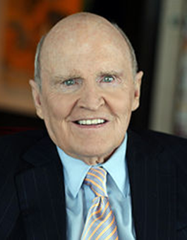
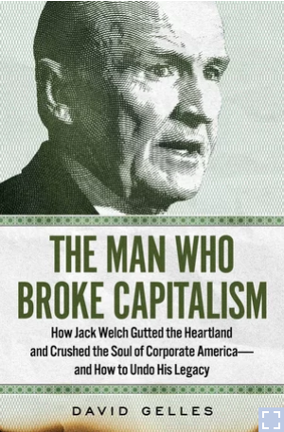
Jack Welch: CEO of the Century, Famous or Infamous?
Glenn A Giordano
Florida State University Panama City
Leadership Contributions
“Before you are a leader, success is all about growing yourself. When you become a leader, success is all about growing others.” – Jack Welch
Social Dynamics
Moral Leader?
Welch’s emphasis on shareholder value may have clouded some of the other aspects of ethical leadership. This take on his leadership is further illustrated by looking at the GE that Welch left in his wake. For example, “celebrated GE Capital became a cookie jar to smooth quarterly earnings with little transparency about systemic risk which became more apparent in a new regulatory climate. Former GE executives later admitted to SEC investigators, for example, that the insurance business hid declining results over the years, burying risks that ultimately kept the company from booking needed reserves as shortfalls emerged” (Sonnenfeld, 2021). Is this ethical? Does it serve the general welfare? It depends on how one defines such things. Welch believed he was acting ethically in the best interest of his shareholders; but this seems to have left the greater society at large in a bit of a blind spot.
The Firings
Welch’s critics have stated that he seemed to enjoy firing people. They have suggested that he may hold the all time record for the most laid off employees. In just the first half of the nineteen-eighties he laid off more than one hundred thousand workers. Many of the jobs that Welch cut were offshored. At the time it was financially expedient to shift American manufacturing abroad. This practice has not aged well and ultimately ushered in the decimation of America's manufacturing base.
The Man Who Broke Capitalism
One of the most critical accounts of Welch’s long term impact on the corporate and social landscape.
Welch will go down in history as one of the most influential and controversial leaders of his century. His aggressive and dynamic style along with his passion for innovation and tearing down bureaucratic silos made a lasing positive influence in corporate leadership. This is in contrast to his win at all costs near singular focus on profit and shareholder value which many argue prompted a degree of short sighted, morally questionable behaviors that reflected lack of social responsibility.
Emotional Intelligence
Emotional intelligence refers to a person’s abilities to perceive, identify, understand, and successfully manage emotions in self and others. Jack Welch, by accounts was a master at this skill. On the positive side, his mastery of emotional intelligence allowed him to achieve amazing and positive changes bringing about value for shareholders. For example, tearing down barriers to communication and driving a culture shift from ‘old school’ inefficient corporate structure. He clearly recognized what he could accomplish, and the usefulness of emotional intelligence. However, a review of the social and personal carnage in his wake give pause. Did his mastery of this skill serve the greatest good, or merely the short term gains of his shareholders and his personal ambitions.
Conclusion

