Slide 1
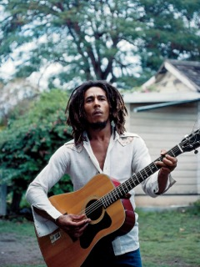
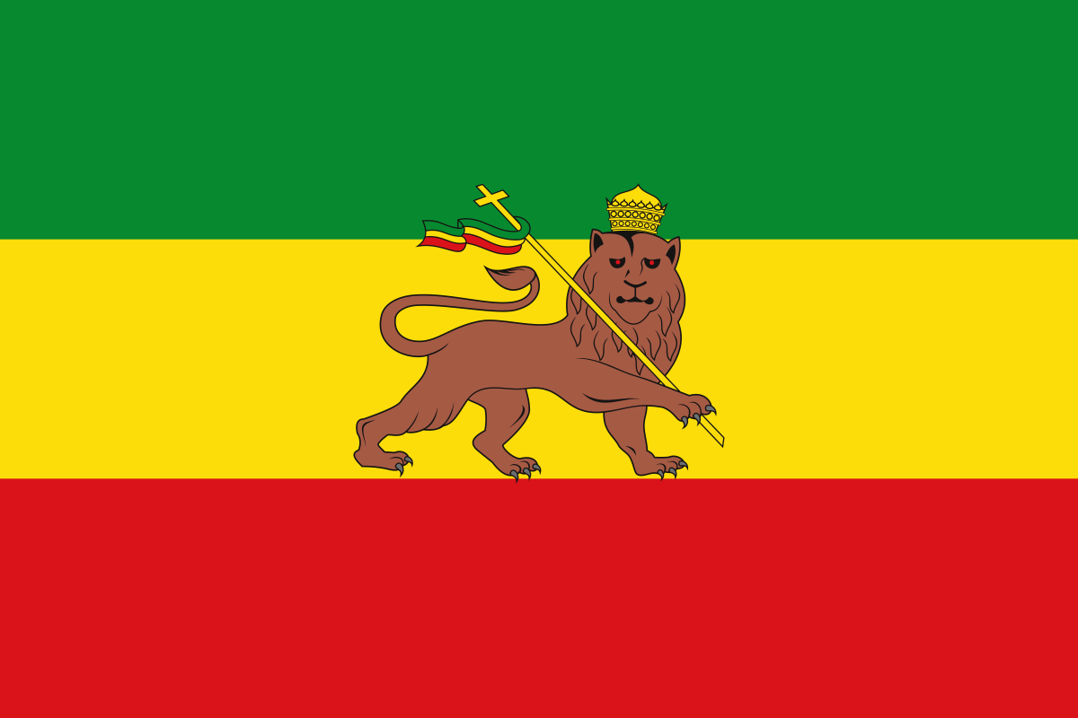
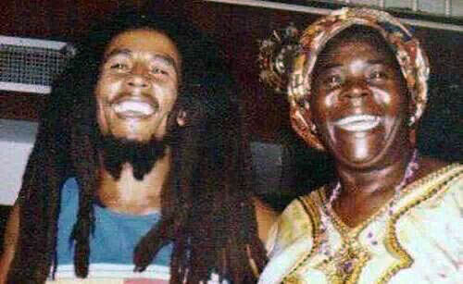
Peace, Love, and Unity: Bob Marley’s Influence as a Leader
Anna Gilliard
Florida State University
Abstract
Traits and Behaviors
Although he may not be the first person to come to mind when thinking of a leader, Bob Marley exhibited many leadership qualities and characteristics that align with other successful leaders. He was passionate about the things he believed in including peace and freedom among and within countries, as well as the Rastafarian faith. Marley used his platform to spread positive messages and provide hope for people around the world living amongst poverty and injustice. This project evaluates his leadership style and the way that it aligns with the three required texts for EIN5184 Systems Engineering Leadership.
Leadership Characteristics
Positivity
Honesty
Relatable
Consideration for others
Emotional Intelligence
Marley had a deep understanding of himself and his emotions, largely because of his religion and culture. Rastas are known for using meditation as a contemplative inquiry and universal consciousness. It is a way to understand one’s inner self and understand thoughts and emotions. He used his emotions to write and perform powerful songs that reflected his emotions to influence a positive change. Marley chose to put himself in potential danger to express his feelings that aligned with so many others in oppression. This self-awareness and self-confidence is a large part of his success.
Courage
Marley had the courage to stand up for what he believed in against people who had far more powerful than him. This shows that he had the courage to assume responsibility, challenge, participate in transformation, and serve.
Motivation
Personal Motivation
Marley was mixed-race and raised by a single mother amongst poverty and injustice in the ghetto of Jamaica. He recognized the struggles he and his community faced and used his musical talents to share his reality. Throughout violence towards him from the Jamaican government and declining health, he continued to share his inspirational message of peace, love, and positivity to others who were facing the same struggles.
Motivational Themes
Visionary
Make an impact
Experience the ideal
Overcome
Serve
Explore
Improve
Develop
Conclusion
The greatness of a man is not in how much wealth he acquires, but in his integrity and his ability to affect those around him positively.
– Bob Marley
Bob Marley’s leadership led to the independence of Jamaica from the British government, as well as the independence of Zimbabwe. He introduced the world to reggae and Rastafarianism, both of which have ideas rooted in freedom and unity. Marley’s message and music remains popular because of the resonation with people of all backgrounds. His ideas are still an inspiration to people around the world.

