Slide 1
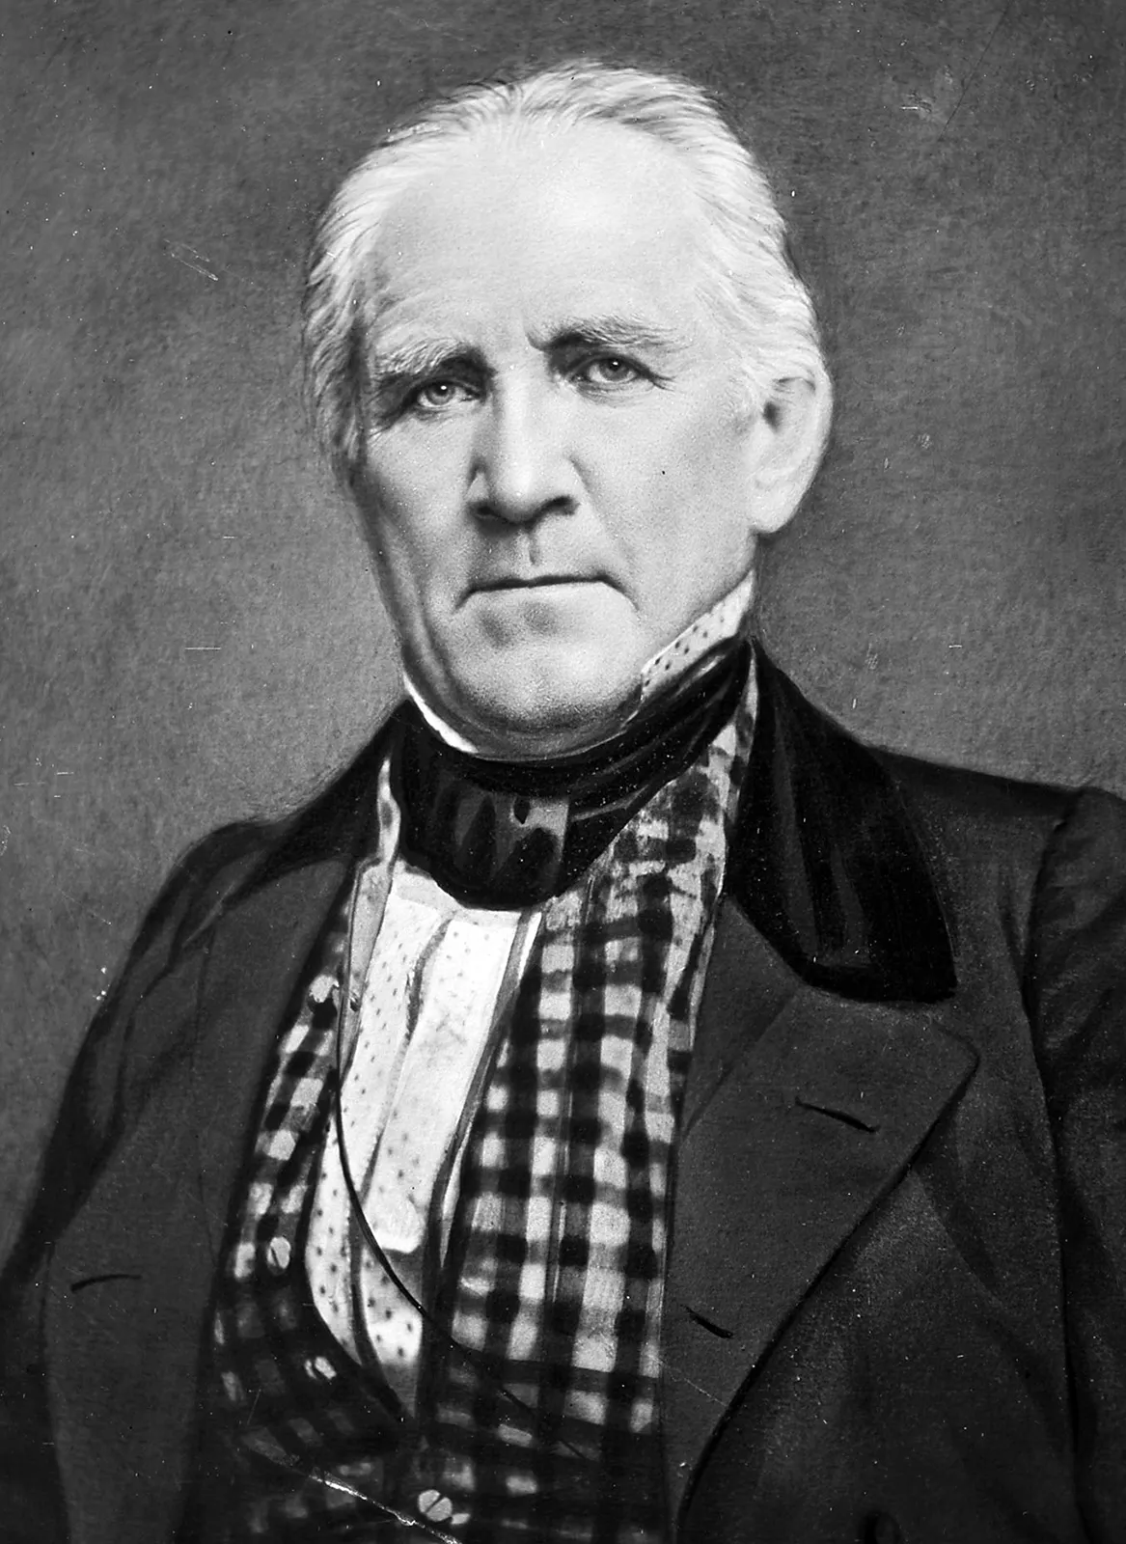
Remembering Sam Houston: Legacy of a True Leader
Michael Fults
Florida State University Panama City
Sam Houston was a towering figure in the history of Texas, serving in several key roles including the first president of the Republic of Texas, the first senator of Texas after it joined the union, and later as a governor. Houston's leadership skills were widely recognized, including his bravery, determination, and charisma. As a powerful speaker, he was able to inspire people to rally around his cause and had a talent for bridging political divides to find common ground. This project will examine the impact of Houston's leadership style, traits, and behavior on those around him, ultimately helping him to achieve his vision of a free and independent Texas. Today, Houston's legacy continues to inspire Texans and serves as a testament to his exceptional leadership abilities.
Abstract
Reflection
Leadership Qualities
Encyclopædia Britannica. (n.d.). Battle of San Jacinto. Encyclopædia Britannica. photograph. Retrieved March 3, 2023, from https://www.britannica.com/biography/Antonio-Lopez-de-Santa-Anna#/media/1/521266/221023.
San Jacinto Museum of History. (2022). Samuel Houston - general of the Texian Army. San Jacinto Museum of History. Retrieved March 4, 2023, from https://www.sanjacinto-museum.org/The_Battle/Commanders/Sam_Houston/#Pane1
Smith, E. (2022). Sam Houston &amp; Chief Bowl (Duwali) (Aka "The Treaty") . Native Americans. photograph, East Texas History. Retrieved March 4, 2023, from https://easttexashistory.org/items/show/310.
Encyclopædia Britannica, inc. (2023, February 26). Sam Houston. Encyclopædia Britannica. Retrieved March 4, 2023, from https://www.britannica.com/biography/Sam-Houston
“A leader is someone who helps improve the lives of other people or improve the system they live under.”
— Sam Houston
References

