Slide 1
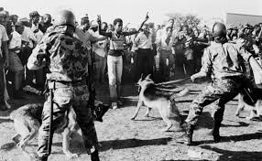
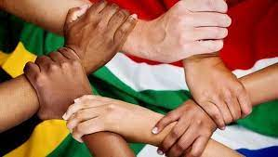
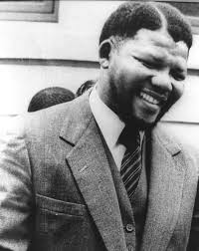
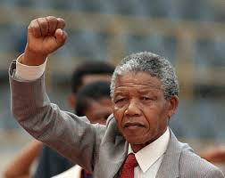
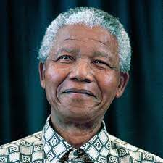
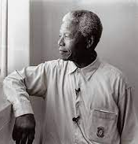
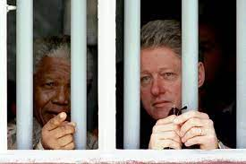
Nelson Mandela—The Leader who rode a Unicorn
By Daniel Fopa –Florida State University, Panama City
ABSTRACT: Nelson Mandela is one of the most iconic leader and person of our time. His leadership was a journey through the tumultuous history of South Africa's multi-cultural and multi-racial society ruled by a ruthless apartheid regime. His leadership styles were tested and refined by events and time, but Mandela the prince, terrorist, the prisoner, and charismatic leader stayed true to his vision for South Africa.
A student of life and a master of his destiny:
Nelson Mandela’s leadership proved that ambition, resilience, and self-awareness are leadership ingredients essential for success .At Fort Hare University he constantly fought against injustice and was expelled for organizing student boycott of a powerless Student Representative Council. Yet his resilience kept his ambition, justice for all, for close to 60 more years. During this period, he joined the African National Congress (ANC) and fought vehemently against apartheid. Earning a sentence to life imprisonment and hard labor. For 27 years in prison Mandela was able lead the fight against apartheid, learn and master the culture and language of the oppressor and earn his Law degree started 50 years earlier. Mandela proved that in order to become a Master one must be a student of life and learn to win against all odds and including our own doubts.
The Xhosa Prince:
Young Mandela tendered to cattle as all Xhosa boys did, and maybe learned his fundamental leadership lesson there. As part of Thembu Royal clan of Mvezo, he aspired to a career as interpreter for Native Affairs Department and then a privy of the royal court. During his college education, he was leader and an activist
Motivation Code Optimism, Self-Confidence, and Honesty:
The setbacks faced by Nelson Mandela did not rob him of his motivation. Life imprisonment sentence, opposition, and family losses, and illness shook him to his core, but Mandela was animated by a multitude of motivations themes. His achiever potential motivation theme let him see the future when no one else did; his meet the challenge, collaborate, and leaner motivation themes kept his eyes on the prize. They also fortified the honesty and integrity that characterized the ethical climate he built between himself, the ANC, and apartheid regime. At the same time the make it right and establish motivation themes worked plus his courage, self-confidence and optimism helped strengthen the foundation of his vision over a period of about 60 years. All this worked because of his emotional intelligence used to promote reconciliation and justice. This emotional intelligence was the reason he divorced Winnie Mandela to save the struggle.
Released in February of 1990, a year after he earned his law degree, He went on to lead the ANC, win Noble Peace price, and transformed South Africa into a nation where Indians, whites, Colored, and blacks all felt seen and accepted. He rode the unicorn, when everyone thought it could never be done.
After expulsion from college, he joined the African National Congress (ANC), and later created the first black-owned law firm. After the ANC Youth League, he cofounded the armed wing of the ANC to reciprocate the apartheid regime’s violence against black citizen. Eventually, he was captured and sentenced to life imprisonment, with forced labor.
People make leaders, and good leaders make great people:
With Nelson Mandela it was always about the people. He created Mandela & Tambo, the first black-owned law firm, to help people fight against apartheid. He created the armed-wing for the ANC, Umkhonto we Sizwe, after the Sharpeville massacre was for the people. His leadership style was marked by a people-oriented behavior. Even during negotiation with the apartheid regime, he turned down offers of early release and other perks because he aimed for the greater good that was for all his people.
But he people-oriented behavior lacked a diplomacy flavor. He seemed not very concerned about the plight of the Cuban minority victim of unfair treatment under Fidel Castro’s tenure. Fidel Castro was a source of support to Nelson Mandela and the struggle against the apartheid regime, and that seemed enough. This lacking was his most prominent Blind Spot.
The President:
The Terrorist /Lawyer:
While in prison, Mandela resumed with his education taking classes by correspondence, learned Afrikaner culture and language. More importantly still work hard against apartheid and finally brokered a deal that ushered a democratic era in South Africa.
Conclusion: Mandela once said, “I am fundamentally an optimist. Whether that comes from nature or nurture, I cannot say. Part of being optimistic is keeping one’s head pointed toward the sun, one’s feet moving forward. There were many dark moments when my faith in humanity was sorely tested, but I would not and could not give myself up to despair. That way lays defeat and death.” ~ Nelson Rolihlahla Mandela (Madiba)
The Prisoner:

