Slide 1
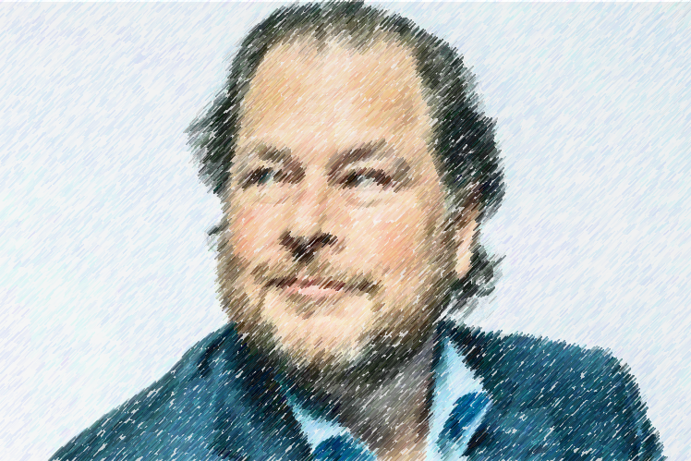
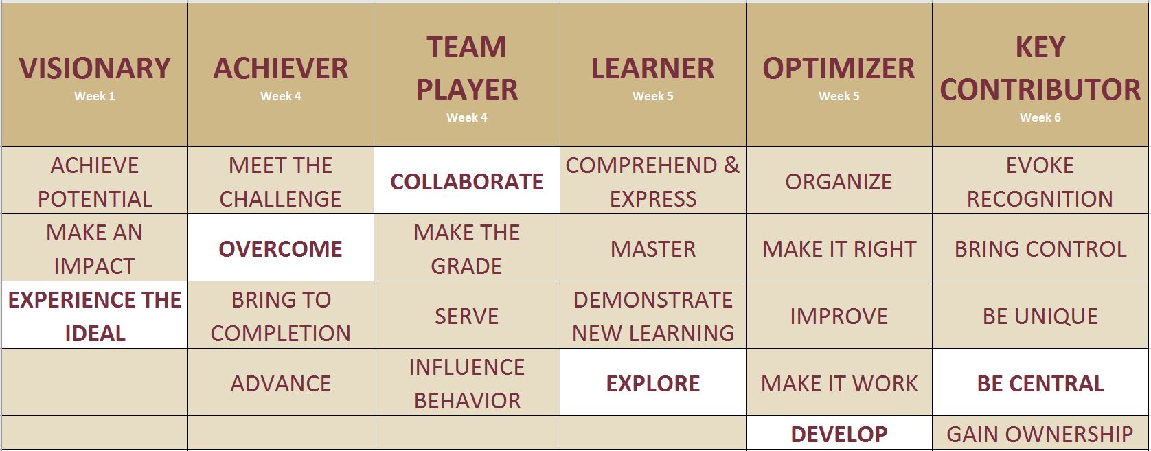

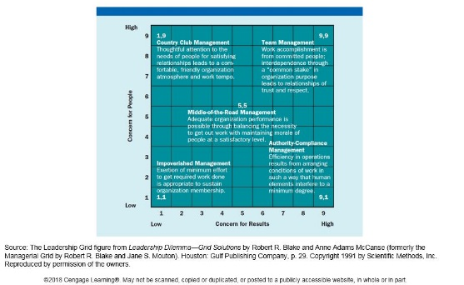
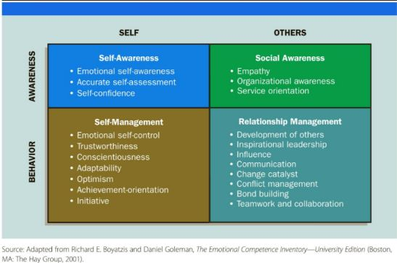
Closing Bell: Examining Benioff’s Leadership Effectiveness Then and Now
André L. Evans
Florida State University Panama City
Abstract
“
Discussion
We believe business is the greatest platform for change.
We are passionate proponents of stakeholder capitalism, committed to doing well by all our stakeholders — our customers, employees, partners, communities, the planet, and society as a whole.
Introduction
Marc Benioff co-founded Salesforce in 1999. The company has provided shareholders with a 10-year price total return of 252.5%. Recent macroeconomic conditions have put Salesforce’s profitability in the spotlight. Over the past 12 months Salesforce market capitalization has decreased from $281B USD to $145B USD. He is a stakeholder capitalist that believes business is the platform for social change. In week one, Salesforce and Benioff’s leadership started to come under attack for the first time in roughly 25 years. One by one, activist investors aimed at changing how the company is run are piling in. Unlike Benioff, these activist investors have more traditional objectives and subscribe to shareholder capitalism, believing it is the social responsibility of the business to continually increase profits. To complicate matters, Benioff’s technology represents a gateway into the fourth industrial revolution where everything is digitally connected. Benioff’s tendency to be a relationship-based leader runs as deep as his cloud-computing technology aimed at efficiently connecting stakeholders in the cloud. Benioff has been recognized on several occasions throughout Salesforce’s history as one of the best Chief Executive Officers (CEOs) and leaders in modern time. This case study will systematically evaluate Benioff’s evolution as a leader, comparing and contrasting his leadership style under favorable and unfavorable economic conditions to see if the knowledge, skills, and attitudes that got him here today will keep him here tomorrow. Initial success metrics are known in week seven when Benioff announces quarterly earnings after the stock market’s closing bell on March 1, 2023.
Week 1
This week the study assesses and identifies Benioff as a visionary who is motivated by experiencing the ideal. Characteristics associated with this motivation include people who are dissatisfied with the present, who are able to generate buy-in across multiple stakeholders, who are flexible and open to feedback and who are persistent in their objective of turning a vision into reality. Ironically, the shadow side of this motivation is that they sometimes are unable to face reality and want to execute the objective their way or no way at all. The very motivation that brought Benioff to these levels contain weaknesses that could facilitate his downfall. His ability to manage these emotions and behaviors throughout the duration of the study will likely determine his pending success or failure and aid in determining his emotional intelligence maturity level.
Week 2
Two large investors buy multi-billion dollar stakes in Salesforce. Critics begin to blame aggressive acquisitions and Benioff’s hyper focus on social change as key contributors to poor operating margins. His trust and integrity are under fire as investors attempt to establish themselves as equally-weighted stakeholders.
Week 3
Four activist investors are involved with Salesforce and a nomination process has begun for a new board of directors. Benioff begins to layoff 10% of the workforce which he announced in January, 2023 and takes a major misstep by not effectively communicating the layoff to impacted employees, bringing into question if all stakeholders are truly created equal.
Week 4
Another activist investor joins the swarm. Benioff is assessed as an achiever and team player. The motivation to overcome by sticking to stakeholder capitalism remains consistent. The shadow side is he may inadvertently make shareholders “the enemy.” His motivation to collaborate in achieving a common goal is threated by the shadow side of losing his identity, neglecting self-care, and “spinning into destructive patterns.”
Week 5
Benioff demonstrates strong emotional intelligence by continuing to build relationships with activist investors but by also going on a “digital detox” to the French Polynesia -- a risk that was identified in week four by his shadow side and mitigated by Benioff’s emotional intelligence this week. His behaviors identify him as an explorer. Investors will need to “set wide boundaries” and explain that “going deeper is a form of exploration” if they want to positively influence Benioff to focus on the day-to-day operations and reduce spending.
Week 6
Additional families and themes are attributed to Benioff’s leadership style most significant being to be central, a behavior that motivates individuals to become a key person who holds things together.
Another activist investor joined the pursuit. Possible motivations for each activist investor was also publicized:
Starboard Value: Growth and profitability
Elliott: Strategic initiatives
Inclusive Capital Partners: CEO Succession
ValueAct Capital: CEO Appointed to Board
Third Point: Growth and Profitability
Strive: Merit-based hiring practices
Week 7
Salesforce presented earnings after the stock market’s closing bell on March 1, 2023. The results were strong company performance, billions in stock buy backs, a commitment to only profitable growth, and optimistic forecasting regarding future performance and technological advancements. The results indicate a balance was struck between both stakeholders and shareholders and was reflected by eight reputable investor analyst corporations raising their Salesforce share price predictions.
And we lead by example, spearheading initiatives in philanthropy, racial equality and justice, climate action and advocacy, and the ethical and humane use of technology. – Marc Benioff, Salesforce CEO
”
Motivational Family and Themes
Methods
The Motivation Code
The motivational code concept maintains that there are specific motivational families and specific themes within each family. These motivations are not discrete. Instead, they influence one another situationally and are used to explain why people are motivated to achieve objectives. Additionally, each motivational theme comes with its own weakness, known as the shadow side. During each week of the study, a specific family was used to examine Benioff’s behaviors for that specific week. Then a theme that best matched his behaviors was chosen in an attempt to understanding what motivational behaviors could be attributed to Benioff. Last, the same family and theme was then used to examine Benioff’s behaviors during more favorable macroeconomic conditions in the company’s history to try and determine if the situation affected the consistency of Benioff’s motivational behaviors.
The Leadership Grid
This study also used the leadership grid to better understand what type of leadership style aligns with Benioff’s motivational behaviors. The intent is to measure Benioff’s concern for people versus his concern for production. That is to say, did he prescribe to more of a relationship-based or task-basked leadership style.
Conclusion
The study indicates that during both favorable and unfavorable macroeconomic conditions, Benioff consistently demonstrated characteristics associated with his motivational themes and shadow side. He consistently demonstrated that his concern for people is stronger than his concern for production, identifying him as a team manager using The Leadership Grid.. Interestingly, while he also consistently demonstrated high emotional intelligence in all categories, his tendency to be a relationship-based leader grew his capability in the relationship management category by accounting for the needs of the activist investors. Because shareholder and stakeholder capitalism are fundamentally opposed in terms of leadership objectives, Benioff achieved balance between the two concepts, indicated by an earnings report in the final week that initially appears to have exceeded the expectation of both stakeholders and shareholders.. Additionally, this use case indicates that relationship-based management over task-based management can produce unexpected monetary returns. Considering the onset of the fourth industrial revolution and the inevitable digital connection between all stakeholders through the Internet of Things it is important, if not required, that many more systems engineering leadership use cases are performed. One noteworthy observation is that the structure and content contained within this study illustrates the roles, responsibilities, and scope of systems engineers, requiring them to have a holistic and interdisciplinary approach to solving problems for all stakeholders. This study used the Theory X and Theory Y model to help make assumptions about Benioff’s leadership values, beliefs, traits and characteristics. Simply put, in regards to interpreting the historical data set, this study approached Benioff’s public accounts by assuming Theory Y – “people do not inherently dislike work and will commit themselves willingly to work that they care about.” By using this approach, the study is limited to interpret that all media accounts, interviews, and other research material used to examine, assess, and measure Benioff assumes he is authentic and the Salesforce culture is transparent. Future weekly accounts that chronical the relationship between Benioff and activist investors (as well as between Benioff and the Salesforce workforce) would help bring fidelity to the initial findings. For example, continuing to monitor Salesforce’s profitability and culture will provide better insights into how Benioff continues to manage these relationships. Furthermore, identifying the board of director nomination results would help to determine if balance was maintained between the company and the activist investors. Next steps should include monitoring the results of Benioff’s succession plan that the investors demanded during the negotiations. If Benioff continues as CEO well into the future, then the succession demand was enough to motivate Benioff to strike balance between shareholders and stakeholders. If Benioff is asked to step down as Salesforce CEO in the next 12 months, it can be assumed that he was unsuccessful. Either way, one can assume that Benioff will continue to portray consistent leadership behaviors and approach future challenges in the same spirit as he displayed on Wednesday March 1, 2023, after the stock market’s closing bell when Salesforce shocked the investment community with nearly a 16% increase, when he said, “We’re just getting started. This is an acceleration of the profitability framework... We have hit the hyper-space button…Our profitability is our highest priority…In regards to the activists, let me just tell you this, we can learn from everybody… It’s been an amazing journey for me…I am excited that we have created the third largest software company in the world and we’re still going…Our hearts are big enough for everyone.” This study and methodological approach provides a systematic way to apply motivational themes to situations and evaluate motivational strengths and weaknesses in others and in ourselves, helping us to recognize between “what can, and what cannot, be mastered.” The study also illustrates that leadership is situational, meaning things change. Both leaders and followers are forever adapting to new situations. As Benioff demonstrated in the past seven weeks, and as Klaus Schwab proclaimed in his definition of the fourth industrial revolution, “technological change over time blurs the lines between the physical, digital, and biological worlds.” As systems engineering leaders, it is our responsibility to move through these worlds using effective leadership in ethical, measured, and fluid ways.
References
Emotional Intelligence
This study also uses the components of emotional intelligence to assess Benioff’s behaviors for any given week and then compared those characteristics to his past to determine if emotional intelligent characteristics evolved, diminished, or remained consistent during different situations.
Daft, R. (2017). The Leadership Experience. Cengage Learning.
Mad Money—YouTube TV. (n.d.). Retrieved February 11, 2023, from https://tv.youtube.com/watch/ZebJMC5728o?pwa=&vpp=2AEA&vp=0gEEEgIwBA%3D%3D
Marc Benioff. (2023). In Wikipedia. https://en.wikipedia.org/w/index.php?title=Marc_Benioff&oldid=1133297235
Salesforce CEO Marc Benioff took a 10-day “digital detox” trip after sacking over 7,000 employees. (2023, February 15). Business Today. https://www.businesstoday.in/latest/story/salesforce-ceo-marc-benioff-took-a-10-day-digital-detox-trip-after-sacking-over-7000-employees-370365-2023-02-15
Salesforce Stakeholder Capitalism. (n.d.). Salesforce.Com. Retrieved January 16, 2023, from https://www.salesforce.com/company/stakeholder-capitalism/
The Motivation Code: Discover the Hidden Forces That Drive Your Best Work. (2020). Publishers Weekly, 267(35), 53.
What Is Stakeholder Capitalism? (n.d.). Investopedia. Retrieved January 27, 2023, from https://www.investopedia.com/stakeholder-capitalism-4774323

