Slide 1
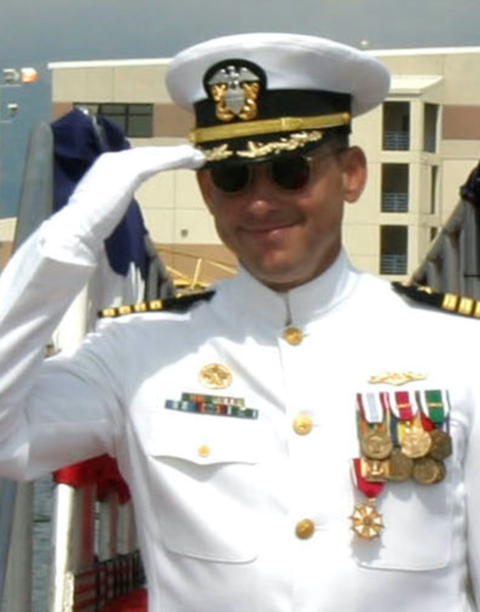
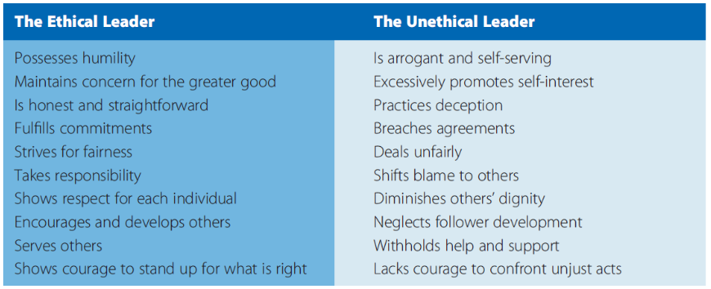
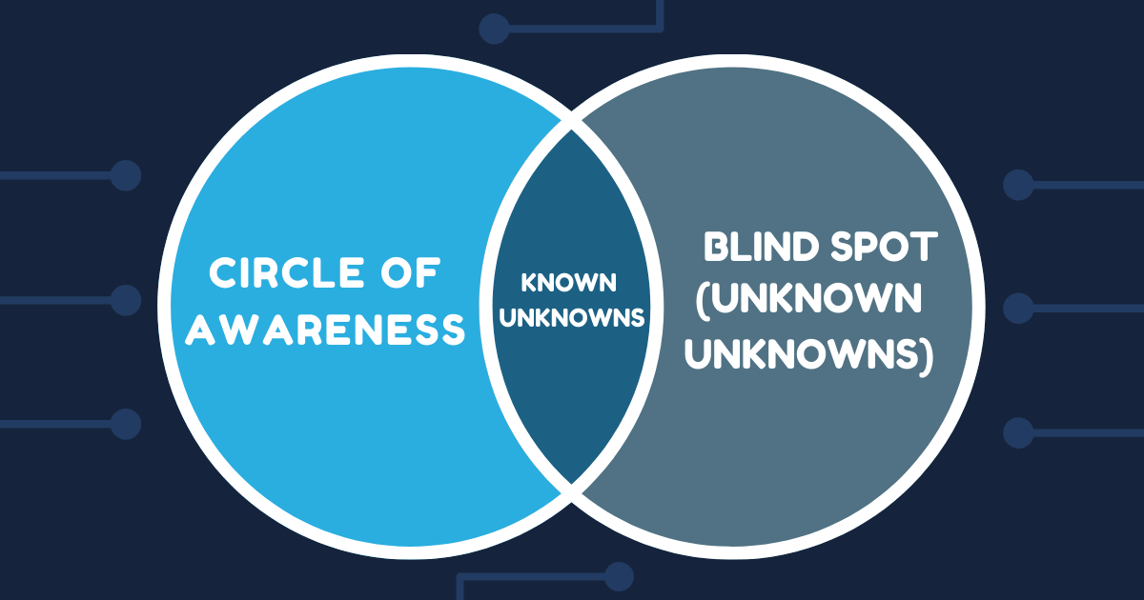
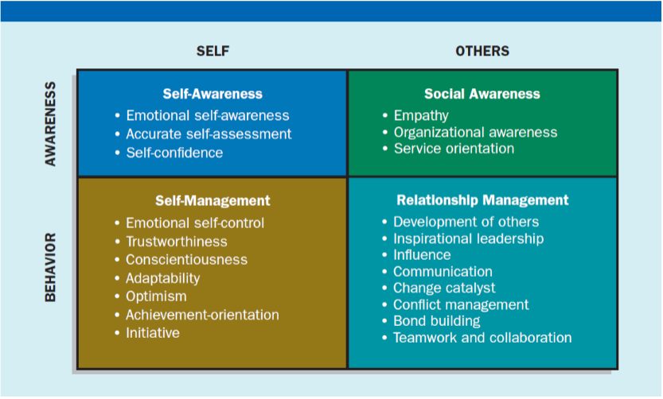
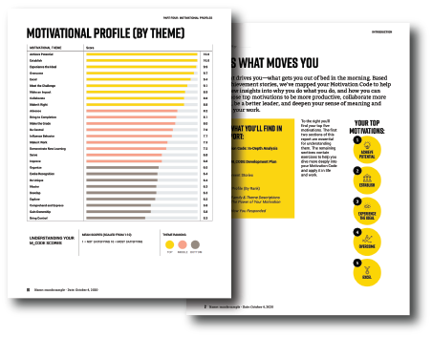
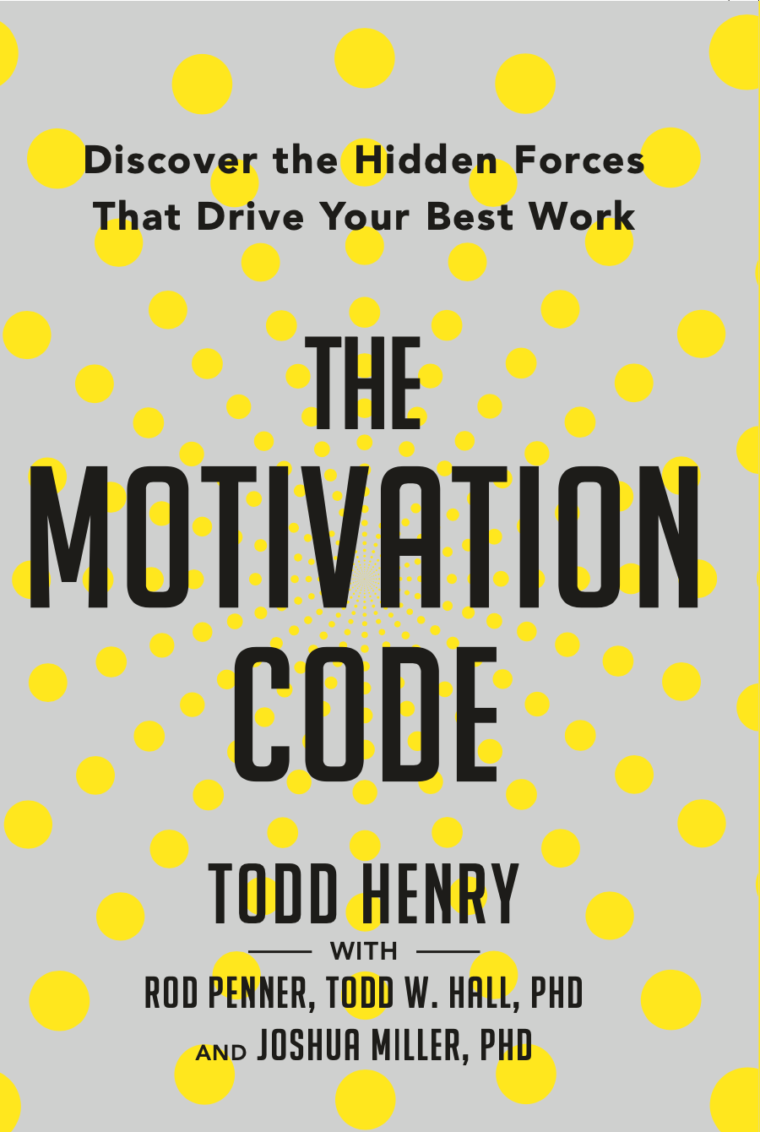
CAPT David Marquet: Leading Others to Leadership
Ryan Close
Florida State University Panama City
Abstract
“A good leader has to let go of their ego and self-interest and focus on raising up their employees and working through the process of building leaders.”
CAPT L. David Marquet, USN (Retired)
Leadership Traits
Ethics
As Daft puts forth in The Leadership Experience, “ethical leaders are honest with employees, partners, customers, vendors, and shareholders. They strive for fairness and take care to honor their agreements or commitments to others. Unethical leaders, on the other hand, often practice deception.” Ethical leadership is necessary to maintain morale and engagement of the workforce, making good on agreements and honoring commitments without deception and self-serving attitudes and actions.
Throughout Marquet’s time on the USS Santa Fe, there appears to be no evidence that Marquet’s leadership relied on deception, or that his approaches were simply self-serving. To the contrary, from the very beginning Marquet honored agreements made with his Chiefs, even those that he really did not have the authority to make given the existing leadership structure. Marquet consistently fulfilled commitments and developed leadership within his crew, which shows that Marquet was an ethical leader.
L. David Marquet is a former attack submarine captain who in the span of a few years “turned the ship around,” raising the performance and reputation of the USS Santa Fe from worst in the fleet to the best (Marquet, 2015b). This research biography is a look into the leadership characteristics and attributes exemplified by Marquet during his transition to and command of the USS Santa Fe. The purpose is to explore those characteristics and their effectiveness in Marquet’s work aboard the USS Santa Fe, learning lessons to augment the author’s own skills, leadership abilities and effectiveness within the author’s organization and begin leading others to leadership, emulating Marquet.
Leadership Traits
Honesty and Integrity
Daft (The Leadership Experience) notes that honesty and integrity are also key traits of any leader. Honesty is simply telling the truth without deceptive intent. Integrity is having a character that is complete and consistent in all aspects, not bending or behaving differently under different circumstances. Many of Marquet’s crew would consider him to have both traits, noting that integrity is a key tenant of Marquet’s leadership philosophy called “Intent-based Leadership.” When asked “what are the most important questions that leaders should be asking?”, Marquet responded, ““How much integrity do we have between what we say and what we do with what we do with our clients, and what we do internally?”
Emotional Intelligence
Emotional intelligence is a concept popularized by Daniel Goleman that is defined as “the ability to perceive, use, understand, manage, and handle emotions.” Through several related instances, Marquet demonstrates keen self-awareness and an ability to control his emotions in order to better handle emergent situations and general leadership of his crew. Time and time again he restrains himself and his chiefs from responding with emotion, managing the empathy of the crew (social awareness) and conflict management, bond building, and teamwork and collaboration (relationship management).
Blind Spots
Daft describes what he calls the “secret ingredient for leadership success” as self-awareness and the ability to identify and compensate for blind spots. Marquet acknowledges that blind spots exist, and it is important to increase awareness of blind spots if improvement is to be made. Marquet’s blind spot, the “unknown unknowns” blind spot, was a focal point that he would continually seek and promptly address.
Motivation Code
The Motivation Code, encompassing decades of research, describes a collection of twenty-seven “motivational themes” that drive and energize people to perform their best work. Understanding the things that motivate us and others is an important aspect of leadership, and Marquet reveals through his actions some of his motivators and his understanding of what motivates many of his crew. Marquet reveals motivational themes in several defined families, but many of his self attested goals show clear alignment with the “Optimizer” and “Team Player” families, which includes collaboration, service, behavior influence, organize, improve, and establish.
Challenge Culture
In addition to applying a leader-leader intent-based leadership structure on the crew of the USS Santa Fe, Marquet also imparted the tenets of a challenge culture on the crew. Marquet relates a tale where he, as captain, is challenged during an operation by a quartermaster who happened to be correct. Marquet would later reflect, “I thought about what it takes for a young sailor to say, ‘Captain, you’re wrong.’” This, and other cultural changes on the USS Santa Fe, would persist through the next decade even after Marquet’s retirement from service.
Conclusions
The leadership mechanisms employed that have the greatest effect on the USS Santa Fe and are mentioned time and again in Marquet’s works are (1) use “I intend to …”, (2) resist the urge to provide solutions, (3) take deliberate action, (4) learn (always), (5) use immediate recognition to reinforce behaviors, and (6) encourage a questioning attitude over blind obedience.

