Slide 1
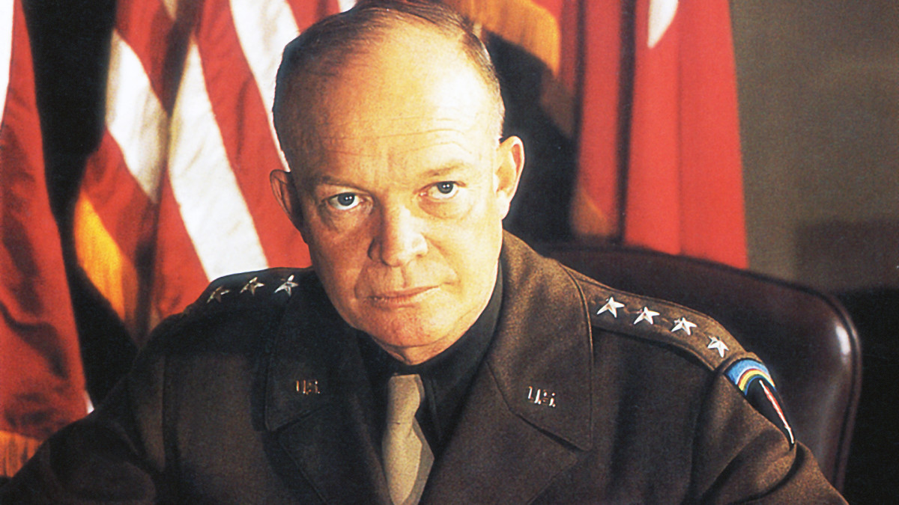
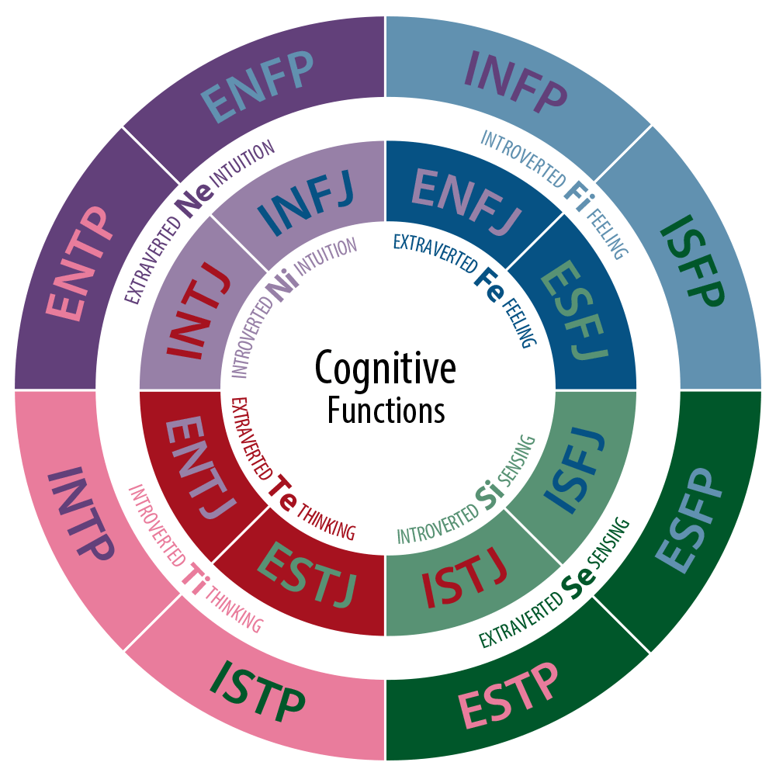
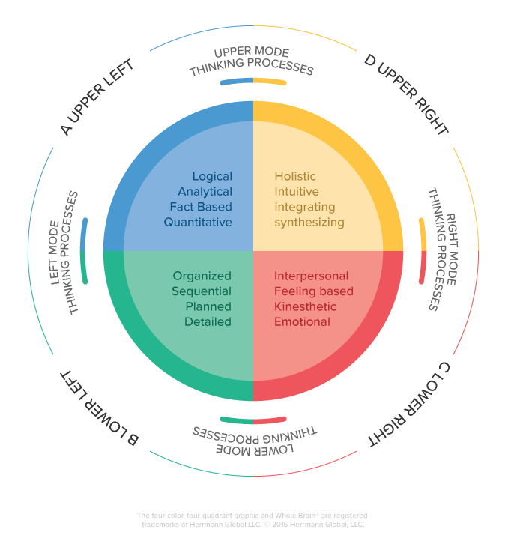
Dwight D. Eisenhower: Military Officer and Statesman
Alejandro M. Cano
Florida State University Panama City
Leadership is a complex and multidimensional phenomena that has been studied extensively over time. Presently, it has taken on a greater importance than in the past due to today’s fast-paced and increasingly globalized environment. Various methods of leadership and personality models have been developed challenging or expanding previous traditional ones. Some of these methods will be used to assess and analyze Dwight D. Eisenhower’s leadership and personality traits. As a military officer in the U.S. Army, Eisenhower rose to the second highest rank in U.S. military history and was a key figure in America and its allies winning World War II. After a long and stellar military career Eisenhower would later become the 34th President of the United States.
Abstract
General Dwight D. Eisenhower
Results
Leadership Assessments:
Possessed many leadership traits such as humility, highly intelligent, optimistic, and self confident.
Emotionally intelligent continuously practiced self-awareness, self-management, and relationship-management
Very ethical having a reputation of humbleness, honesty, responsibility, and giving credit when and where due
Served under many historic generals whose mentorship contributed to his learning and leadership development
Myers-Briggs Type Indicator:
Inspector personality type (ISTJ)
Introverted, Sensing, Thinking, Judging
Serious-minded, thorough, likes to plan, schedule and drive through to completion, strong sense of duty and loyalty.
Hermann’s Whole Brain Concept:
  Quadrants A and B dominant (Left brain)
  Logical, Analytical, Fact-based, Organized, Detailed
Dwight David “Ike” Eisenhower was one of America’s greatest military leaders and 34th President of the United States. During his military career he achieved the second highest rank in the history of the United States Army (U.S. Army) as a five star general serving in the role of General of the Army during World War II. As General of the Army he oversaw the successful invasion of Normandy contributing greatly to America and its allies winning World War II. After retiring the U.S. Army he went on to become the 34th President of the United States (POTUS) serving two consecutive terms from 1953-1961. As POTUS he established the National Aeronautics and Space Administration (NASA), the U.S. Highway System, the 1957 Civil Rights Act, peace between North and South Korea, as well as many other achievements. This research will focus on Eisenhower’s leadership style and analyze it using traditional and modern leadership theories and personality concepts. It will highlight his leadership traits and how they contributed to his success as both a military commanding officer in the U.S. Army and President of the United States.
Discussion
Methods
Leadership Assessments
  Personality Traits and Behaviors
  Self-Awareness
  Emotional Intelligence
  Ethical Leadership
  Followership
The Myers-Briggs Type Indicator
  16 Personality Types
  Most popular personality tool
  Used by 400+ Fortune 500 companies
Hermann’s Whole Brain Model
  Developed by Ned Hermann in 1970’s
  Expands left vs right brain concept and adds conceptual vs experiential
  Divides brain into four quadrants: Quadrant A, B, C, and D
Leadership
Influence
Intention
Shared
Purpose
Followers
Responsibility
and Integrity
Change
Conclusions
Highly effective leader possessing many traits critical for leadership success
Honed leadership skills over time learned from mentors.
Personality traits suited for leadership roles especially military.
References
Daft R. (2018). The Leadership Experience. Centage Learning Inc.
Personality at Work. (n.d.) Dwight D. Eisenhower The Inspector. Retrieved from https://personalityatwork.co/personality-type/istj.
The Myers-Briggs Co. (n.d.) Myers-Briggs Type Indicator. Retrieved from https://www.themyersbriggs.com/en-US/Products-and-Services/Myers-Briggs.

