Slide 1
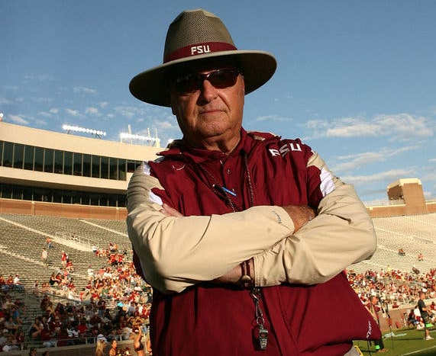
“DADGUMMIT!!” – Bobby Bowden
Morgan R. Bublitz
Florida State University
Abstract
Major Contributions
Bobby Bowden was the greatest football coach that Florida State University had ever seen. Bowden coached FSU football for 44 seasons where he ultimately climbed the college football coaching ladder to where he finished at the 2nd most winningest coach. (Goldstein, R., 2021). Having the distinct responsible to coach young men in their most formative men, Bowden took it upon himself to lead these men during their time with him and committed to imparting them each with the wisdom needed to be successful men in life when they were done with athletics. (Broome, J., 2015).
Head coach of FSU football for 34 seasons
Coached 10 years at prior colleges
Led Florida State University to 377 career wins, 12 Conference Titles, and Two National Championships
Mentored many other great college football coaches
Ex: Jimbo Fisher, Mark Richt, and Kirby Smart
Major philanthropist in local community
Key Takeaway
Bobby Bowden had his fair share of struggles and successes as a head college football coach, however the reward that he felt from successfully mentoring those student-athletes far outweighed the negatives. Because of this motivation to succeed as a mentor, Bobby Bowden was able to accel as a leader of not only football players but also to the people those football players were.
The Five Leadership Traits
Handling of Academic Scandal
Vision
Knew exactly what he wanted to accomplish as a coach and mentor
Communication
Skilled at motivating people and inspiring them to achieve greatness
People Skills
Taught others the importance of developing character and integrity both on and off the gridiron
Competence & Excellence
One of the best coaches and master of the X’s and O’s of the game
Boldness & Courage
Dealt with academic cheating scandal head on
As a prominent leader, scandals must be dealt with in a very delicate manner to maintain your integrity and to also punish those who deserve reprimand. To help do this Bowden did everything he could to handle the 2007 academic scandal as such.
Suspended all players involved immediately
Publicly expressed the importance of academic integrity
Hired academic compliance officers for football team
Implemented required study hall sessions and strict academic monitoring
Fully cooperative with NCAA and University officials during investigation
References
Daft, R. (2011). The Leadership Experience, Sixth Edition.
Bowden, B., & Bowden, S. (2015). The Bowden Way: 50 Years of Leadership Wisdom. Sports Publishing
Broome, J. (2015, December 14). Bobby Bowden and leadership. Proclaim. Retrieved January 22, 2023, from https://proclaim.com.au/bobby-bowden-and-leadership/
https://seminoles.com/. (2022, June 28). Bobby Bowden. Florida State Seminoles. Retrieved March 5, 2023, from https://seminoles.com/coaches/bobby-bowden/
Morgan, J. (2021, August 9). Kirby Smart, Mark Richt thankful for late Bobby Bowden's impact. USA Today. Retrieved March 5, 2023, from https://ugawire.usatoday.com/2021/08/08/kirby-smart-mark-richt-thankful-bobby-bowden-georgia-bulldogs-uga/
.

