Slide 1
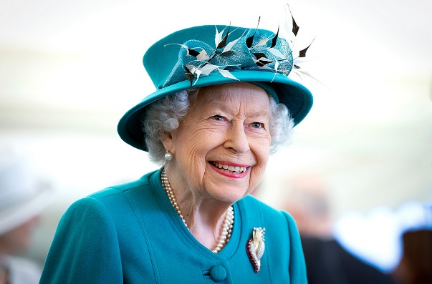
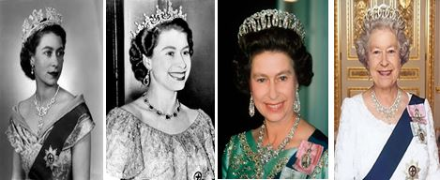
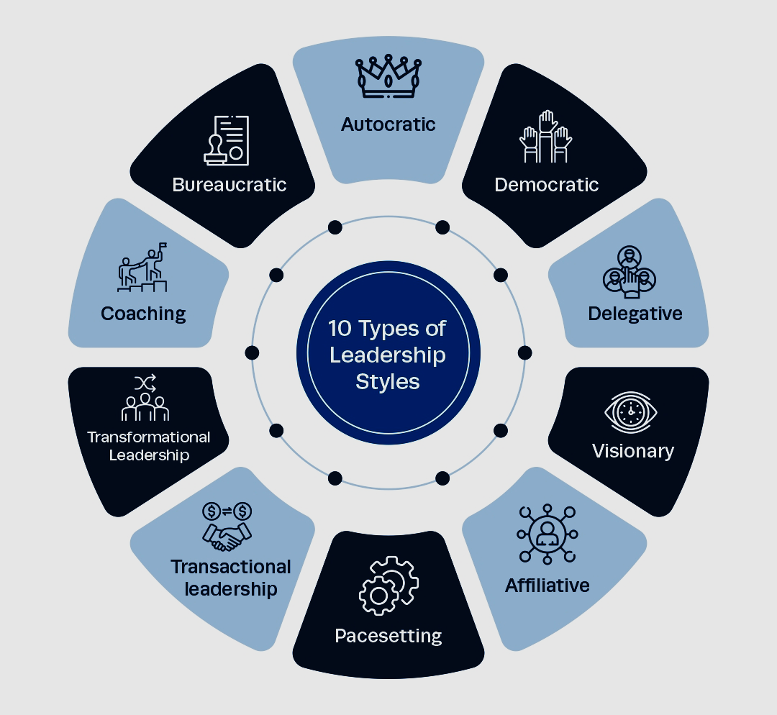
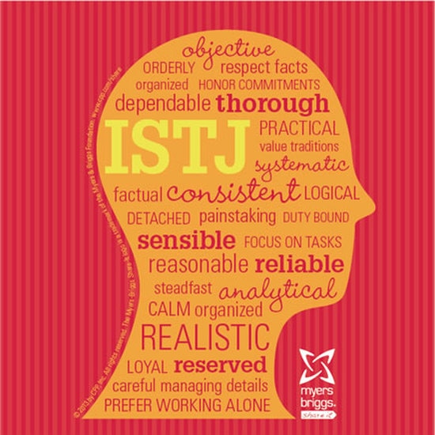
“I have to be seen to be believed” – Queen Elizabeth II
Adair Blomeley
Florida State University Systems Engineering - Panama City
Abstract
Queen Elizabeth II was the longest reigning Queen of any British Monarch ruling over 70 years. An unexpected turn of events led her to become Queen at just 25 years old. She was known to be driven by her family and faith, publicly commenting on her Christian faith often and taking time to thank her family. The purpose of the research is to understand how the Queen’s personality type impacted her leadership style and successes. The desired outcome is to draw parallels between her personality and lifestyle that conclude why the Queen led the way she did and how she was able to be so successful.
Major Impacts and Accomplishments
Longest reigning monarchy
Head of the Commonwealth
Large following of supporters
Kept the UK in good spirits during WWII
Stayed in touch with society, being the first Monarchy to use social media
Helped pass Crown Act of 2013 supporting gender equality
Renewed the bond with the United States by addressing U.S. Congress
Personality Type
Leadership Style
Elizabeth was described as “a jolly little girl, but fundamentally sensible and well-behaved” and she “had an air of authority and reflectiveness astonishing in an infant” (Wikipedia, 2023). Elizabeth “loved horses and dogs, her orderliness and her attitude of responsibility” which benefited her throughout her life as Queen (Wikipedia, 2023). The top five traits are “introverted, pragmatic, logical, responsible, and emotionally stable” (IE, 2022). One thing Queen Elizabeth can teach everyone is that leadership is not a one-size-fits-all job; Elizabeth was authentic and let her unique traits and behaviors set her apart as one of the world’s greatest and longest leaders.
Visionary: Inspires people and brings them towards a vision
Democratic: Values unity and wants to make decisions together
Affiliative: Creates harmony and builds emotional bonds.
Pacesetting: Strong family bond and high performance expected
Transformational: Fights for goals and brings about change
Key Takeaway
Leads by example. “I have to be seen to be believed”
Peaceful personality leads to a peaceful following. Thoughtful, realistic, consistent, calm, personality shows in her leadership of transforming and visionary.
Humble and confident presence but determined, go-getter attitude explains how her personality and leadership style lead to her success
A peaceful organizer who had a vision that led to transformation through democratic, affiliative leadership.
Enneagram is 9: The peacemaker
Calm, collected, private, well-liked
Values harmony and unity, comfort, and avoids conflict
References
Daft, R. (2011). The Leadership Experience, Sixth Edition.
Myers-Briggs personality type is ISTJ: The Organizer or Inspector
Prefers structure, value family traditions, fight for goals, patient, accurate, perfectionist
Introvert, Sensing, Thinking, Judging
parade.com. (n.d.). https://parade.com/1028154/alexandra-hurtado/queen-elizabeth-ii-quotes/
Malone, M. (2022, November 17). What are Queen Elizabeth’s Myers-Briggs and Enneagram Personality. Truity. https://www.truity.com/blog/what-are-queen-elizabeths-myers-briggs-and-enneagram-personality-types
Deanna. (2023). The Mediator Enneagram Type 9. mirabellecreations.com.
Myers-Briggs Personality Type: ISTJ. (n.d.). PLEASE VISIT ANGELGUARD.ORG [ AD ]. http://www.breakthroughpsychologyprogram.com/myers-briggs-personality-type-istj.html
(2023, February 10). 10 Leadership Styles and How to Identify Your Own. Institute of Project Management. https://www.projectmanagement.ie/blog/leadership-styles/
World History Edu. (2022, November 2). Queen Elizabeth II: 10 Major Achievements. https://www.worldhistoryedu.com/queen-elizabeth-ii-10-major-achievements/
IE Insights. (2022, September 14). Elizabeth II: Four Lessons in Life and Leadership. https://www.ie.edu/insights/articles/elizabeth-ii-four-lessons-in-life-and-leadership/
Wikipedia contributors. (2023, January 16). Elizabeth II. Wikipedia. https://en.wikipedia.org/wiki/Elizabeth_II

