Slide 1
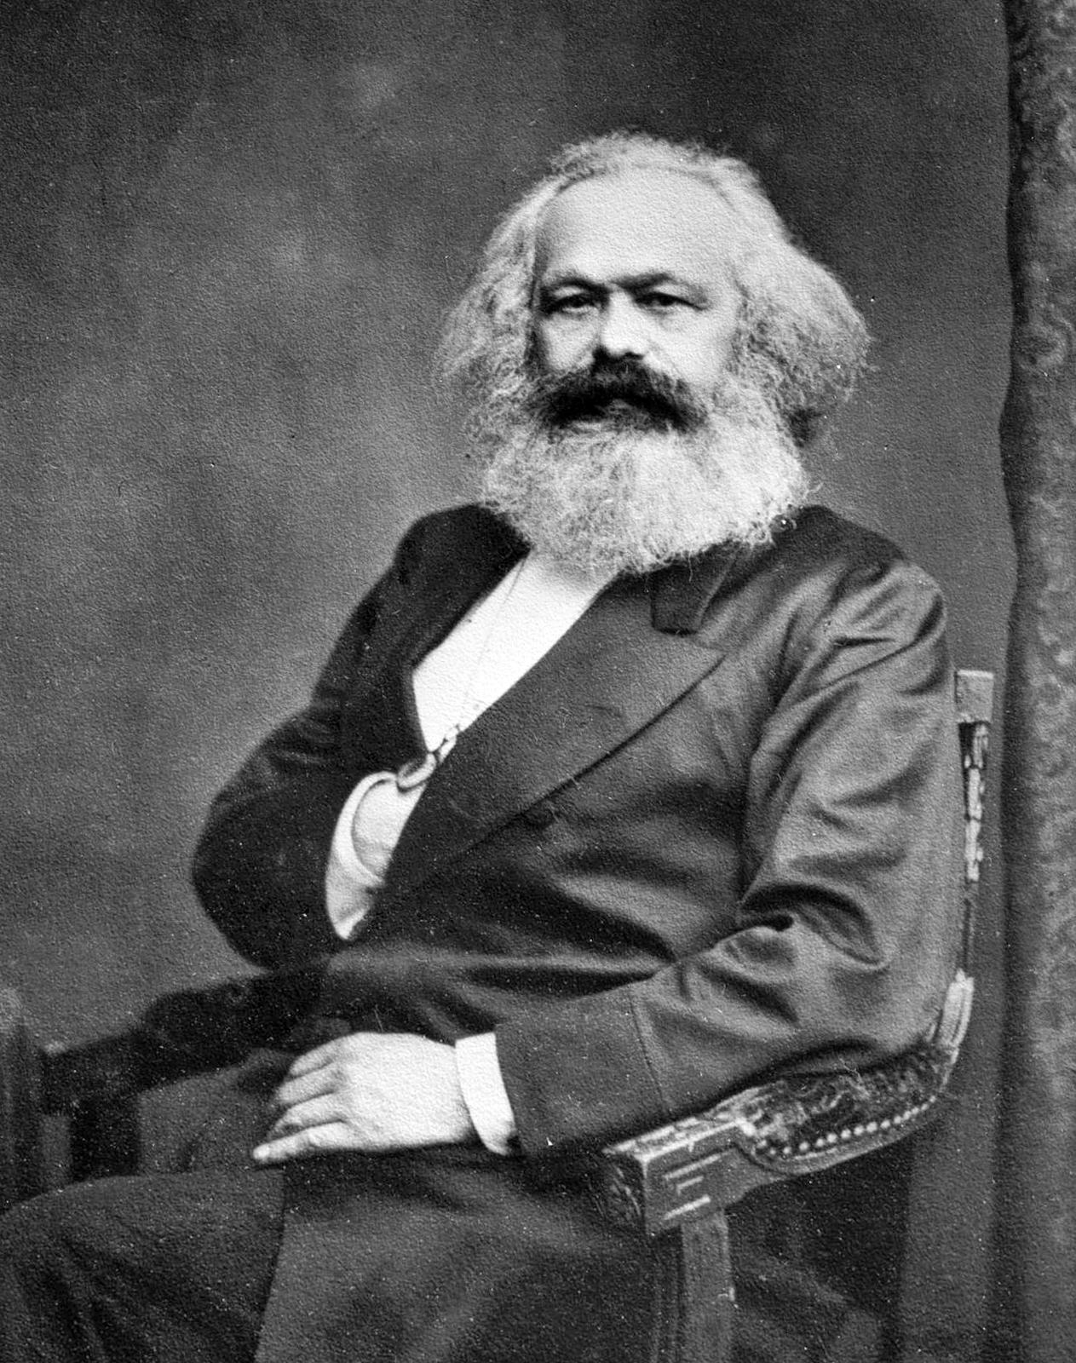
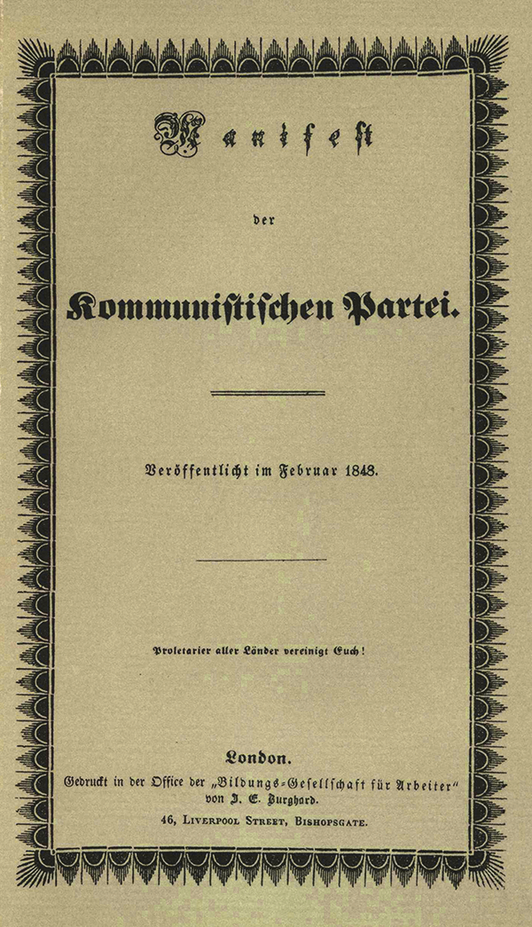
Karl Marx: a Cold-Hearted Commie or a Revolutionary Leader?
Lanna Black
Florida State University
Abstract
Ethical Leadership
Karl Heinrich Marx was a German philosopher, sociologist, political theorist, economist, and historian born in 1818 and died in 1883. He has been described as one of the most influential figures in human history and is known today as the Father of Marxism and the Father of Communism. He developed the Marxist ideology through analysis of class conflicts between the bourgeoisie (the capitalist/ruling class) and the proletariat (the working class). He proposed that, with historical materialism in mind, capitalism produced internal tension, due to its inherent instability and crisis-prone nature, that would lead to its own self-destruction and replacement with a system known as the socialist mode of production. He published about this ideology in his works The Communist Manifesto and Das Kapital. This research into Marx' style of leadership will use knowledge of various leadership methods to analyze how and why he became a great leader of political ideology and revolution.
Qualities that make up an ethical leader include possessing humility, having a concern for the greater good, being honest, being fair, respecting others, being able to take responsibility, serving others, and having courage to stand up for what is right. This is the quality that resembles Karl Marx the most. His lifelong devotion to fighting for the working class people reflects his humility, concern for the greater good, service towards others, and having courage to stand up for what is right. It is evident that Marx did greatly value honesty as well, theorizing about the concept of truthfulness within human existence and society.
Karl Marx was a selfless individual who displayed countless examples of leadership, emotional intelligence, and ethical leadership throughout his life. His consideration and relentless fight for the rights of the oppressed was admirable. It is not unsurprising that his works were helpful in many revolutions and are used as a foundation for much of modern social science today.
Conclusion
Leadership
Emotional intelligence is said to enable leaders to recognize and respect followers as whole human beings with feelings, opinions, and unique ideas. Karl Marx shows a high level of emotional intelligence for this reason. Marx’ defense of the proletariat is evidence of his respect for people of the working class. He recognized these people as human beings who don’t deserve exploitation.
Emotional Intelligence
References
Karl Marx had distinct and incomparable logical, dialectical, and erudition traits. His gifted ability to perform sophisticated critical analysis and utilize it in a dialectic to win-over any opposing arguments or parties was exceptional. He also was incredibly brave and bold in his relentless quarrels with rulers and showed great determination to the point where it sometimes even endangered his and his family's’ survival.
Daft, R. L. (2023). The Leadership Experience 5th Edition by Daft, Richard L. [Paperback]. Suoth-Western College Pub, 2010. 5th Edition.
Mayall, J., Rivera, D., Marx, K., & Angulo, Y. (n.d.). Karl Marx. Wikipedia. Retrieved January 22, 2023, from https://en.wikipedia.org/wiki/Karl_Marx
Fogarolo, L. (n.d.). Morettian Graphology: » Karl Marx. Retrieved January 27, 2023, from http://www.graphology.it/index.html%3Fp=153.html

