Slide 1
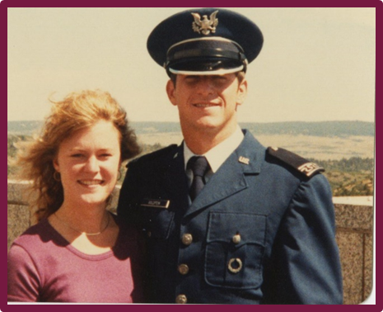
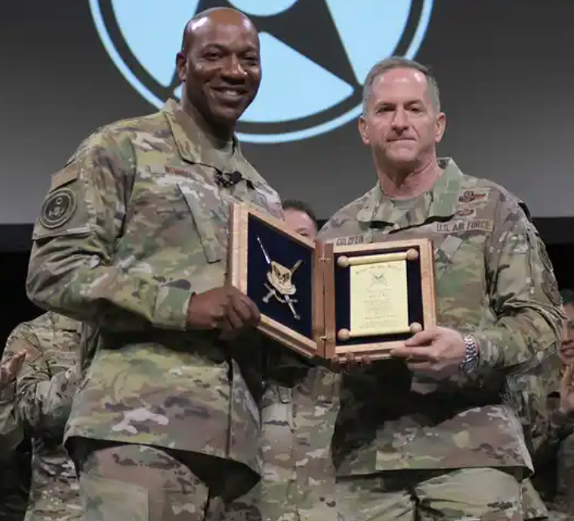
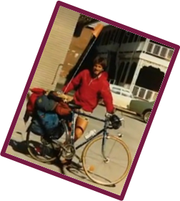
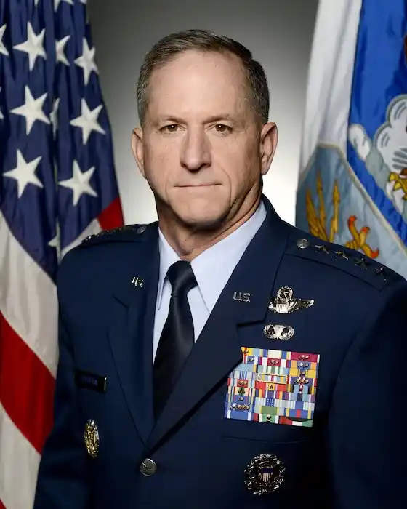

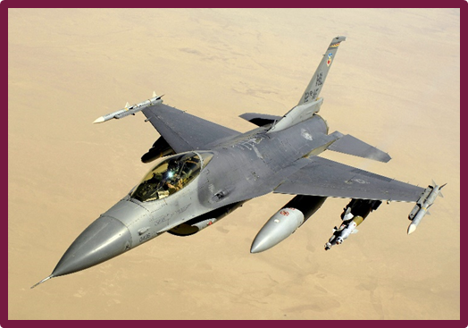
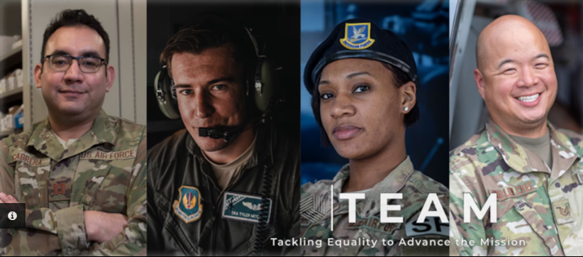
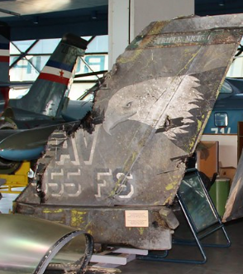
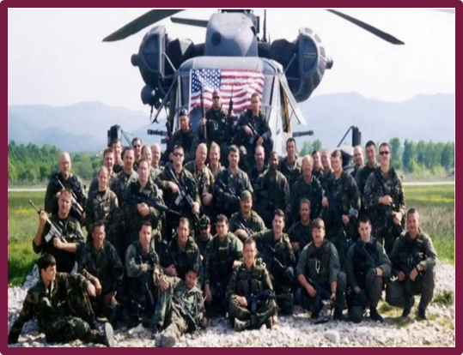
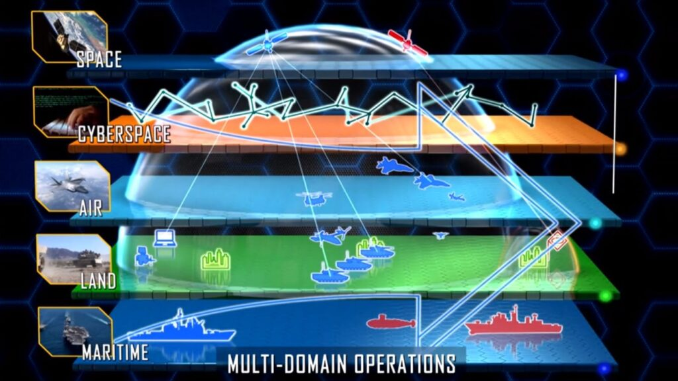
General Goldfein: One Introvert’s Journey to Leading the Largest Joint Team
Alyssa P. Beyler
Florida State University Panama City
Road To Maturity
“Leadership is a gift. It’s given by those who follow. You have to be worthy of it.”
Gen David L. Goldfein, USAF
Leadership Legacy
Search For Purpose:
Goldfein’s journey began at The Air Force Academy in 1978. As an underclassman, he was in his brother’s shadow. He spent his first few years “fighting the institution.” He took the opportunity to leave for one year, a program offered at the time, to ride his bike around the country. He found that the people he met and the kindness that they showed motivated him. He realized that the Air Force was his chance to be a part of something bigger than he was; he wanted to serve others. He returned to the Academy with a new sense of purpose and graduated in 1983 with a degree in Philosophy and a slot as a pilot.
Servant Leadership:
Goldfein based his character definition on the Air Force’s Core Values of Integrity First, Service Before Self, and Excellence in all you do. He said,” If you have integrity, others will be willing to follow. If you put the service of others and the mission ahead of yourself, those you meet feel valued. If you strive for excellence in everything you do, people will naturally want to be a part of what you are doing.” He further stated that a servant leader must have character, competence, and charisma.
Steps Towards True Equality:
After George Floyd died in 2020, Goldfein’s team stated, “what happens on America’s streets is also resident in our Air Force. Sometimes it’s explicit, sometimes, it’s subtle, but we are not immune to the spectrum of racial prejudice, systemic discrimination, and unconscious bias. We see this in the apparent inequity in our application of military justice. We will not shy away from this.” He initiated swift and deliberate changes to Air Force policies. His willingness to lead immediate change during unprecedented times earned him the highest award enlisted Airmen can bestow, the Order of the Sword, presented by The Chief Master Sergeant of the Air Force Kaleth Wright.
Teaching is Key:
After graduating from undergraduate pilot training in 1984, he became a first-assignment instructor pilot, and for 4 years, he taught new pilots to fly the T-38. He would be responsible for their safety and efficiency until he was assigned a spot as an F-16 Pilot. His first assignment as a commander of the 555th Fighter Squadron would forever alter his perspective as he was now responsible for dozens of young pilots whom he would lead into war. His experiences as a new commander inspired his book Sharing Success Owning Failure, written in 2021, to help teach young commanders about the challenges of taking command in the modern world.
Power of Teams:
On May 2, 1999, while operating in support of Operation Allied Force, Goldfein was shot down in the middle of the night. He had time to evaluate the situation and make one last radio call, where he said, “Start finding me, boys.” He ejected and landed in enemy territory in NW Serbia. The heroic story of the team who came together to rescue Goldfein and bring him home to his family reminds us of our service members’ sacrifices. Goldfein never forgot the risks those men took to find him. It left a mark on him, reminding him to remain humble and kind, a tribute to the kindness he witnessed while searching for his purpose. Ultimately, this experience further motivated him to serve others and contributed to molding him as a servant leader.
Team Of The Future:
When General Goldfein was Chief of Staff of the Air Force, he clarified that we must advance our technologies and tactics to remain relevant against our near-peer and peer-peer enemies. He led the way in integrating operations across all branches. He also guided the US through creating the Space Force stating we must “integrate air, space and cyber operations in a truly seamless joint campaign.” His push for Joint All-Domain Operations (JADO) is still growing today.
Abstract
General Goldfein, Once described as a lost wanderer, would experience challenges beyond many people’s comprehension. His open-minded and optimistic outlook on life would eventually help him to find his “purpose.” Ultimately, he would become The Chief of Staff of the Air Force and the Air Force’s greatest servant leader, laying the groundwork for the largest joint service team, a concept called multi-domain command and control.

Slide 2
References:
Air Force chief of staff gen. Goldfein: Every airman, beyond the space specialty, must und. Schriever Space Force Base (Archived). (2018, April 23). Retrieved March 5, 2023, from https://www.schriever.spaceforce.mil/News/Article-Display/Article/1500811/air-force-chief-of-staff-gen-goldfein-every-airman-beyond-the-space-specialty-m/
Aviation, A. (2015, June 29). 88-550 and 82-806 USAF wreckage at Belgrade Aeronautical Museum, 7th June 2015. Flickr. Retrieved March 5, 2023, from https://www.flickr.com/photos/56388143@N06/18646285854/in/photostream/
David L. Goldfein. DAVID L. GOLDFEIN > Air Force > Biography Display. (n.d.). Retrieved March 5, 2023, from https://www.af.mil/About-Us/Biographies/Display/Article/108013/david-l-goldfein/
Everstine, B. (2020, February 27). Goldfein presented with Order of the Sword. Air & Space Forces Magazine. Retrieved March 5, 2023, from https://www.airandspaceforces.com/goldfein-presented-with-order-of-the-sword/
Hitchens, T. (2022, May 26). Milley assigns service roles in all-domain OPS concept. Breaking Defense. Retrieved March 5, 2023, from https://breakingdefense.com/2020/07/milley-assigns-service-roles-in-all-domain-ops-concept
Losey, S. (2022, August 18). 'start finding me, boys' - inside the rescue of lt. col. Dave Goldfein. Air Force Times. Retrieved March 5, 2023, from https://www.airforcetimes.com/news/your-air-force/2019/06/19/start-finding-me-boys-inside-the-rescue-of-lt-col-dave-goldfein/
Team aims to tackle equality issues within AFRS. 37th Training Wing. (n.d.). Retrieved March 5, 2023, from https://www.37trw.af.mil/News/Article-Display/Article/2376435/team-aims-to-tackle-equality-issues-within-afrs/
YouTube. (2019, February 25). Servant leadership | CSAF gen David L. Goldfein. YouTube. Retrieved March 5, 2023, from https://www.youtube.com/watch?v=1YjP28ABmZM
Woodworth, E. (2021, December 20). Three C's every servant leader needs. BetterWithWE.Retrieved January 30, 2023, from https://www.betterwithwe.com/post/three-c-s-everyservant-leader-needs

