Slide 1
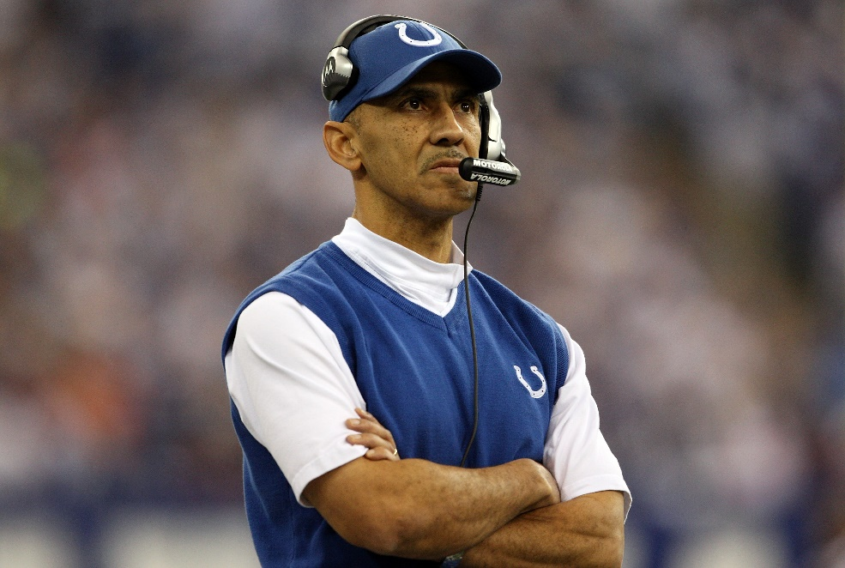
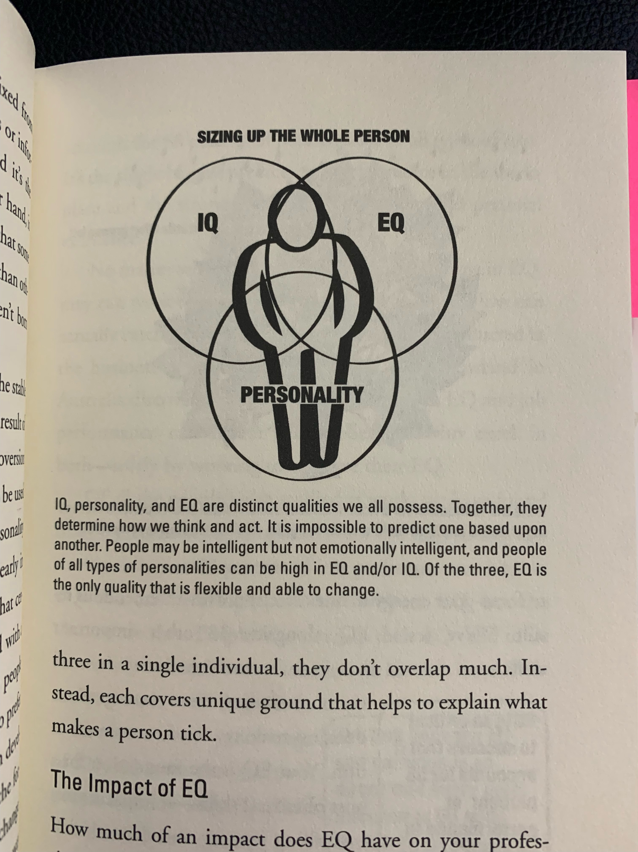
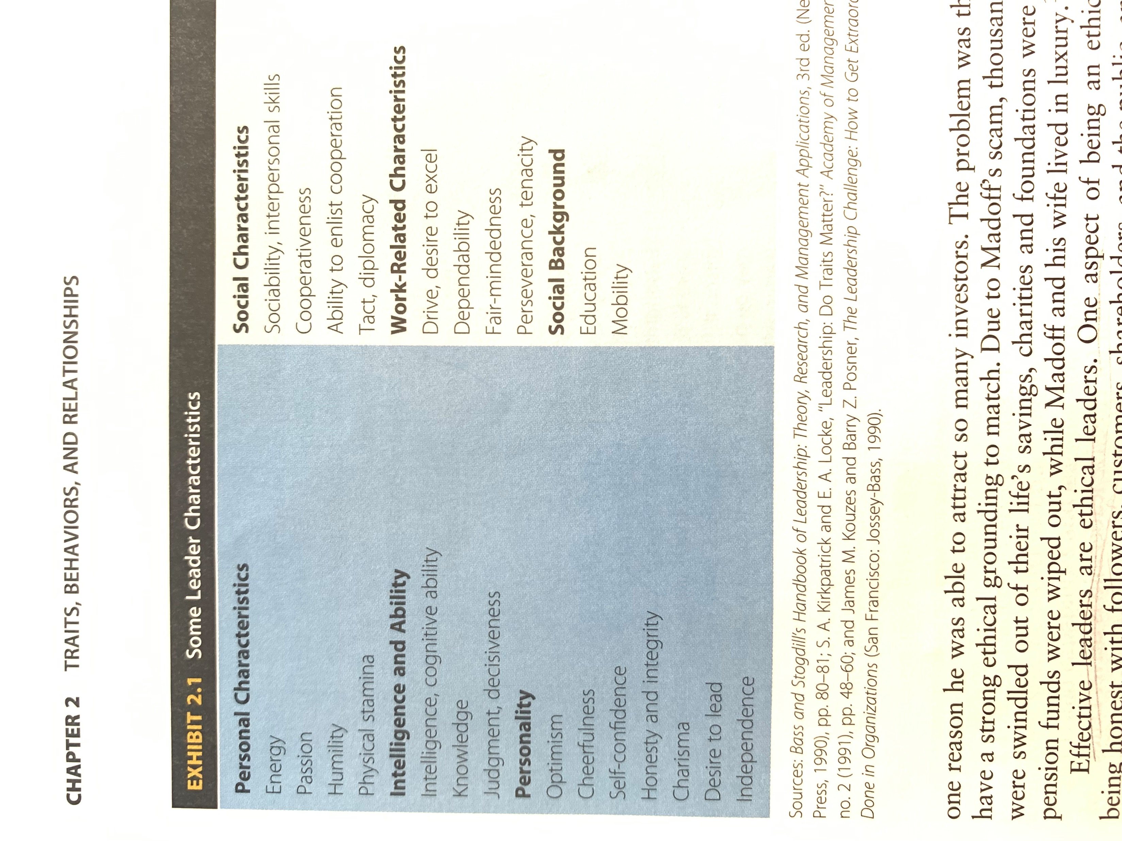
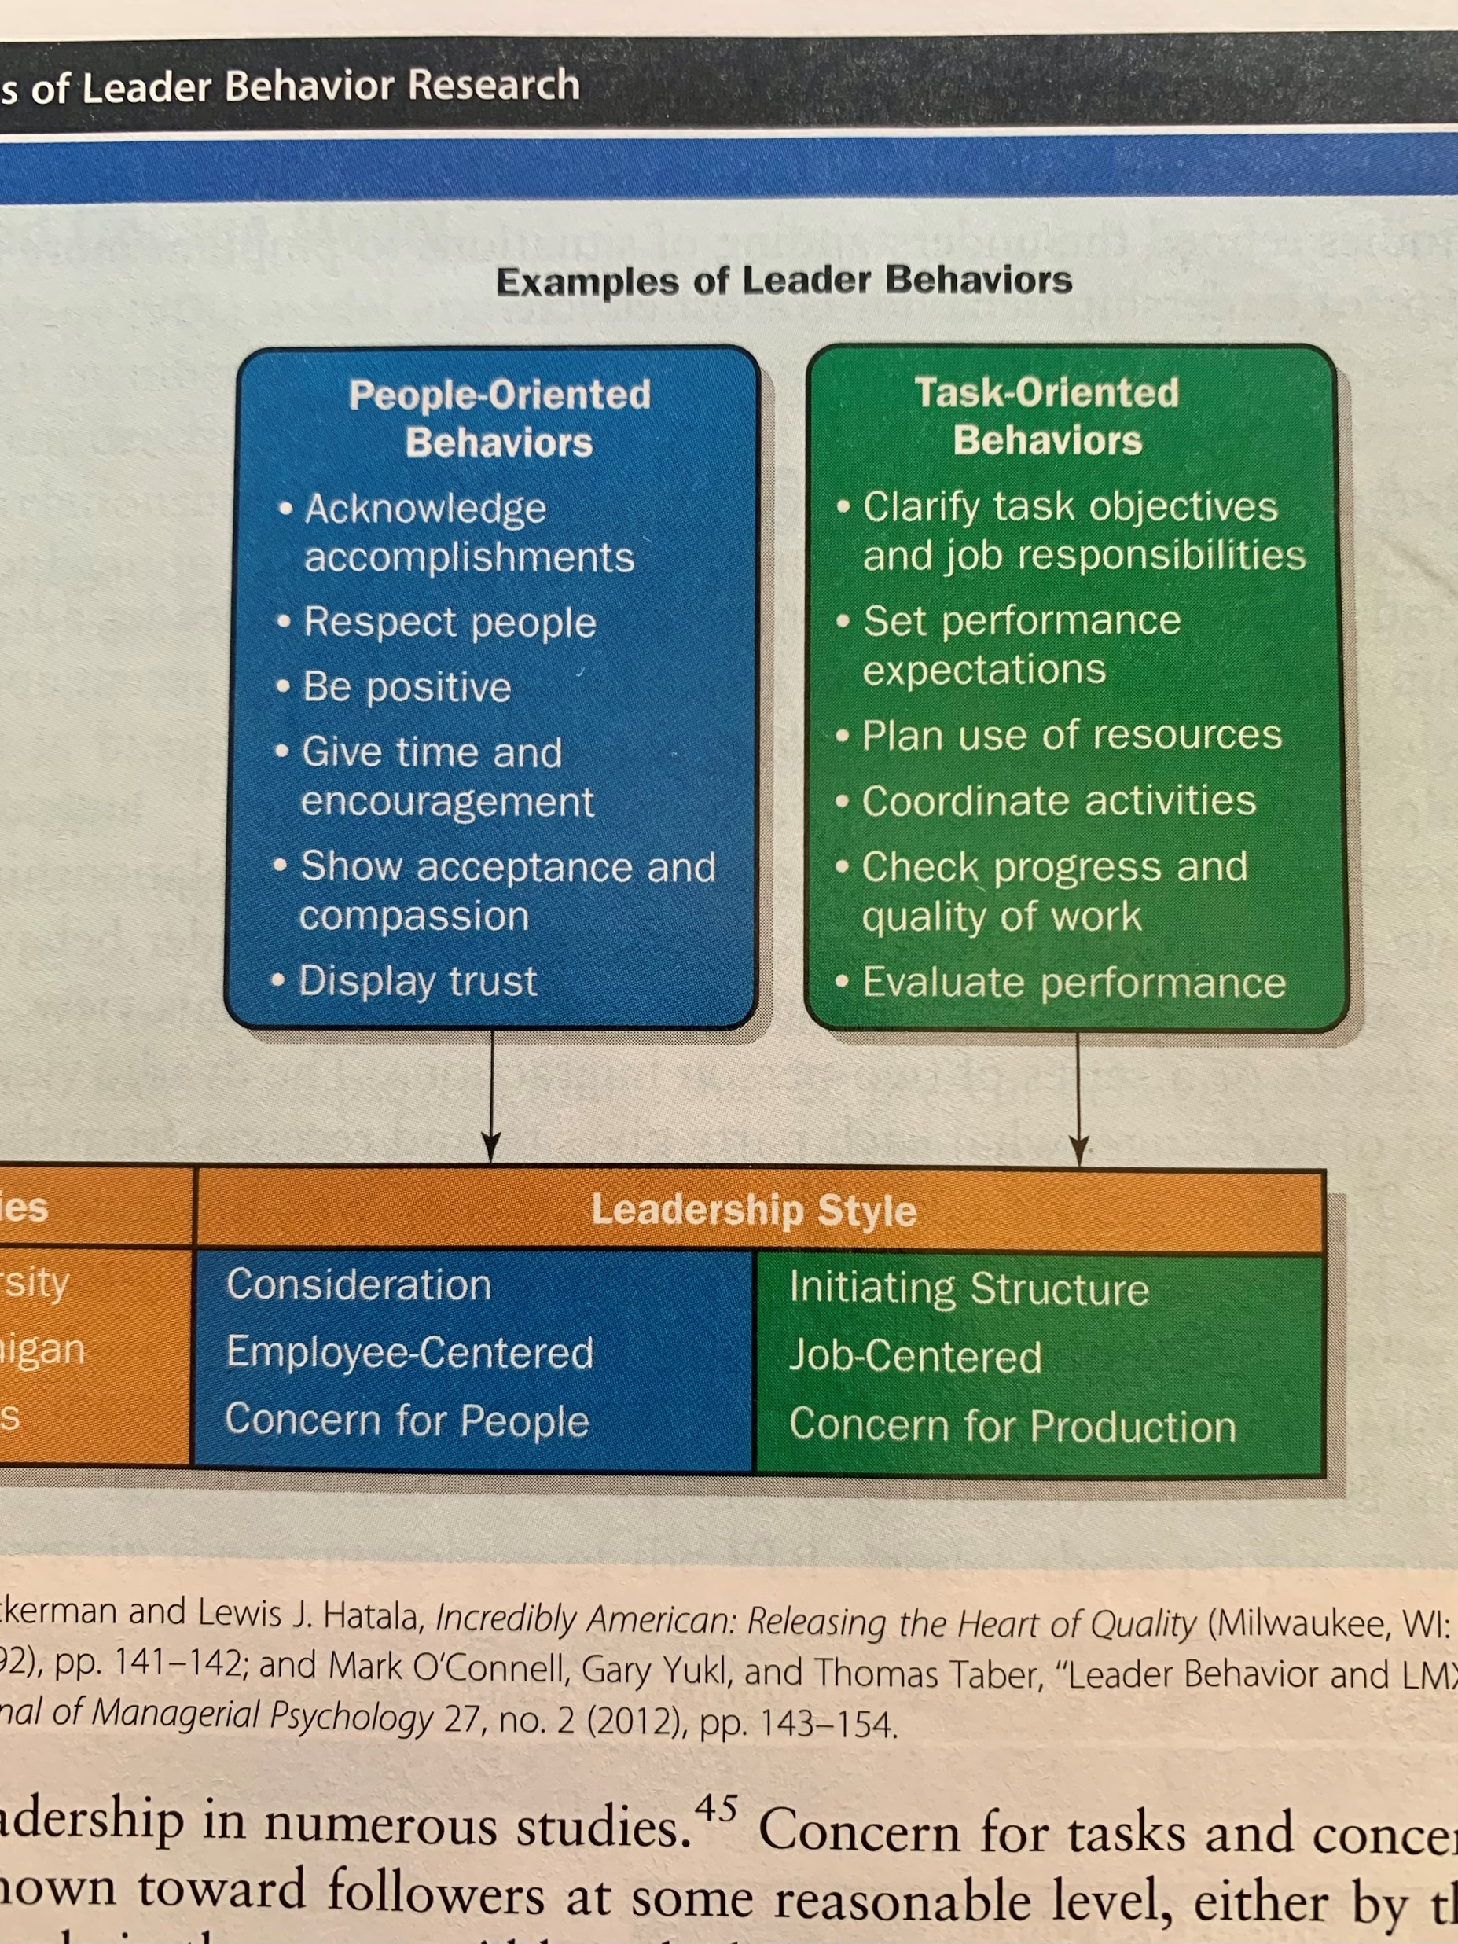
“It’s not about me. It’s about others.” – Tony Dungy
Frederick E. Bass
Florida State University - Panama City
Abstract
Tony Dungy is a former NFL head coach who led the Indianapolis Colts to victory in Super Bowl XLI. Mr. Dungy is a New York Times best-selling author of several books and is widely recognized as an expert mentor and leader. His leadership and influence over the years has made positive impacts to millions of lives around the world. Mr. Dungy is an interesting leader to study as his leadership style is different from what one often thinks of as a traditional style of leadership. This study includes analyses of Mr. Dungy’s leadership style, traits, behaviors, and motivations. The research presented will help new and experienced leaders alike.
Emotional Intelligence
Emotional intelligence (EQ) is the ability to recognize and understand emotions in oneself and others. It includes abilities to leverage this awareness for managing behaviors and relationships. EQ is a measure of intangibles or soft skills. It affects how oneself manages behavior, navigates social interactions, and makes personal decisions that yield positive results (Bradberry & Greaves, 2009, p.17). EQ is distinct from the intelligence quotient (IQ). IQ measures a person’s cognitive ability by a ratio of mental age and chronological age multiplied by 100. A person with an IQ score of 100 is considered to have average cognitive ability (What Is IQ?, n.d.). However, a high IQ score does not necessarily mean a person is or will be a successful leader. EQ is a more significant indicator of leadership success.
Dungy is widely considered an expert in the mentorship domain. Dungy (2010a) explains a mentor leader must have constant self-awareness to make a difference in other people’s lives (p.100). He further states, “you never know when your example might be used to build into someone’s life” (p.102). A successful leader must understand there are others watching them unwittingly. Dungy (2010a) writes from experience, “A lot of eyes will be on you, seeing things you don’t even realize you’re modeling” (p.116). As such, Dungy’s self-management abilities are impeccable. Further, Dungy learned, “leadership is all about relationships” (Dungy, 2010a, p.110). Dungy exhibits high degrees of social awareness and relationship management through coaching and mentoring. He improved his EQ to an exceptional level over 30 years coaching in the NFL, posturing him to become a successful leader.
Leadership Traits & Behaviors
Motivation Code
Characteristics:
The yellow stars in adjacent figure signify traits exhibited by Dungy which are also keys to effective leadership. He is widely known to use Christian faith as a foundation for solid morals and ethics. According to Daft (2017), ethics plays a huge factor in leadership effectiveness. An aspect of effective leadership includes honesty and integrity. This aspect forms the foundation for trust between leaders and followers (pp.38-39). A leadership trait Dungy exhibits is integrity. He handles problems quietly by respecting the privacy of others (Robinson, 2010).
The Visionary Family:
Theme | Motivational Description
Achieve Potential | Constant focus of activities is on identifying and realizing potential (Henry, 2020, p.30).
Make an Impact | Seeks to make an impact or personal mark in the world (Henry, 2020, p.35).
Experience the Ideal | Gives concrete expression to concepts, visions, and values (Henry, 2020, p.41).
Conclusion
Dungy’s motivations include achieving potential and making impacts. Those who follow professional football know that Michael Vick was a star quarterback in the NFL. Dungy (2010a) tells a story of mentoring Vick. He ended up serving prison time resultant from involvement in the heinous crime of dog fighting. Dungy mentored Vick to help rehabilitate Vick’s personal life and career (pp.7-9). Dungy saw the potential in Vick and realized Vick was still capable of doing good personally and professionally when nobody else did. People criticized not only Vick but Dungy as well for working with him. Dungy focused on Vick’s potential, sought to make a positive impact, and had a vision for Vick. Vick ended up returning to the NFL and reclaiming part of the life that he had lost. Dungy said in mentoring Vick, “My primary goal was to build into his life so that he, in turn, can have a positive impact on other young men” (Dungy, 2010a, p.10).
Dungy was appealing to study as his leadership style has been widely known to be different from what one often thinks of as a traditional style of leadership. He was known for his quiet, calm style of leadership. However, in the NFL, coaches are often thought as leaders who communicate by yelling and using profanity to motivate players. In a speech by Dungy, he described that he did not need to yell and cuss at the players on his team to get his point across or help someone. Dungy stayed true to his own style of leadership and never felt like he must fit into a mold of how society often thinks a leader behaves.
Dungy continues to this day, drawing from his Christian faith to lead and volunteer in programs such as All-Pro Dad. Arguably one (1) of the most important and challenging leadership roles a man can have is fatherhood. All-Pro Dad is a nonprofit organization whose mission is to help fathers effectively love and lead their families. Dungy uses the platform to communicate and teach others leadership skills.
Behavioral Theme:
Examples of Dungy’s people-oriented behaviors included compassion and acceptance by allowing team members to bring their kids to the office during the summer. He encouraged others to go home when they worked too late, so they could be with their families (Dungy, 2010b). Dungy led by example and did not work too late himself which built trust among followers. Dungy (2010a) decided to go against the grain of conventional leadership by fostering close relationships with his staff and players. He felt the better he knew people, the more he was able to help them (p.208). Thus, Dungy is an employee-centered leader. He helps followers succeed by focusing on human needs and establishing close relationships.
The Team Player Family:
Theme | Motivational Description
Collaborate | Enjoyment from involvement in efforts where people are working together for a common purpose (Henry, 2020, p.84).
Make the Grade | Measuring up and gaining acceptance into a group (Henry, 2020, p.91).
Serve | Identification and fulfillment of needs, requirements, and expectations from others (Henry, 2020, p.97).
Influence Behavior | When an individual looks for signs that they impacted another person’s thinking, feeling, and behavior (Henry, 2020, p.104).
References
Daft, R. (2011). The Leadership Experience, Sixth Edition.
Bradberry, T., & Greaves, J. (2009). Emotional Intelligence 2.0. TalentSmart.
Daft, R. L. (2017). The Leadership Experience (7th ed.). Cengage Learning.
Dungy, T. (2010a). The Mentor Leader: Secrets to Building People and Teams That Win Consistently. Tyndale.
Dungy, T. (2010b). Game plans: How do we keep ourselves and our teams focused on the right things? Leadership Journal, 31(4), 36–38.
Dungy, T. (2019). The Soul of a Team: A Modern-Day Fable for Winning Teamwork. Tyndale.
Dungy, T. (2022, September 19). How Do You Motivate Yourself as a Dad? All Pro Dad.
https://www.allprodad.com/finding-motivation-as-a-dad/
Henry, T. (2020). The Motivation Code: Discover the Hidden Forces That Drive Your Best Work. Portfolio.
Robinson, T. L. (2010). Leadership is one of our most valuable assets. ASHA Leader, 15(3), 19–20.
What is IQ? (n.d.). Mensa International. Retrieved February 19, 2023, from https://www.mensa.org/iq/what-iq
Dungy’s motivations mostly fall in the Team Player Family. He describes selflessness as, “Putting individual needs aside for the good of the team” (Dungy, 2019, p.207). Dungy (2019) asserts that truly great teams apply four (4) highly effective principles: selflessness, ownership, unity, and larger purpose–the “SOUL” of a team (p.205). When people are selfless, they become part of something bigger and more successful than themselves. Team players are relentlessly looking to improve yet allowing to set aside their individual goals for the good of the team (Dungy, 2019, p.209). Dungy’s actions are consistent with Henry’s (2020) literature in that the Collaborate motivational theme can be characterized by the enjoyment of working with people towards a common goal (p.84). Dungy shows behaviors of the Serve motivational theme as he is passionate about meeting the needs of the team as well as advancing the cause of the team (p.97).

