Slide 1
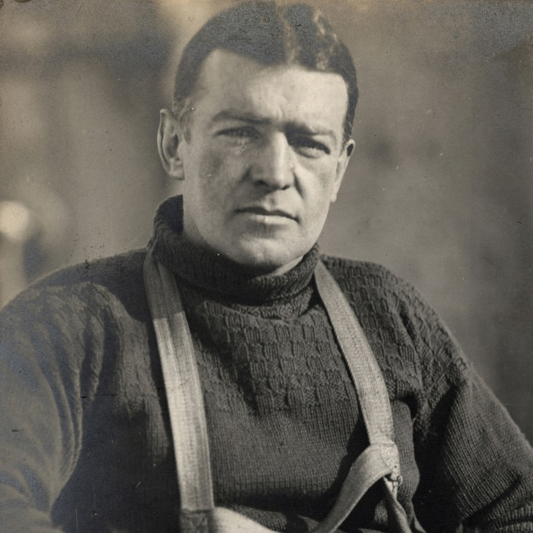
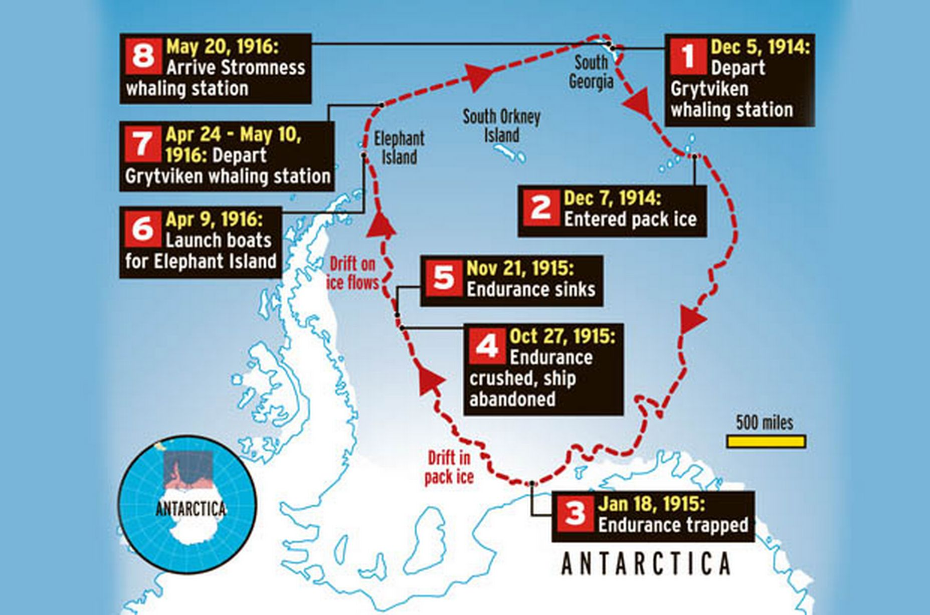
The worst can always be got over – Ernest Shackleton
Jeffrey Barr
Florida State University - Panama City
Abstract
Challenge Culture
Sir Ernest Shackleton was an Antarctic explorer whose ship, the Endurance, became trapped in ice and the expedition to spend over two years patiently rescuing themselves. Shackleton had the ability to inspire confidence and optimism, teamwork, and a sense of community while receiving very little papering himself. His result was the complete rescue of his crew, not a man was lost.
Shackleton’s optimism, caste-free team structure, focus on the ultimate goal, and personal connection to the crew – leadership traits that were ahead of their time – enabled the expedition to beat the odds and survive where others would have failed. In this project we explore these leadership topics (and more) to better understand effective leadership.
The challenge culture recognizes that great leaders learn from those around them and understand the value in differing opinions. Although leaders can be the top of the pyramid, the key is having good communication with the foundation of that pyramid to gain insight and an understanding of those around you (Travis. 2018).
In Shackleton’s way, Morrell & Capparell tell us the “the Boss asked all the men what they thought of any important situation” (Morrell, & Capparell. 2001 p. 146). His goal was to keep in touch with the crew and collect ideas, even those differing from his own. It was his way of “thinking out loud” to arrive at his best possible solution. On some occasions he listened to his men, like when Orde-Lees suggested he eat dinner with the men to make them feel better. Sometimes they had differing opinions, like how much food to cache. But what is clear, whatever he decided was his own decision and was final (Morrell, & Capparell. 2001 p. 146-147).
Leadership Traits and Behaviors
Optimism and self-confidence: These are traits that Shackleton exhibited in all his expeditions, but most notably in his ill-fated Trans-Antarctic Expedition. In fact, Frank Worsely (the Endurance ship captain) is known to have said “…in fact his (speaking of Shackleton) attitude was ‘You’ve damn well got be optimistic’” (Perkins, et al. 2012. p. 46). Shackleton’s self-confidence came from his previous Antarctic expeditions, which allowed him the freedom to be optimistic, even “recklessly optimistic” at times.
Lead by Example: Shackleton’s method of leading his crew was from the trenches, he wasn’t above getting dirty or helping with the work, he led by example (Morrell, & Capparell. 2001. p. 94). In this way he was able to get to know the crew and develop relationships with each of them.
Take the big risk when necessary: For the final leg of his self rescue Shackleton had to lead three of his crew for 36 hours and over 30 miles of mountain passes to reach rescue, but when they finally saw the station at Stromness Bay Shackleton shook their hands (Morrell & Capparell. 2001. p. 189).
Seek Council from the rest of the team: Shackleton was fond of his team and knew they had a lot to offer. “he kept his finger on the pulse of the crew, letting them have their say, and colleting idea” (Morrell & Capparell. 2001. p. 148).
Followership & Courage
Key Takeaway
Understand the strengths of your men: Shackleton matched his men’s strengths to their daily responsibilities. His stores keeper (Thomas Orde-Lees) was assigned during the expedition because of his tendency to be a hoarder. The position would allay Orde-Lees’ worries of running short of supplies (Morrell & Capparell. 2001. p.115).
Demonstrate good followership: When Shackleton and his crew became stranded after their ship sank, he had to rely on the ship’s carpenter [technically the second most important person in a wooden vessel] to construct a boat that could make an 800-mile, open-sea journey. Shackleton also deferred at times to the ship’s navigator” (Shea. 2021).
Make the tough decision: On two occasions Shackleton had to order the culling of the expedition animals, a tough ask for his crew. This was necessary to conserve food and supplies and reduce the overall volume of the expedition to make the final sea voyage (Koehn. 2010).
Be a team player: Shackleton's prior polar experiences had demonstrated the importance of building a team. During the Trans-Antarctic expedition Shackleton took great pains to unite the crew and avoid the interpersonal frictions that had fragmentated other expeditions (Perkins, et al. 2012. p.80).
Be an Optimist – “The quality I look for most is optimism: especially optimism in the face of reverses and apparent defeat. Optimism is the true moral courage.” – Sir Ernest Shackleton
Be fair, treat everyone equally – Shackleton treated everyone equally including himself, he treated them as human beings not just workers. Develop their talents.
Have a plan, and a backup plan – When things don’t go according to plan be flexible and adjust your plans, even if it is simply “to survive”.
References
Daft, R. (2011). The Leadership Experience, Sixth Edition.
Koehn, N. (2010). Leadership in Crisis: Ernest Shackleton and the Epic Voyage of the Endurance.
Harvard Business School.
Morrell, M., & Capparell, S. (2001). Shackleton’s Way: Leadership Lessons from the Great Antarctic
Explorer. Penguin Books.
Perkins, D., Holtman, M., & Murphy, J. (2012). Leading at the Edge: Leadership Lessons from the
Extraordinary Saga of Shackleton’s Antarctic Expedition (2nd ed.). American Management
Association.
Shea, G., PhD. (2021, September). Lead Better by Knowing When to Follow. Wharton Executive
Education. https://executiveeducation.wharton.upenn.edu/thought-leadership/wharton-at-
work/2021/09/lead-by-following/
Travis, N. (2018). The Challenge Culture (1st ed.). Public Affairs.

