Slide 1
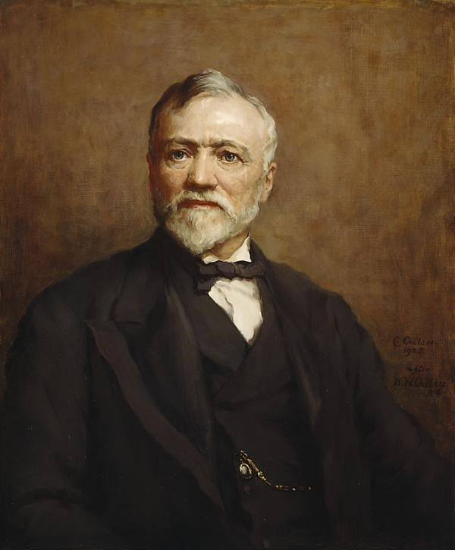
Andrew Carnegie
Caterina M. Arnold
Florida State University Panama City
Abstract
Carnegie had a Keen Eye for Innovation and Opportunity
Bessemer Process: First inexpensive industrial process that allowed for the mass production of steel from raw pig iron
The Carnegie Steel Company Revolutionized the Industry
Supply Chain Management: Controlling the manufacturing process beginning to end, from sourcing raw materials to delivering the final product to its destination
Steel Magnate/Tycoon
Ruthless Monopolist
Man Who Built America
Father of Modern Philanthropy
The Gospel of Wealth
Industrial Contributions
Andrew Carnegie was a poor immigrant who believed strongly in the value of hard work and The American Dream. The self-educated Scottish born man proficiently worked his way into society to become a steel tycoon by the early 1900’s and came to be known as one of the Men Who Built America. Carnegie spread jobs and prosperity and eventually sold his empire making him the richest man in the world, at which point he devoted his life to the welfare of others. Andrew Carnegie lived by his belief that the rich should die poor and is thus referred to as the Father of Modern Philanthropy.
Notable Titles and Works
Ethical Leaders possess and express humility, maintaining concern for the greater good and especially those involved
Servant Leaders transcend their own needs while inspiring others to grow, develop, and continuously improve
The Achiever Family of Motivation characterizes those who meet challenges, overcome, and bring to completion
Philanthropic Leaders are passionate and lead by example
No man will make a great leader who wants to do it all himself or get all the credit for doing it.
You must capture and keep the heart of the original and supremely able man before his brain can do its best.
Think of yourself as on the threshold of unparalleled success. A whole, clear, glorious life lies before you. Achieve!
Surplus wealth is a sacred trust which its possessor is bound to administer in his lifetime for the good of the community.
Leadership Qualities
Peak net worth estimated to be ~$375 Billion
Sold Carnegie Steel to J.P. Morgan for $480 Million in 1901. This is equivalent to $16.9 Billion in 2023
  Made him the richest man in the world at the time
Donated over 90% of his fortune, approximately $400 Million, to charitable causes including public libraries, research institutions, non-profits, churches, and even causes promoting world peace
  A large portion went to trusts and institutions that still bear his name and promote his vision
Lasting Impact
Complementary Quotes
References
York, C. C. (n.d.). Andrew Carnegie's Story. Retrieved from Carnegie Corporation of New York: https://www.carnegie.org/interactives/foundersstory/#!/
Editors, B. (2021, May 26). Andrew Carnegie Biography. Retrieved from Biography.com: https://www.biography.com/business-figure/andrew-carnegie
Reeve, A. (n.d.). Andrew Carnegie, 1835-1919. Ironmaster and philanthropist, 1925. National Galleries Scotland, Artist Estate .
Notes:
Hello everyone my name is caterina and today I will be discussing, one of the men who built America.
Andrew Carnegie came to the US from Scotland with his family in search of better economic opportunities when he was about 12 years old. This is when his formal education ended, and when he began working in factories for just over a dollar a week, which is not even $40 today with inflation considered. Through hard work and determination, he quickly worked his way to bigger and better jobs, until he found himself working for the railroad.
This is where he began making valuable connections with very successful people who further developed his natural aptitude for business. Most of the money he made was invested back into the railroad, which did prove to be profitable, but his biggest returns came from oil investments. These calculated financial decisions made Carnegie a very rich man before he even reached 30 years old.
So, interestingly enough, this was the first point in his life that he pledged to retire from business.
Fortunately for the future of the united states we know it, he took a trip back to his home country where he witnessed the Bessemer process with his own eyes.
Having a keen eye for opportunity, he realized the potential for expansion of American steel production and rejoined the business world.
By utilizing an economic concept referred to as supply chain management, Carnegie’s steel factories produced the refined final product more efficiently and for a much lower cost that their competitors. Bringing this process to America drove down prices, making things like skyscrapers affordable for the first time in American history. Not only was Carnegie at the forefront of an industrial transition, but his company provided a majority of the steel that literally built America. This rags to riches story is actually quite ironic considering he led the same industrial transition in America as the one that drove his family from Scotland to begin with.
Carnegie did eventually retire some 30 years later, but only after becoming the richest man in the world by selling his company to JP morgan for a whopping 480 million dollars. Today, that would be just under 17 billion dollars. He is one of the richest men to have ever lived, even by todays standards, yet he donated over 90% of his fortune before he died and left no inheritance. Most of the donations aided in the establishment of numerous colleges, public libraries, research institutions and nonprofits all around the world that still exist and carry on his vision to this day.
There is much debate as to whether or not Andrew Carnegie was an ethical leader. Many say he was simply because he gave back to society willingly, and others argue his success came at the expense of his workers. For example, a lot of people say he should have distributed his fortune amongst his workers while he was making it, yet many wonder how different society might be without his substantial charitable donations. That being said, he was known to be an inspirational leader who earned his place through service and followership and motivated others to achieve their full potential. One notable quality was that he always took responsibility for his subordinate’s mistakes, even during the infamous Homestead strike of 1892 where doing so forever tarnished his reputation. Carnegie was out of the country when the incident occurred, but having given his junior manager a carte blanc, he took full responsibility for the chaos that ensued during his absence. This manager fired and replaced thousands of workers who went on strike, understandably, due to a wage cut, then called in Pinkerton agents to guard the plant. The part of the story not often told is that the contract with these workers was already set to expire, and upon the strike this manager decided to terminate early. These angry workers stormed the factory and those hired to protect it, inevitably resulting in shots fired and lives lost.
I will leave it up to you to form your opinion as to whether Andrew Carnegie was a good man. With regards to the current scope of discussion, Andrew Carnegie was an inspirational individual who believed in hard work, self-improvement, and lifelong learning.
Thank you for listening.

Slide 2

Andrew Carnegie
Caterina M. Arnold
Florida State University Panama City
Abstract
Carnegie had a Keen Eye for Innovation and Opportunity
Bessemer Process: First inexpensive industrial process that allowed for the mass production of steel from raw pig iron
The Carnegie Steel Company Revolutionized the Industry
Supply Chain Management: Controlling the manufacturing process beginning to end, from sourcing raw materials to delivering the final product to its destination
Steel Magnate/Tycoon
Ruthless Monopolist
Man Who Built America
Father of Modern Philanthropy
The Gospel of Wealth
Industrial Contributions
Andrew Carnegie was a poor immigrant who believed strongly in the value of hard work and The American Dream. The self-educated Scottish born man proficiently worked his way into society to become a steel tycoon by the early 1900’s and came to be known as one of the Men Who Built America. Carnegie spread jobs and prosperity and eventually sold his empire making him the richest man in the world, at which point he devoted his life to the welfare of others. Andrew Carnegie lived by his belief that the rich should die poor and is thus referred to as the Father of Modern Philanthropy.
Notable Titles and Works
Ethical Leaders possess and express humility, maintaining concern for the greater good and especially those involved
Servant Leaders transcend their own needs while inspiring others to grow, develop, and continuously improve
The Achiever Family of Motivation characterizes those who meet challenges, overcome, and bring to completion
Philanthropic Leaders are passionate and lead by example
No man will make a great leader who wants to do it all himself or get all the credit for doing it.
You must capture and keep the heart of the original and supremely able man before his brain can do its best.
Think of yourself as on the threshold of unparalleled success. A whole, clear, glorious life lies before you. Achieve!
Surplus wealth is a sacred trust which its possessor is bound to administer in his lifetime for the good of the community.
Leadership Qualities
Peak net worth estimated to be ~$375 Billion
Sold Carnegie Steel to J.P. Morgan for $480 Million in 1901. This is equivalent to $16.9 Billion in 2023
  Made him the richest man in the world at the time
Donated over 90% of his fortune, approximately $400 Million, to charitable causes including public libraries, research institutions, non-profits, churches, and even causes promoting world peace
  A large portion went to trusts and institutions that still bear his name and promote his vision
Lasting Impact
Complementary Quotes
References
York, C. C. (n.d.). Andrew Carnegie's Story. Retrieved from Carnegie Corporation of New York: https://www.carnegie.org/interactives/foundersstory/#!/
Editors, B. (2021, May 26). Andrew Carnegie Biography. Retrieved from Biography.com: https://www.biography.com/business-figure/andrew-carnegie
Reeve, A. (n.d.). Andrew Carnegie, 1835-1919. Ironmaster and philanthropist, 1925. National Galleries Scotland, Artist Estate .
Notes:
Hello everyone my name is caterina and today I will be discussing, one of the men who built America.
Andrew Carnegie came to the US from Scotland with his family in search of better economic opportunities when he was about 12 years old. This is when his formal education ended, and when he began working in factories for just over a dollar a week, which is not even $40 today with inflation considered. Through hard work and determination, he quickly worked his way to bigger and better jobs, until he found himself working for the railroad.
This is where he began making valuable connections with very successful people who further developed his natural aptitude for business. Most of the money he made was invested back into the railroad, which did prove to be profitable, but his biggest returns came from oil investments. These calculated financial decisions made Carnegie a very rich man before he even reached 30 years old.
So, interestingly enough, this was the first point in his life that he pledged to retire from business.
Fortunately for the future of the united states we know it, he took a trip back to his home country where he witnessed the Bessemer process with his own eyes.
Having a keen eye for opportunity, he realized the potential for expansion of American steel production and rejoined the business world.
By utilizing an economic concept referred to as supply chain management, Carnegie’s steel factories produced the refined final product more efficiently and for a much lower cost that their competitors. Bringing this process to America drove down prices, making things like skyscrapers affordable for the first time in American history. Not only was Carnegie at the forefront of an industrial transition, but his company provided a majority of the steel that literally built America. This rags to riches story is actually quite ironic considering he led the same industrial transition in America as the one that drove his family from Scotland to begin with.
Carnegie did eventually retire some 30 years later, but only after becoming the richest man in the world by selling his company to JP morgan for a whopping 480 million dollars. Today, that would be just under 17 billion dollars. He is one of the richest men to have ever lived, even by todays standards, yet he donated over 90% of his fortune before he died and left no inheritance. Most of the donations aided in the establishment of numerous colleges, public libraries, research institutions and nonprofits all around the world that still exist and carry on his vision to this day.
There is much debate as to whether or not Andrew Carnegie was an ethical leader. Many say he was simply because he gave back to society willingly, and others argue his success came at the expense of his workers. For example, a lot of people say he should have distributed his fortune amongst his workers while he was making it, yet many wonder how different society might be without his substantial charitable donations. That being said, he was known to be an inspirational leader who earned his place through service and followership and motivated others to achieve their full potential. One notable quality was that he always took responsibility for his subordinate’s mistakes, even during the infamous Homestead strike of 1892 where doing so forever tarnished his reputation. Carnegie was out of the country when the incident occurred, but having given his junior manager a carte blanc, he took full responsibility for the chaos that ensued during his absence. This manager fired and replaced thousands of workers who went on strike, understandably, due to a wage cut, then called in Pinkerton agents to guard the plant. The part of the story not often told is that the contract with these workers was already set to expire, and upon the strike this manager decided to terminate early. These angry workers stormed the factory and those hired to protect it, inevitably resulting in shots fired and lives lost.
I will leave it up to you to form your opinion as to whether Andrew Carnegie was a good man. With regards to the current scope of discussion, Andrew Carnegie was an inspirational individual who believed in hard work, self-improvement, and lifelong learning.
Thank you for listening.

