Slide 1
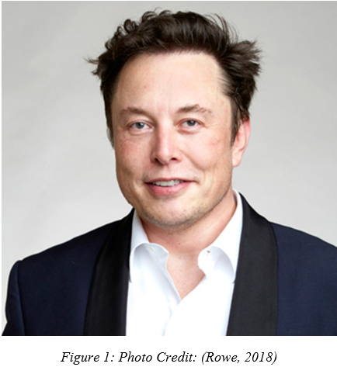
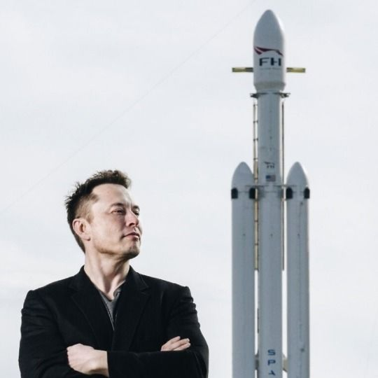
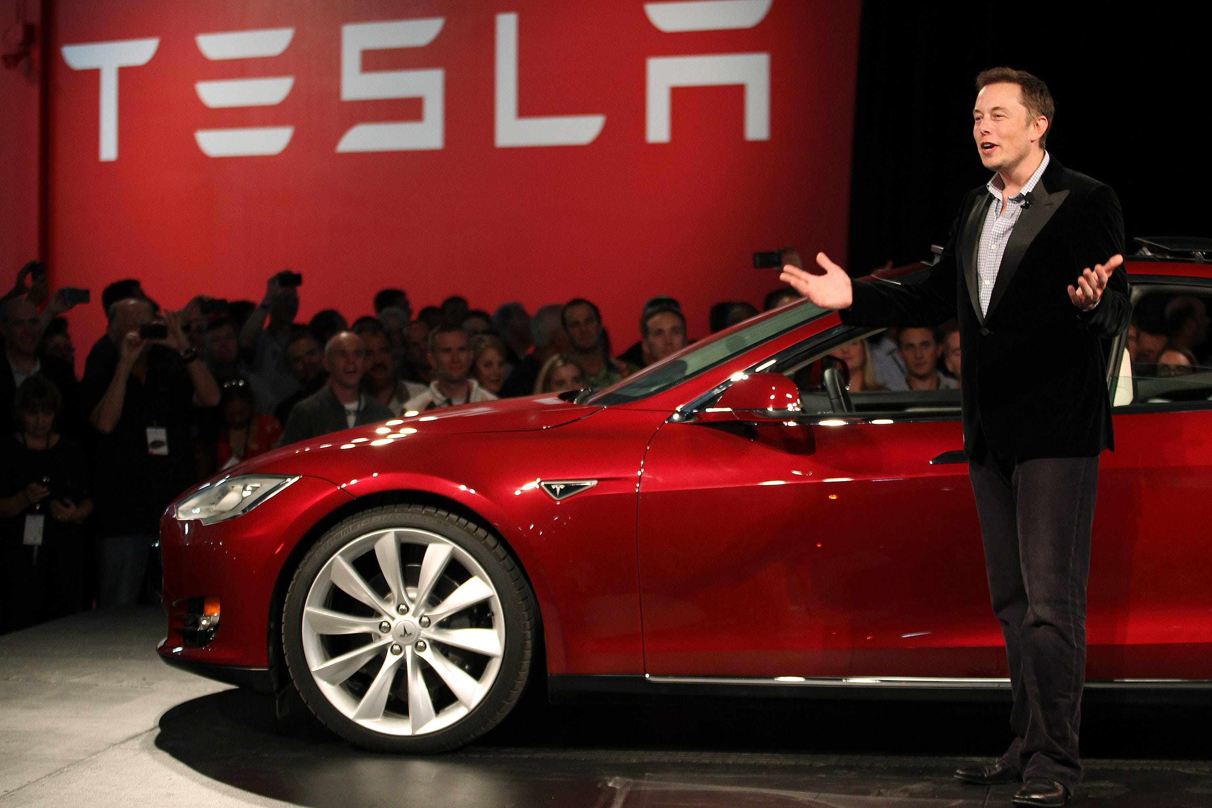
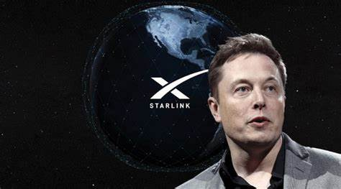
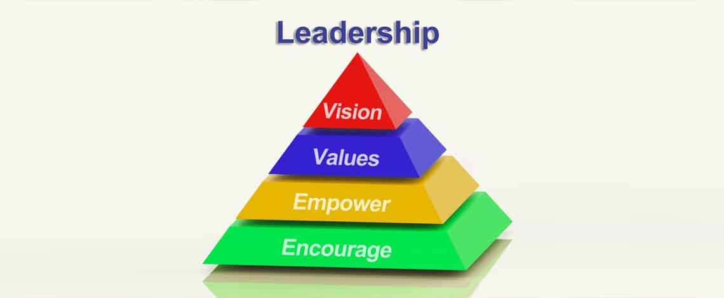
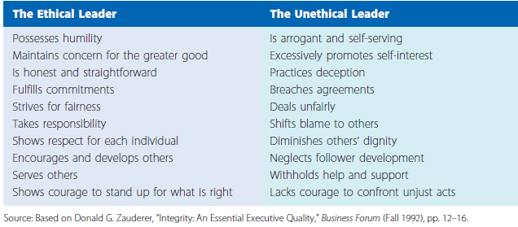
“Visionary and Innovative” – Elon Musk
Naqash Ali
Florida State University - Panama City
Abstract
SpaceX
CEO and chief engineer
Musk's leadership has disrupted the space industry by creating reusable rockets and making space travel more accessible, with plans to send humans to Mars.
Tesla
CEO and Product Architect
Musk's leadership has transformed the automotive industry by pushing the limits of electric vehicle technology and renewable energy, making the future of sustainable transportation a reality.
StarLink
CEO of Starlink
Musk's leadership has broken new ground in internet connectivity by developing a revolutionary satellite-based network that will provide high-speed internet access to the entire planet, even in the most remote areas.
This paper explores the leadership style, traits, behaviors, and qualities of Elon Musk, a prominent entrepreneur and visionary in the technology industry. Through analysis of Musk's experiences and accomplishments, the paper aims to provide insights into how his leadership style has impacted his success and how it can be emulated by future systems engineering professionals. The paper serves as a guide for those seeking to incorporate Musk's leadership principles into their own careers, striving to become successful leaders in their respective fields.
Major Contributions
The Visionary Family & Ethical Climate
Traits & Behaviors
Visionary Family:
In the context of Todd Henry's "Visionary family," Musk's leadership style can be seen as aligned with the key characteristics of individuals who are motivated by a clear and inspiring vision (Henry, T. 2009)
Elon Musk is widely recognized as a visionary and innovative leader, known for his bold and ambitious ideas and projects. He has been described as a "crazy visionary" who possesses a unique combination of technical expertise, business acumen, and creativity (Kimbal et al., 2015)
Ethical Climate:
The single most important factor in ethical decision-making in organizations is whether leaders show a commitment to ethics in their talk and especially their behavior. Employees learn about the values that are important in the organization by watching leaders (Daft, R.L. 2015).
Accountability: Elon Musk holds himself and his team members accountable for their actions, which creates a sense of responsibility and ownership among his employees. Musk has created and has maintained a personal brand of honesty and transparency (Vance, 2015).
Traits:
Traits are the distinguishing personal characteristics of a leader, such as intelligence, honesty, self-confidence, and appearance (Daft, R.L. 2015).
Some of the traits that have been associated with Musk's leadership style include (N. Padgett, 2015):
Risk-taking: He is not afraid to take risks and to pursue bold and ambitious projects, even if they are considered unconventional.
Innovation: He is known for his ability to come up with new and innovative ideas and ways of doing things.
Resilience: He has shown a remarkable ability to bounce back from setbacks and to keep pushing forward.
Determination: He is very determined and persistent in pursuing his goals, and he doesn't give up easily.
In her biography of Elon Musk Vance. (2015) recounts, “Musk said that he didn’t just want to build the best electric car in the world; he wants to build the best car, period.” (Vance, 2015) Tesla aims to disrupt the auto industry and is considered a potential success in an industry that hasn't seen a successful American car company since Chrysler in 1925.
Behaviors:
Many researchers have examined the behavior of leaders to determine what behavioral features comprise leadership style and how particular behaviors relate to effective leadership (Daft, R.L. 2015).
In terms of behaviors, Musk is known for being an intense and demanding leader. He has high expectations for himself and his employees, and he is known for being hands-on and for being involved in the day-to-day operations of his companies. He's also known for being a hard worker and for putting in long hours.
Some common behaviors associated with his leadership include:
Decisiveness: Musk is known for making quick decisions, often in high-pressure situations, which has allowed his companies to move fast and stay ahead of competitors.
High standards: Musk sets high standards and pushes his teams to meet them, leading to continuous innovation and improvement.
Work ethic: Musk is known for his tireless work ethic, often working 100-hour weeks, which sets an example for his teams and contributes to the success of his companies.
Direct communication: Musk is known for being transparent and direct in his communication, which can sometimes create controversy but also ensures clear expectations and accountability.
Unwavering Optimist: While Musk’s ability to fail may not separate him from his competitors, he differentiates himself with his ability to remain optimistic and wholeheartedly convinced that he will succeed. After the lengthy development of a new model of his all-electric Tesla car, the vehicle burst into flames during a test run. On Tesla’s blog, Musk gave his rebuttal to the public, “For consumers concerned about fire risk, there should be absolutely zero doubt that it is safer to power a car with a battery than a large tank of highly flammable liquid.” (Bonnell, 2016)
Key Takeaways
Leadership from the Front: Elon Musk inspires his employees because, although he has high expectations for them, he demands even more from himself. Leaders must be committed to doing the work necessary for the company’s success before they will be able to get others to commit (Yauney, 2018)
Ambitious: Musk's approach to enabling a challenge culture is multifaceted. First, he sets audacious goals for his companies that are meant to push the boundaries of what is possible. For example, he set a goal for Tesla to produce 500,000 electric vehicles per year by 2018 (Khan, 2021), which was seen as highly ambitious at the time.
“Earth is the cradle of humanity, but you cannot stay in the cradle forever. It is time to go forth, be out there among the stars, and expand the scope of human consciousness.” (Musk)
Hands-on: Musk is known for being highly involved in the day-to-day operations of his companies and expects the same level of dedication from his employees. He leads by example, working long hours and taking calculated risks to push his companies forward. This level of involvement and dedication is infectious and encourages employees to also go above and beyond to achieve their goals.
Open Communication: Musk engages with his workforce in open dialogue and encourages them to ask any question they may have (Zipkin, 2017).
References
Daft, R. (2011). The Leadership Experience, Sixth Edition.
Daft, R. (2011). The Leadership Experience, Sixth Edition
Bonnell, S. (2016, August 10). Every Entrepreneur Can Learn From These 5 Leadership Traits of Elon Musk. Entrepreneur. https://www.entrepreneur.com/leadership/every-entrepreneur-can-learn-from-these-5-leadership-traits/279971
Kimbal, R., Criterion, publisher of T. N., president, Culture, publisher of E. B. H. most recent book is T. F. of P., & Amnesia, A. in an A. of. (2015, December 23). Crazy Like a Visionary. City Journal. https://www.city-journal.org/html/crazy-visionary-9883.html
Vance, A. (2015). Elon Musk: Tesla, SpaceX, and the quest for a fantastic future (First edition.). Ecco, an imprint of HarperCollinsPublishers.
N. Padgett, L. (2015, March 26). Elon Musk: Transformational Leadership in Action. https://sites.psu.edu/leadership/2015/03/26/elon-musk-transformational-leadership-in-action/
Yauney, R. (2018, September 14). Leadership Development: A Study of Elon Musk – The Marriott Student Review. https://marriottstudentreview.org/vol-2-issue-2/leadership-development-a-study-of-elon-musk/
Henry, T., (2009). The Motivation Code, Discover the Hidden Forces That Drive Your Best Work. Portfolio Penguin, ISBN 9780593418826
.

